Slide 1
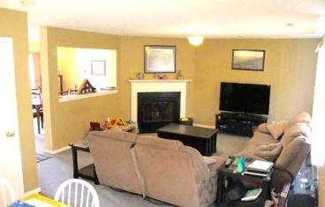
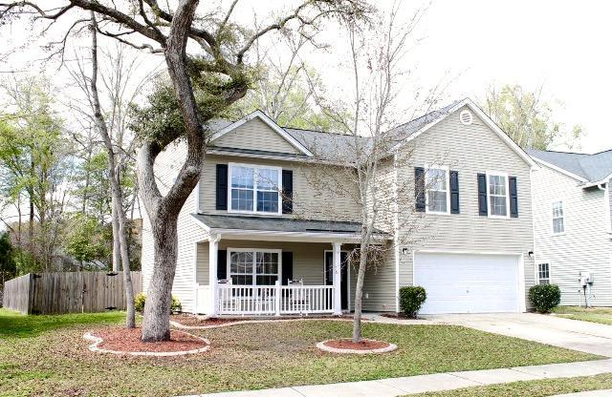
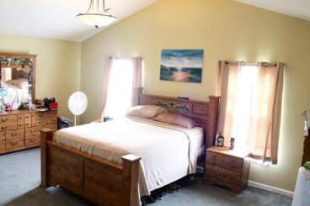
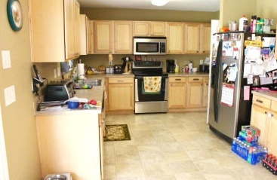
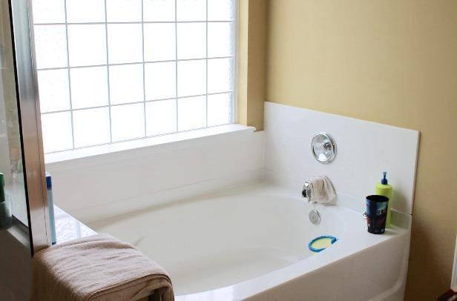
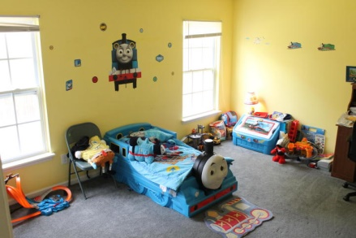
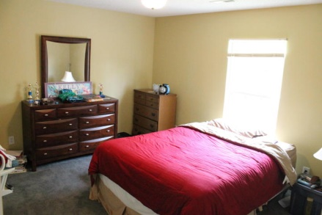
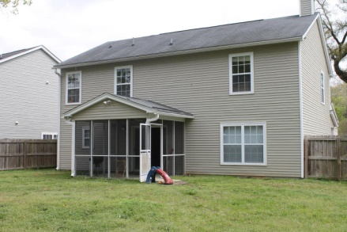
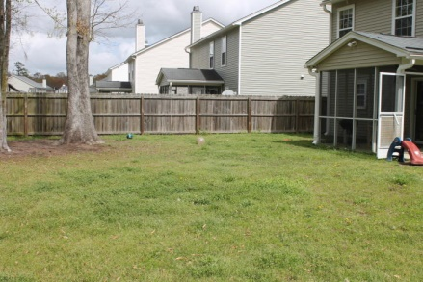
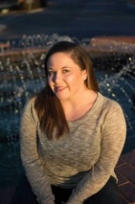

$1000 Buyers Agent Bonus Bring us a Ratified Contract Before May 15, 2015
5117 Morrow Lane
Wescott Plantation | Summerville | MLS# 15007701 | $214,900
Welcome to Wescott Plantation, in the Dorchester District II school district. The well landscaped yard offers tons of curb appeal. As you drive up, take notice of the oak tree in the front yard.
This 4 bedroom, 2.5 bathroom home offers an open floor plan, with numerous closets throughout to offer ample storage space. This home has a fenced in backyard and a screened in porch. The living room offers a fireplace and carpet throughout.
The Woodlands at Wescott Plantation offers a playground, within walking distance of the house. Stainless steel appliance to convey.
$5,000 Buyer's Agent Bonus at Closing!
Danielle Cook (843) 425-9357 danielle.cook@agentownedrealty.com
Britney McWethy
(843) 345-1892
britney.mcwethy@agentownedrealty.com
AgentOwned Charleston Group | 902 Savannah Hwy | Charleston, SC 29407-7802

