Slide 1

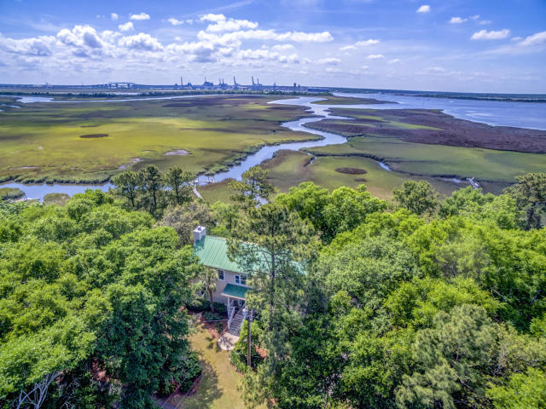
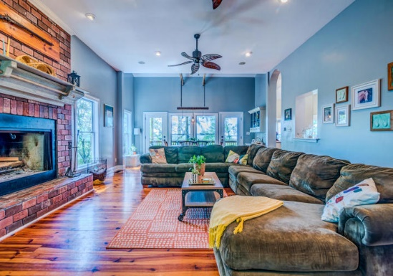
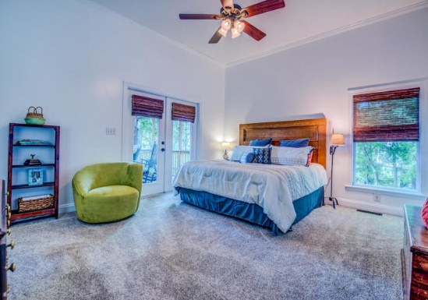
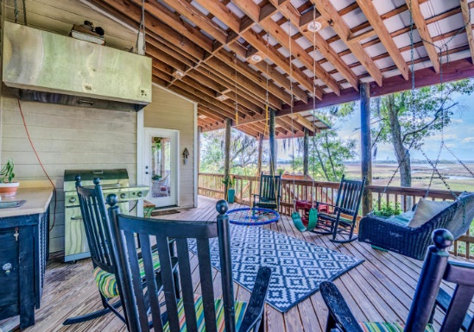



511 Yellow House Place
Yellow House Place | Wando, SC 29492
MLS# 19014896 | $850,000
Cooper River Access with Dock - $850,000
Asking $1,200,000
MLS# 17023051
3,692 SqFt
4 Bed/3½ Baths
Short Drive to Historic Downtown Charleston & Beaches
Views across Cooper River to Naval Weapons Station & Port of North Charleston
High Elevation on .93 Acres in Quiet Neighborhood
Easy Access to 526 Off of Clements Ferry Rd
First Floor Master
4 BR, 2.5 B, 3,020 sf
Energy Efficient
2 Waterfront Porches
Workshop underneath home
Rees Johnston
(843) 696-7278
rees.johnston@carolinaone.com
www.TeamDawsonSC.com
Carolina One Real Estate • 2713 Highway 17 North • Mount Pleasant, SC 29466

