Slide 1
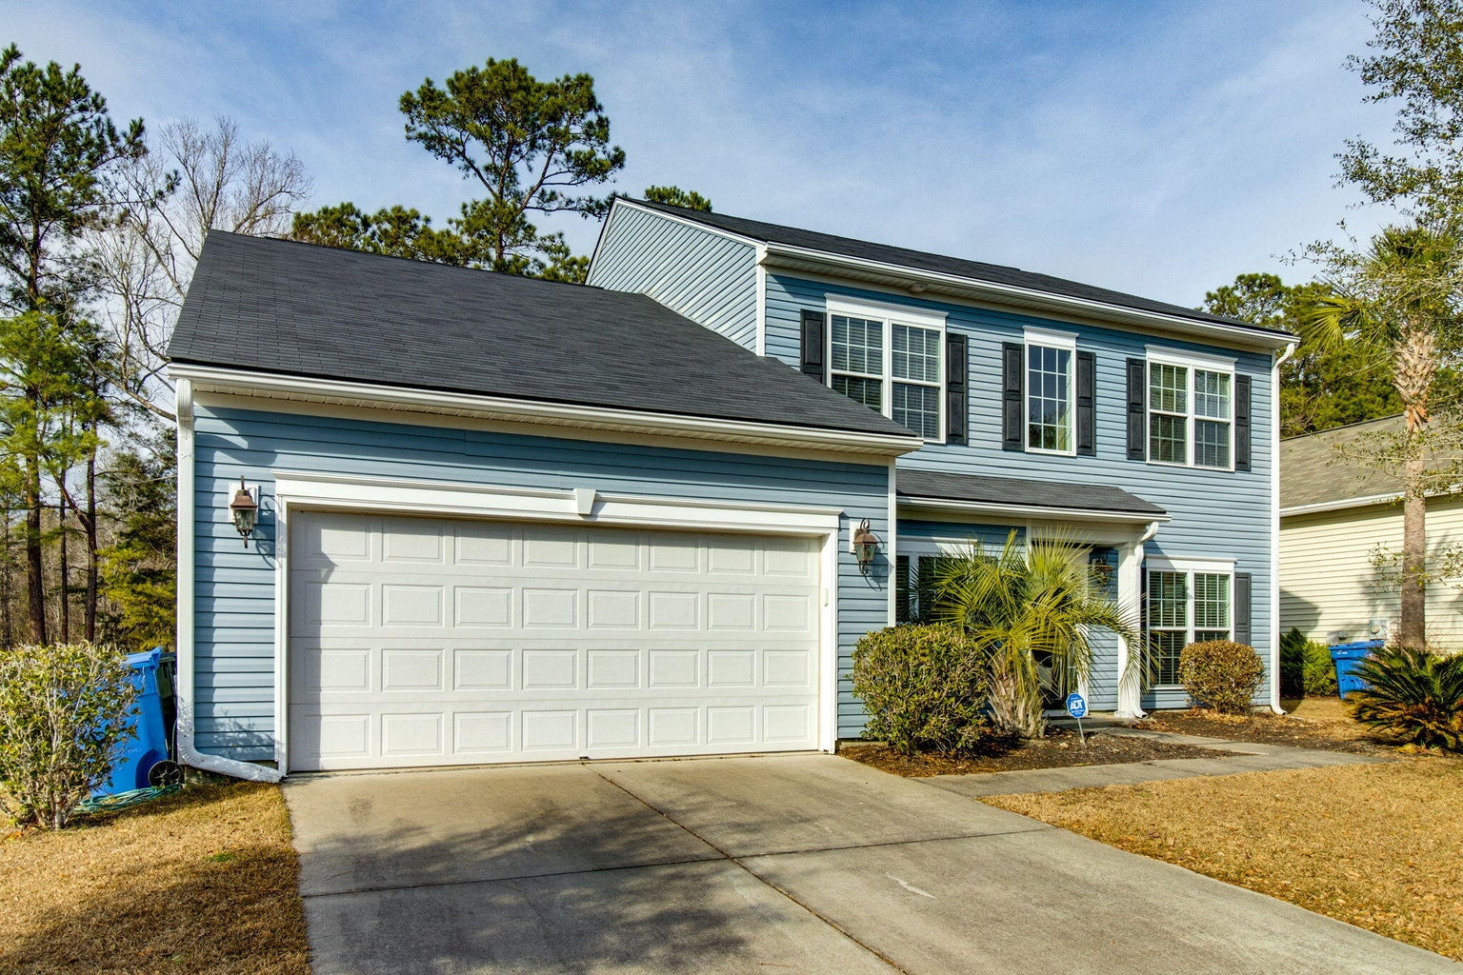
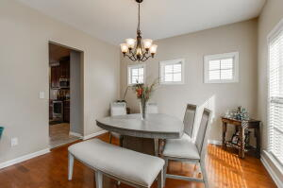
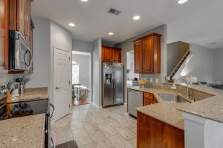
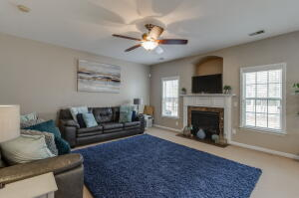
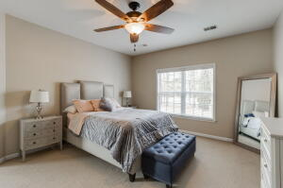
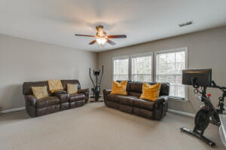
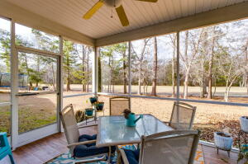
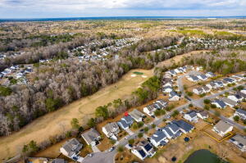


5120 Timicuan Way
Wescott Plantation | Summerville, SC 29485 | MLS# 23005770 | $449,999
NEW HVAC & WATER HEATER
$5000 CLOSING COSTS
Looking for a golf course property? This beautiful home is located in the highly desirable neighborhood of Wescott Plantation. Situated on the 6th fairway with direct views of the golf course and offering an abundance of natural light throughout, this spacious 5 bedroom home has it all! Step inside to a large 2-story foyer with gleaming wood floors with a living room on the left and separate dining room on the right. As you continue in you are greeted by an open great room with a gas fireplace, a well appointed kitchen with loads of 42'' cabinets, plentiful granite counter-top space, SS appliances, a breakfast bar, a walk-in pantry and large eat-in area with access to the screen porch. De-stress in your Owner's Ensuite which is downstairs and offers views of the backyard and golf course. Upstairs are 3 additional bedrooms and a full bathroom plus an enormous bonus room that can serve as a 5th bedroom. Walking distance to a community pool, playground and pond. Not in a flood zone. Great location and close to shopping, restaurants, highly rated DD2 schools, Joint nBase, Bosch, Boeing, airport, interstate, downtown Charleston and area beaches.
Beth Mandell
M 803-463-7734 | O 843-871-2121
bmandell@century21properties.com
www.bestcarolinahomedeals.com
Century 21 Properties Plus of Summerville | 118 W Richardson Ave | Summerville, SC 29483

