Slide 1
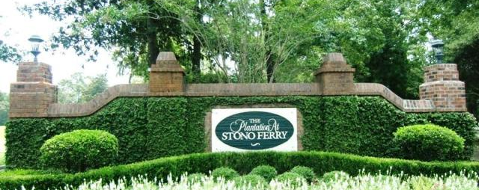
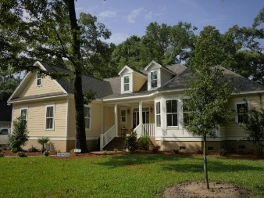

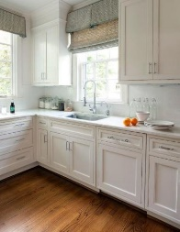
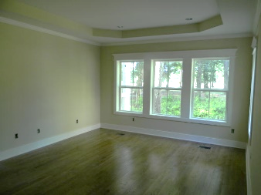
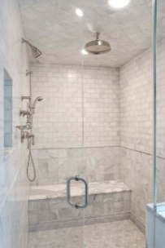
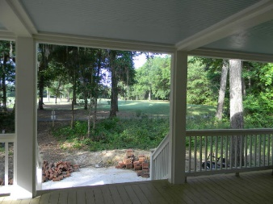
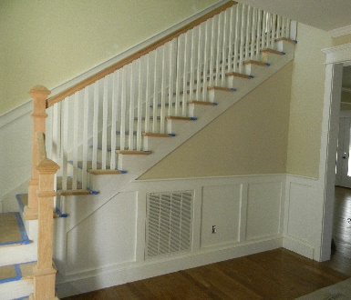
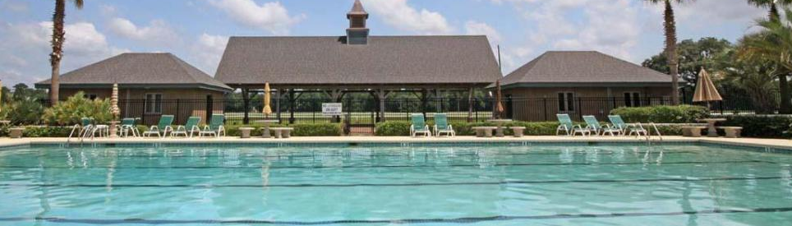
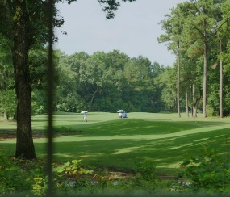


5121 Old Washington Course
MLS# 15003150 ~ $549,900
4 Bedrooms | 3½ Baths | 3,000 Sq Ft
New Construction in Stono Ferry ~ Ready to Move In
Please tour this beautiful 'architect designed'' new home located in Stono Ferry Plantation. This elegant home overlooks the 15th green AND the 16th tee box. Enjoy long range sunset views and the centuries-old live oak from the 330 sf covered veranda. A constant sea breeze cools the veranda. The sun filled study features a 12 ft tray/vaulted ceiling w/views of a natural 1 acre lake. This classic home is exquisitely appointed throughout. The master suite is spacious and features superb views, tray ceiling w crown, a luxurious SPA shower and an oversized WIC. Upgraded 15 SER dual unit energy efficient HVAC systems, Rinnai GAS instant hot water, 2x6'' ext walls, with r-19 insulation & Tech Shield roof sheathing assure energy efficiency. The layout features an open floor plan for today's life style. Upper loft can be enclosed to become the 4th BR. This NEW Home is complete and available to move in as of August 15th.
Michael Elliott
(843) 860-5840
mpelliott2@gmail.com
Ravenel Associates Real Estate
960 Morrison Drive • Suite 100 • Charleston, SC 29403
www.rarecharleston.com

