Slide 1
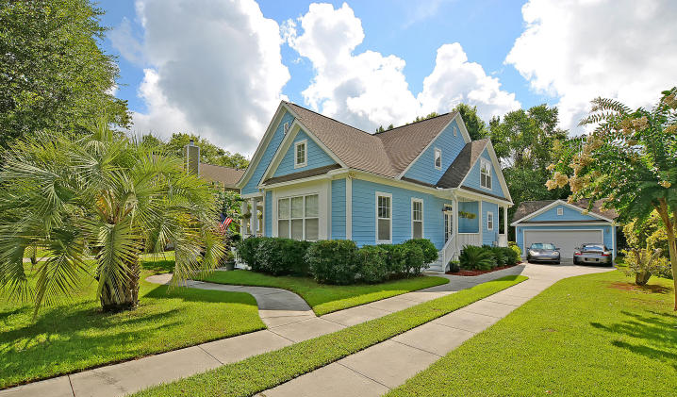

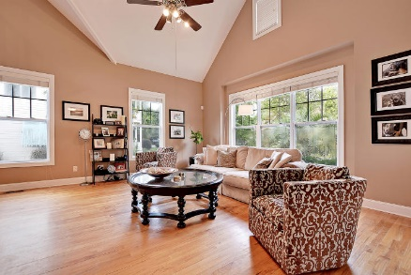
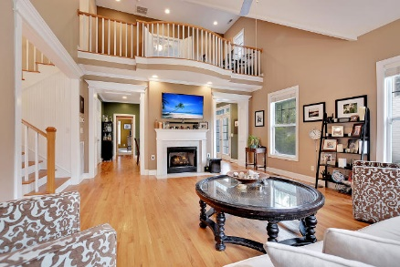
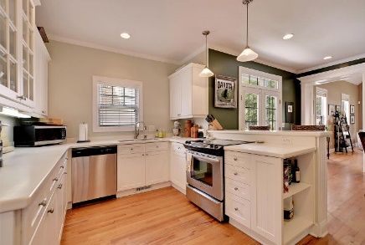
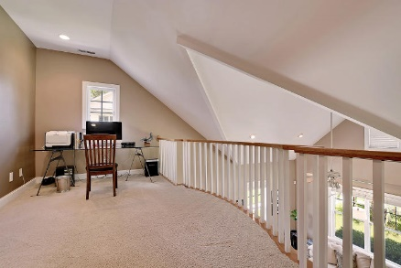
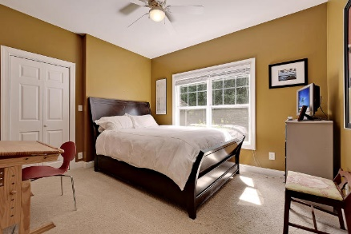
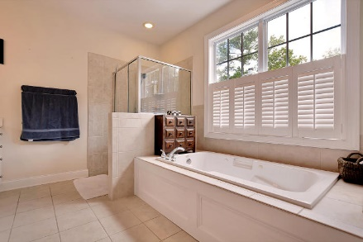
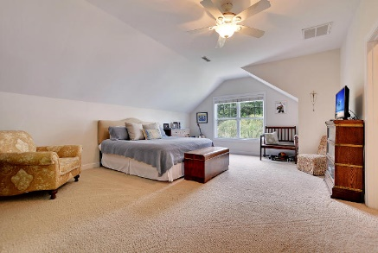
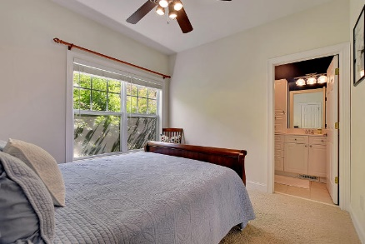
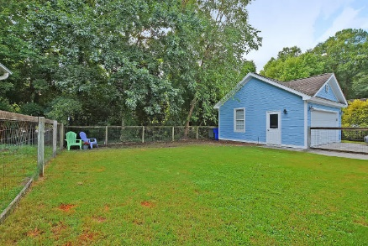
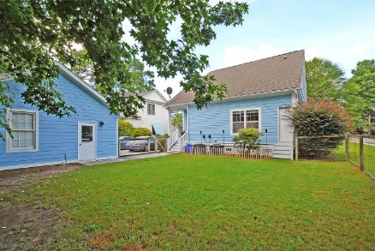

Parkshore Marshfront
Agent Open House Thursday 11-1
5122 Coral Reef Drive
The Villages In St Johns Woods ~ MLS# 16019397 ~ $409,800
5122 Coral Reef Dr offers amenities & convenience for a variety of lifestyles.
Modern floor plan & contemporary finishes make this 3 bedroom/2 bath home welcoming & comfortable. Cathedral ceilings & fireplace grace living room w/hardwood floors. Just beyond is the bright kitchen w/breakfast bar & dining area. 2 bedrooms, full bath & laundry room complete main level.
Airy loft perfect for home office, craft area or reading nook, gives way to master retreat on 2nd story. Master en suite provides large soaking tub, separate shower & ample walk-in closet. Pets & family will appreciate grassy fenced-in backyard, while garage provides space for vehicles & beach toys.
The Villages in St Johns Woods residents enjoy a large pool, party pavilion, sporting fields, walking trails and tennis courts.
Call or email for details: (843) 209-2750 or dancy@mattoneillteam.com

