Slide 1
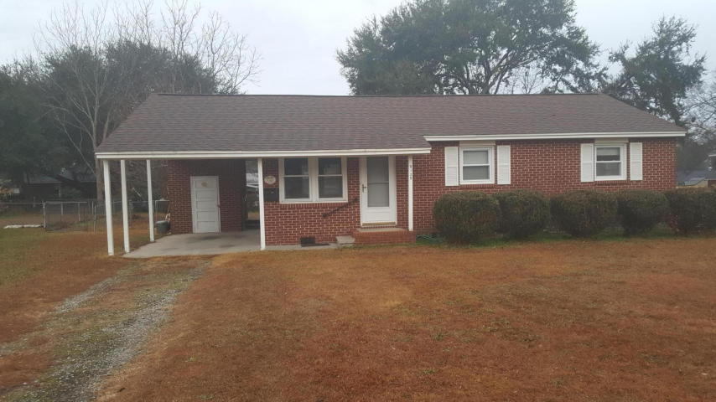
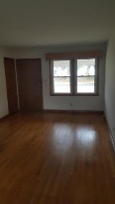
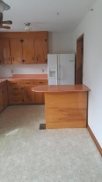
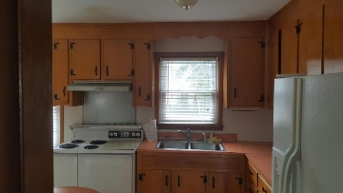
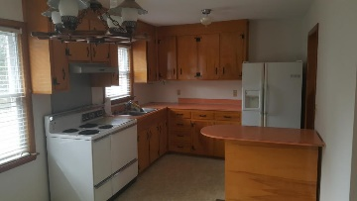
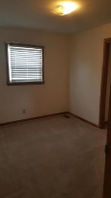
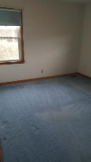


Must See! Beautiful Home and New Listing!!
Just Reduced $10,000!
Offering $1,000 Agent Bonus
5125 W Dolphin Street Cameron Terrace ~ North Charleston ~ MLS# 18003066 ~ $199,000
This adorable 3 bedroom, 1 bathroom Brick Ranch home located in the heart of W Cameron Terrace subdivision across from Park Circle subdivision will sell quickly. Home has an attached carport with lots of space for parking, a large fenced backyard, and looks great from the street! The wood flooring in the family room and hallway looks great! Seller including America Preferred home warranty!
Cornelius Shepherd
(843) 530-6798 | cornelius@ergroupofsc.com
The Elite Realty Group of SC, LLC · 8310-A Rivers Ave · North Charleston, SC 29406

