Slide 1
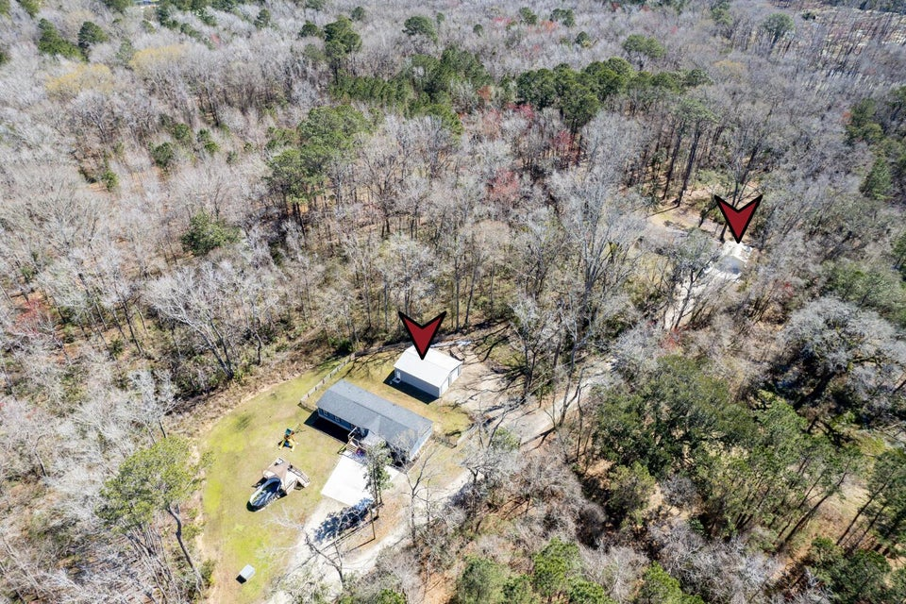

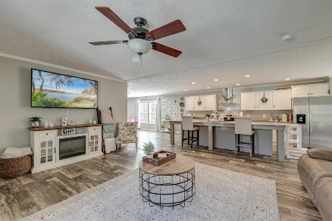
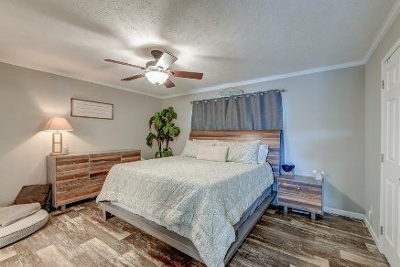
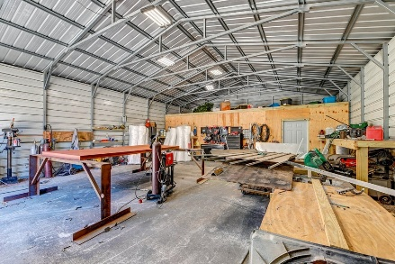
Rare & Unique Opportunity
OPEN HOUSE
SATURDAY 12-3
Open House Saturday 12-3
5126 Chapel Road
Hollywood, SC 29449 | MLS# 25006787 | $969,000
4.5 Acres with TWO Like-New Homes!
Whether you're looking for a multi-generational living setup, a potential income-producing rental option, or the perfect spot to potentially build your dream home while living on-site, this property offers unmatched flexibility. The first home (over 2100 sq ft), at the front of the property, welcomes you as you drive in. A little further down the drive, you'll find the second home (over 1900 sq ft). There is plenty of space between them for privacy! Both homes are like new, have brick foundations, and have many upgrades.
Additional features include No HOA, a huge double-bay workshop ideal for storage or hobbies, a large two-car garage with a 300 sq ft office space with a private entry on the second home, an above-ground pool, and plenty of room for expansion.
Finding two homes on one property with this much acreage is incredibly rare...don't miss out on this unique opportunity!
Sale includes TMS#164-00-00-239 and MH0-00-57-532.
*All rental and building options and availability must be approved by all governing bodies including, town, county, etc.
Book your showing today!
Amanda Kennedy-Colie akcolie@mattoneillteam.com 843-224-5865

