Slide 1
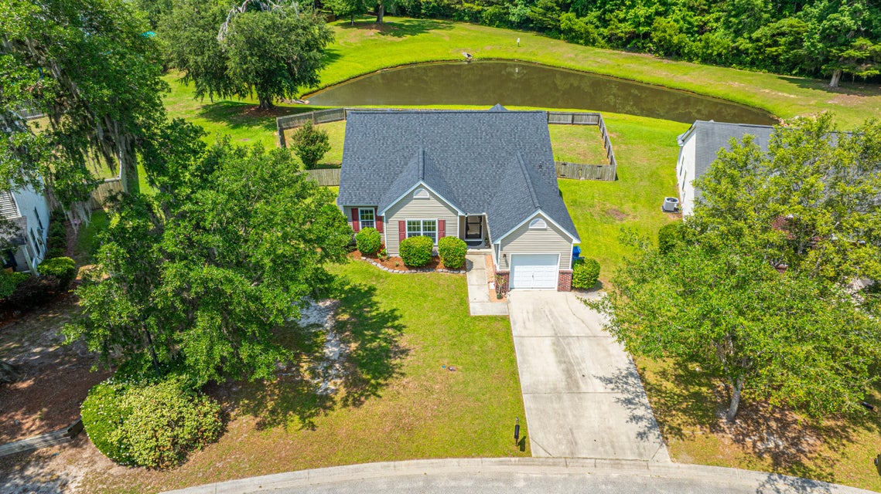
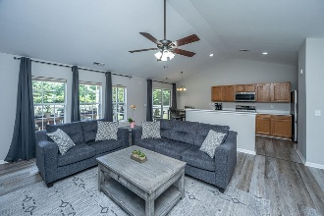
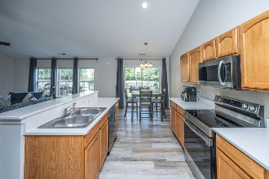
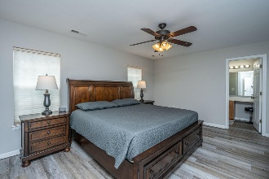
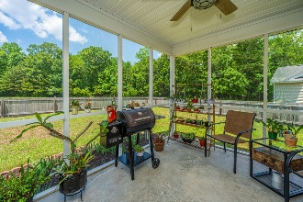
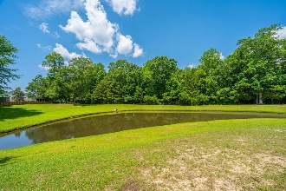

5128 Thornton Drive
Wescott Plantation · Summerville, SC 29485 · MLS# 25014625 · $359,990
Fantastic Price and Fantastic Lot
2.5% Buyer Agent Co-op Being Offered
Updated Roof & H2O tank | LVP Flooring throughout | Refrigerator, Washer & Dryer convey | Turnkey Home
Welcome to 5128 Thornton Drive conveniently located in the Wescott Plantation neighborhood. This turn-key home is sitting on a premier .20/Acre Pond lot that is surrounded by HOA greenspace. Beyond the Pond are an abundance of trees and to the left of the home is an HOA easement giving you more space between you and your next-door neighbor! Upon entering 5128 Thornton, you will notice the LVP Flooring that runs throughout the home (no carpet). You are greeted to a large proper foyer with the dining room to the right. Proceed to the back of the home and you will love the open concept family room and kitchen complete with an abundance of natural light and a vaulted ceiling. The kitchen has been upgraded with Corian Countertops and Newer appliances (installed in 2022) all of which convey (including the refrigerator, washer and dryer). To the left of the home there are 3 bedrooms. The primary bedroom is a generous size complete with a walk-in closet and an ensuite featuring Garden Tub/Shower Combination. The two secondary bedrooms are towards the front of the home and the guest full bathroom has a 5ft walk-in shower. Proceed out back to the screened porch where you can watch nature at its best and enjoy the beautiful sunsets. The baby ducklings swim in the pond, the deer come out to feed and the hawks and owls roam the skies. A few extras to mention: Roof was replaced in 2021, the LVP flooring installed in 2022, H2O Tank replaced in 2022, and the removal of the popcorn ceiling was done in 2022. The convenience to local restaurants, shops, gyms, grocery stores are minutes away. The Charleston International Airport is 10 miles, Charleston Air Force Base is 8 miles, Bosch Plant is 5.5 miles, Mercedes-Benz Vans Plant is approximately 4 miles, and the Summerville Medical Center is about 3 miles away. Come check it out! I don't think you will be disappointed.
Nickole Samios
(843) 330-4136
nickole@carolinaone.com
Carolina One Real Estate
900 N Main St
Summerville, SC 29483
www.summervillesouthcarolinahomes.com

