Slide 1
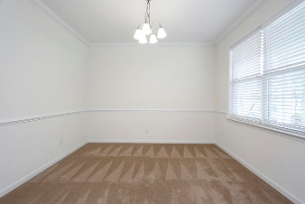
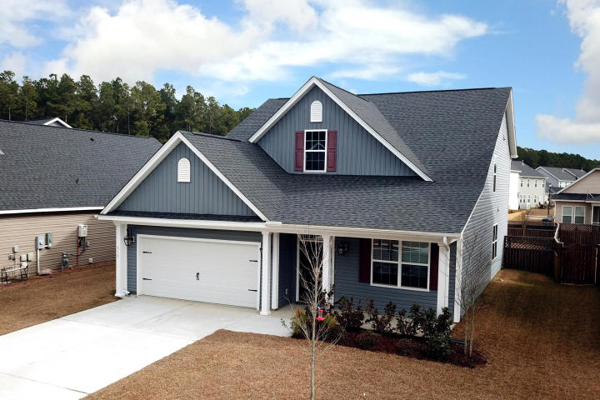
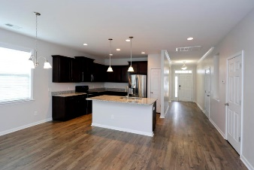
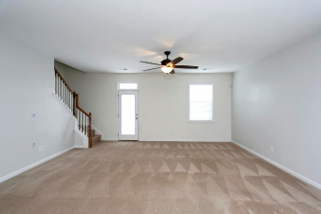
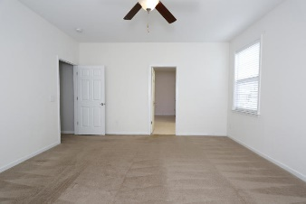
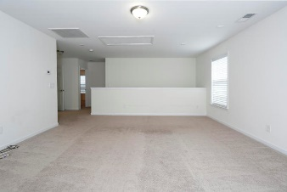
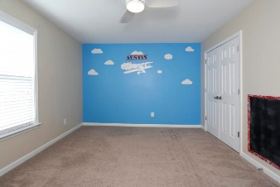
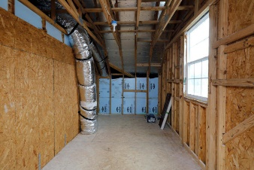
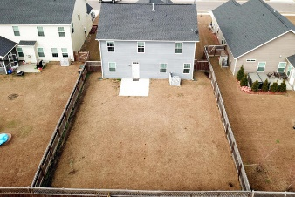


512 Foxbank Plantation Boulevard
Foxbank Plantation ~ Moncks Corner, SC 29461
MLS# 17032604 ~ $249,900
OPEN HOUSE SUNDAY 2/18 1:00-4:00
HUGE PRICE REDUCTION + $1,000 TOWARD THE BUYER'S CLOSING COSTS WITH A RATIFIED CONTRACT BY 2/19/18
BRING YOUR BUYERS AND BRING YOUR OFFERS!!!
Open floor plan with TONS of space to entertain! Large welcoming foyer leads to the front room which can be used as a formal dining room, den or office. The kitchen is spacious and features upgrades including upgraded cabinetry, granite countertops and stainless steel appliances. The Kitchen is open to the additional dining space and large living room! Enjoy a good night's rest in the Master Suite which includes a large walk-in closet and a spacious master bathroom! Upstairs you will find an additional living space great for a playroom, game room, etc. There are 3 additional spacious bedrooms and the second bathroom on the second floor. There is an additional storage space that opens from the front right bedroom. This space is HUGE...10 x 21 (210 sq ft)....this can be finished to add an additional office, playroom, reading nook, etc. The possibilities are endless!!! Hurry to view this beautiful home!!!
Brittany Soldano, REALTOR
Cell - 843-324-0183
bsoldano1217@gmail.com
Beresford Appraisals, LLC of Wando
295 Seven Farms Dr, Ste C-114 | Wando, SC 29492

