Slide 1
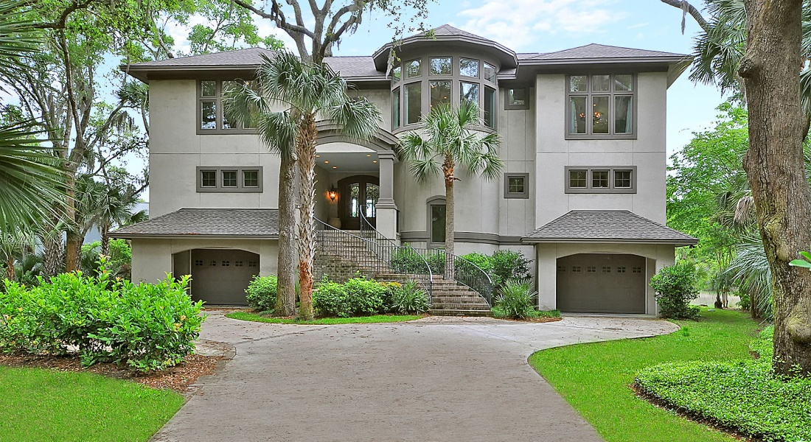
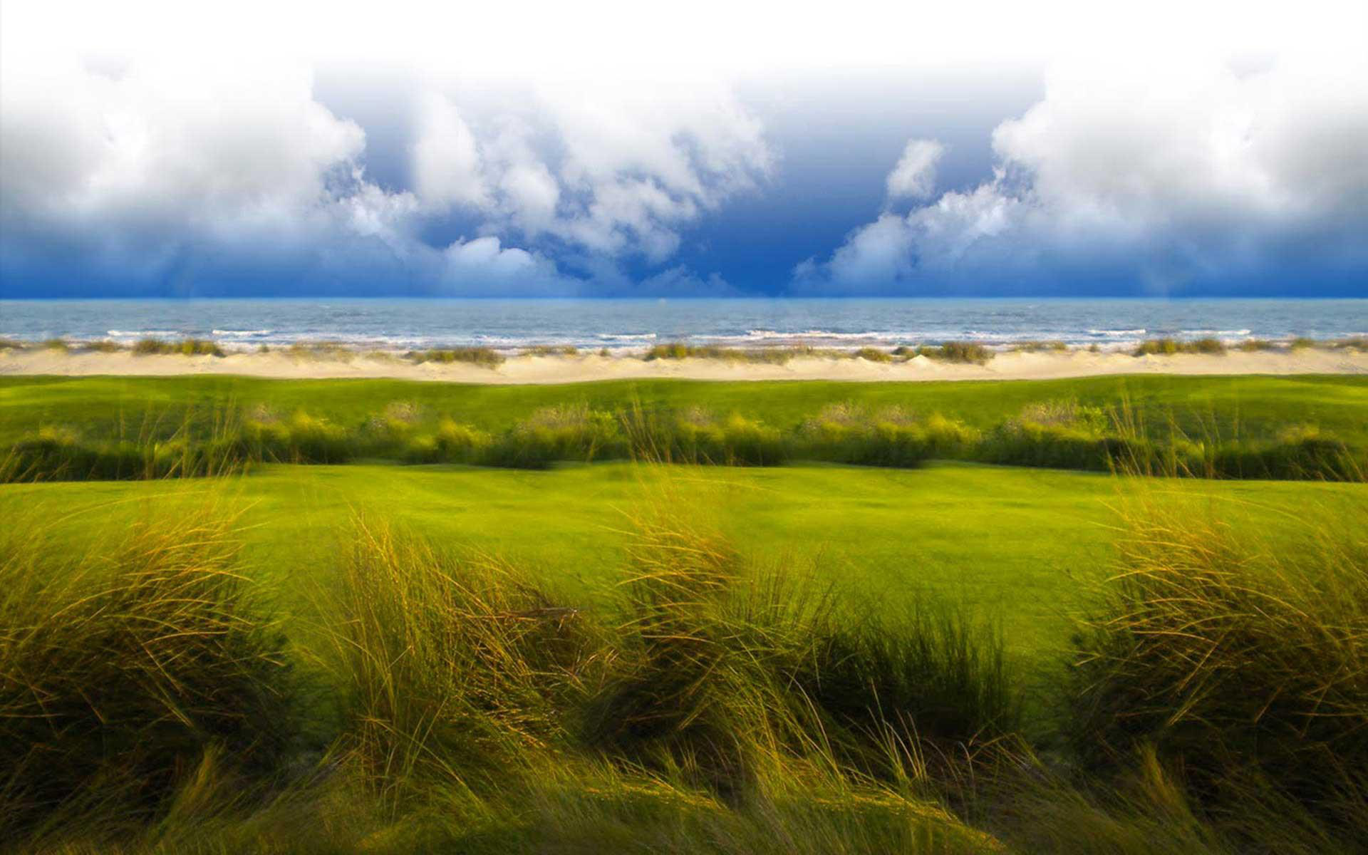
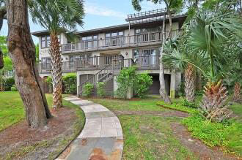
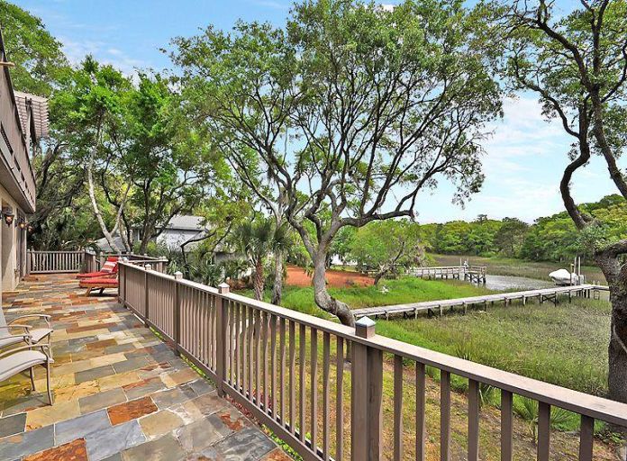
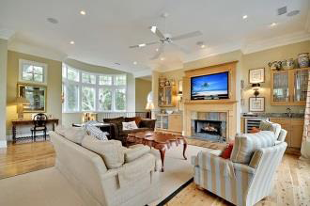

512 Ruddy Turnstone
Kiawah Island, SC
MLS# 1410986 ~ $2,145,000
Come enjoy the beauty of Kiawah's natural marsh! This uniquely built 5 bedroom, 5.5 bath home has a private dock that is perfect for panoramic views of the Kiawah River. Located in the heart of East Beach, the Night Heron Park and beach are just a short bike ride away. As you walk up the front steps, the first thing you notice is the indoor/outdoor breezeway that flows through the house and focuses on the gorgeous marsh views in back. The first floor houses four of the five bedrooms that the home offers. All bedrooms on the first floor have marsh views and access the large rear porch with the exception of one. The second floor is a huge common area with a dining room, gourmet kitchen, and sweeping marsh view out oversized windows. It is on the second floor that you will find the master suite with built in library, California Closet, large upscale bath with Jacuzzi tub and tile inlay walk-in shower, and access to a balcony that overlooks Kiawah's pristine ecosystem. Features include full steel beams built into home and is hurricane rated, Australian Cypress hardwood throughout entire second floor, curved marble staircase, elevator (from garage to second level), theatre room with stadium seating, approx 1000 Sq. Ft. of outdoor living space, private dock with electricity and boat lift, yard is a Certified Wildlife Habitat, outdoor shower, 4 car garage with plenty of locked storage for kayaks, etc. House is currently on a rental program and generating an attractive revenue stream. Home comes mostly furnished.
Listed Exclusively by
Drew Royle
843-901-5996 Cell
drew@sweetgrassps.com
Sweetgrass Properties, 130 Gardeners Cir, Kiawah Island, SC 29455

