Slide 1
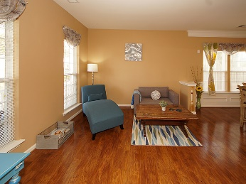
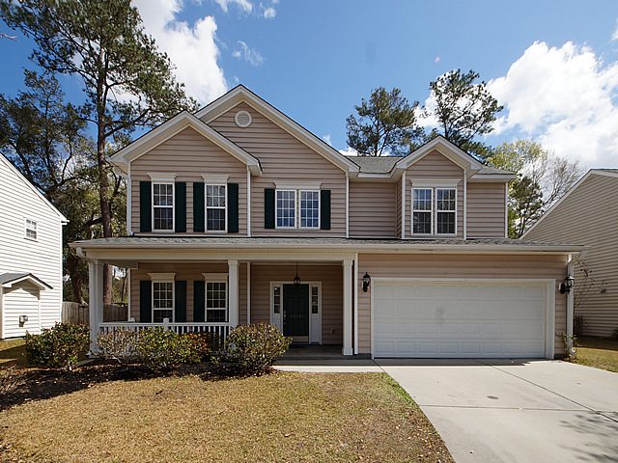
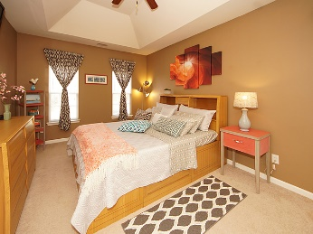
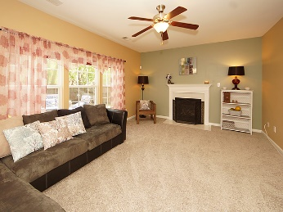
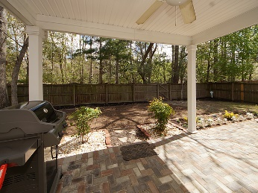
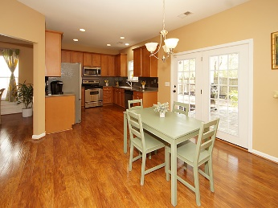
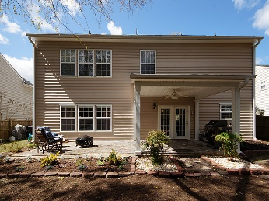
Price Just Dropped! Open House Saturday 4/8 11:30-2pm
5140 Birdie Lane
Wescott Plantation ~ Summerville, SC 29485
MLS# 17008509 ~ $269,500
Beautifully updated home with many designer touches! Great location, close to the front of Wescott. You will love the crown molding and soft colors through the freshly painted home. The kitchen features Corian counter tops & stainless appliances & a new stainless backsplash plus the refrigerator which is less that 1 year old. Through the French doors you will love the large covered patio and shady yard. Upstairs you will find 9' smooth ceilings, a lovely master with a tray ceiling and a large master bath with designer touches. There are 3 other bedrooms, one with a walk in closet that makes a nice guest room and another over sized bedroom. The sellers have updated all the bathrooms and replaced the carpet in the family room. Schedule this one you will be impressed!
Mike Goldston, Realtor
mikesellscharleston@gmail.com | 843-343-7026 | www.cometocharlestonsc.com
Brand Name Real Estate | 4 Carriage Lane, Suite 106 | Charleston, SC 29407

