Slide 1
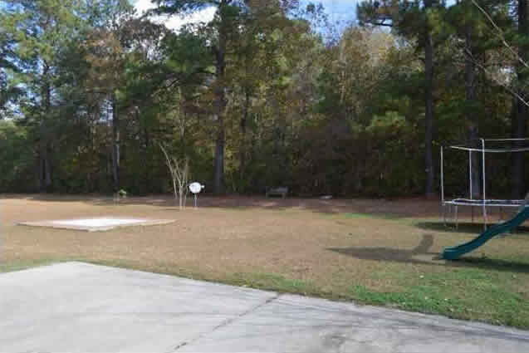
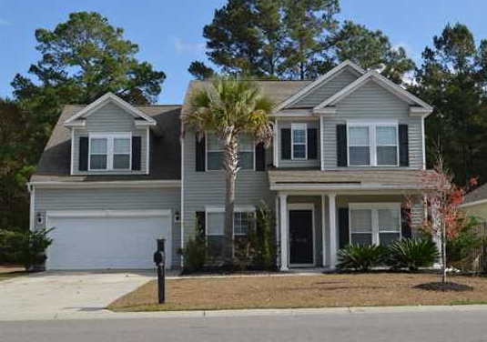
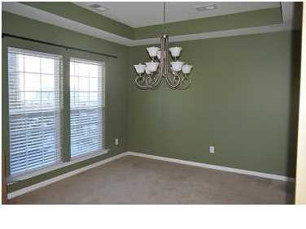
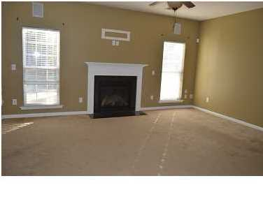
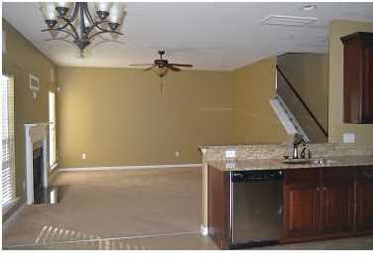
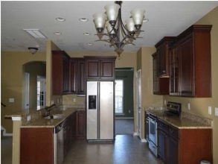
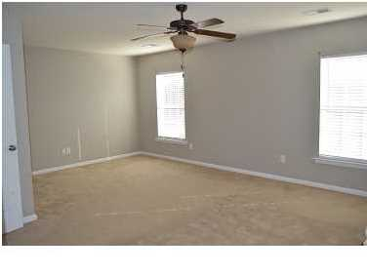
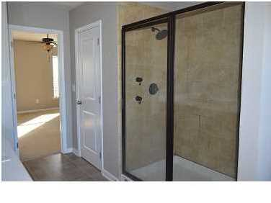
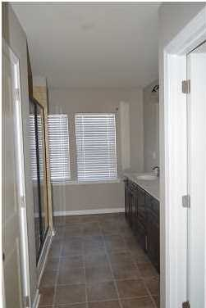
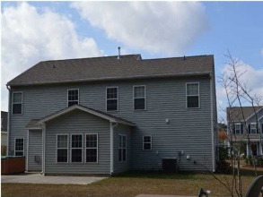
Approved Short Sale Price!
5148 Blair Rd
Myers Mill
Summerville, SC
MLS# 1418481
$227,000
Can close quickly!! Beautiful 4 bedroom / 2.5 bath home in desired Myers Mill. Foyer has Hardwood Oak floors. Step in and see your formal living area or a great office to the right and the formal dining area to the left. As you continue down the foyer, you enter the family room, kitchen, and enclosed sun room. The family room is wired with surround sound for greater movie enjoyment. The kitchen is loaded with upgrades which includes 42" Oak cabinets. The kitchen flows into the enclosed sunroom for more room. Upstairs we have 4 bedrooms and a loft for extended flexibility. The master bedroom and bathroom are exquisite, with dual shower heads in a walk-in tiled shower. Plus, the master bedroom has an endless supply of closets and storage space. Energy efficient, fully landscaped and ready for you to move in! Property backs up to woods. This beauty is not going to last long. The community also offers walking trails, and a pool and clubhouse!
David Hickman | 843.505.0456 | davidisyouragent@gmail.com | www.omnicarolinarealestate.com
Omni Carolina Real Estate | 126 Eston Dr | Goose Creek, SC 29445

