Slide 1
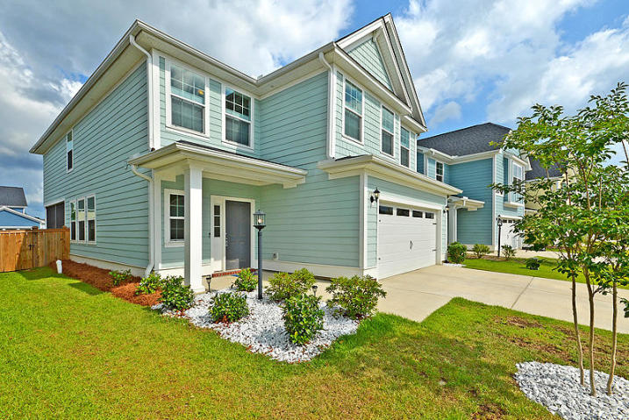
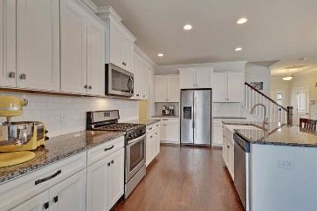
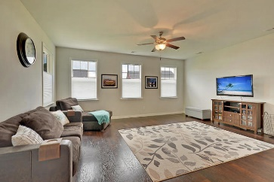
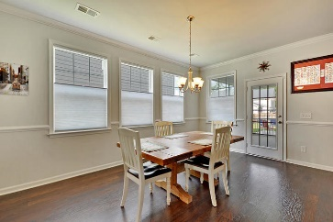
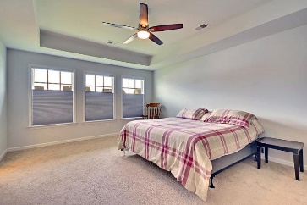
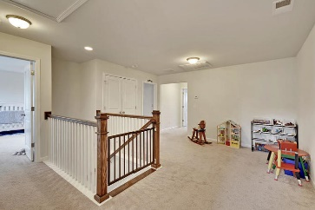
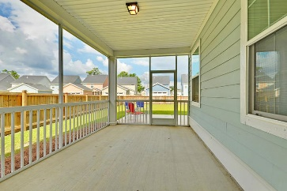
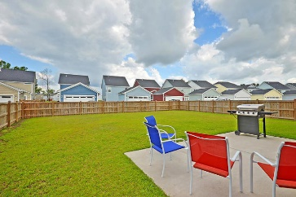
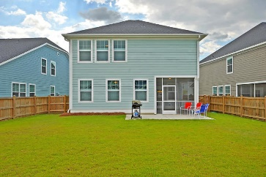

514 Alderly Drive
Moncks Corner, SC 29461 · MLS# 19014606 · $300,000
New Listing in Foxbank Plantation
New Listing in Nexton
Beautiful 4 bedroom, 3.5 bath home in desirable Foxbank Plantation with AWESOME CURB APPEAL including wonderful landscaping and welcoming front porch. Entering the home you are greeted with stunning laminate floors, wood stair treads, custom blinds throughout, open floor plan, and an abundance of natural light. The chef inspired gourmet kitchen has a HUGE GRANITE ISLAND, with farm house sink, white cabinets, gas range, stainless steel appliances, and OVERSIZED PANTRY. The kitchen has a large eat-in area with a wall of windows. The family room is open to the kitchen and is spacious enough to hold a massive sectional couch. Finishing off the first floor there is a fantastic mud room area directly off the garage and powder room in the front of the house. On the second floor landing there is a loft perfect for a living area, play room, workout room, or media room. The master bedroom suite is big and bright and has a spa-like ensuite bath with 5' tiled frameless glass shower, dual sinks, and GIGANTIC closet. Bedroom two has a walk-in closet and private bath. Bedrooms 3 and 4 are nicely sized and share a Jack-n-Jill bath. The fenced backyard is suited for entertaining with a screen porch, patio area for grilling and entertaining family and friends. Foxbank Plantation in Moncks Corner is a wonderfully landscaped community with schools, play park, and community pool! The neighborhood is close to local shopping and grocery stores and is a short drive to downtown Charleston with 5-star restaurants, world class shopping and iconic history as well as a short drive to the beaches, the airport, Boeing, Volvo, and Daniel Island. Come take a look because you will not find another home that offers as much as this one. Call today!
Stan Huff
843-670-2835
stan.huff@agentowned.com
Jill Marcacci
843-297-5590
jill@agentowned.com
www.agentownedrealty.com
AgentOwned Realty Co. Preferred Group, Inc. | 824 Johnnie Dodds Blvd | Mt Pleasant, SC 29464

