Slide 1

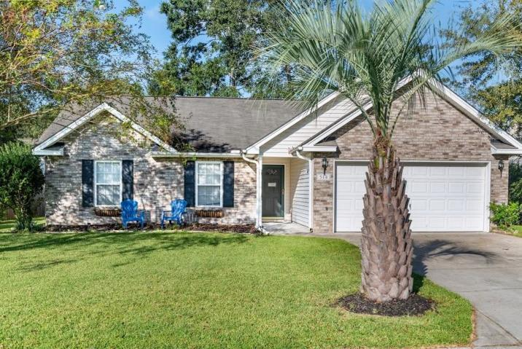
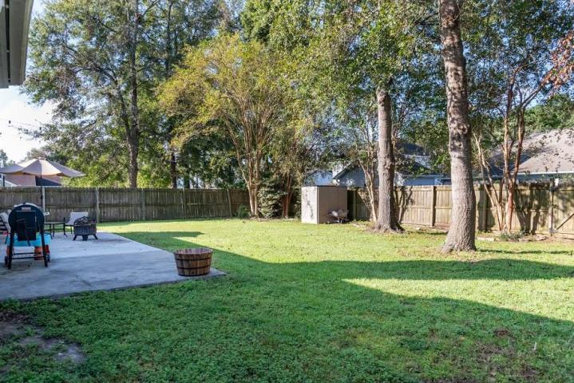
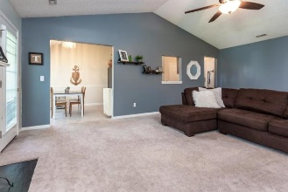
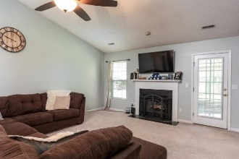
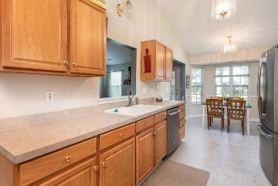
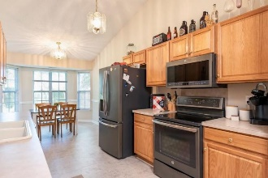
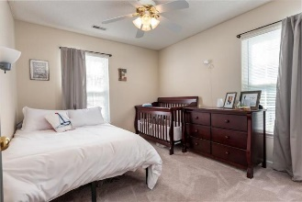
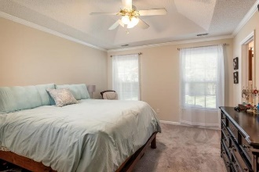
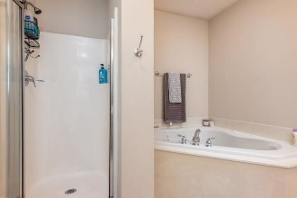
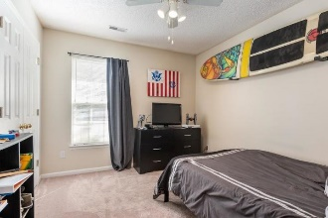
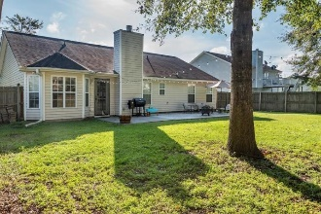
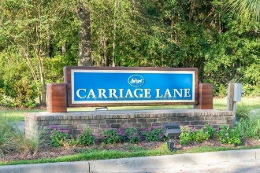

Must See 1-Story Home Conveniently Located In Summerville
Just Minutes To I-26 For Travel To Boeing And Volvo!
514 Rosings Drive
Carriage Lane | Summerville, SC 29483 | MLS# 19026712 | $234,900
Lovely open floor plan with Cathedral ceilings in the freshly painted living room and kitchen. Master bedroom includes tray ceiling, crown molding, his and her sinks, jetted tub and separate shower.
The large fully fenced in back yard is complete with a patio, outdoor fire pit - great for entertaining! Owners have taken excellent care of this home and it shows.
Great schools, miles away from the new Nexton square with great restaurants like Halls Chop House and Taco Boy, shopping and easy access to interstate!
Marthe Teixeira
(917) 325-8033
marthe@agentownedrealty.com
AgentOwned Preferred Group
824 Johnnie Dodds Blvd
Mt Pleasant, SC 29464

