Slide 1
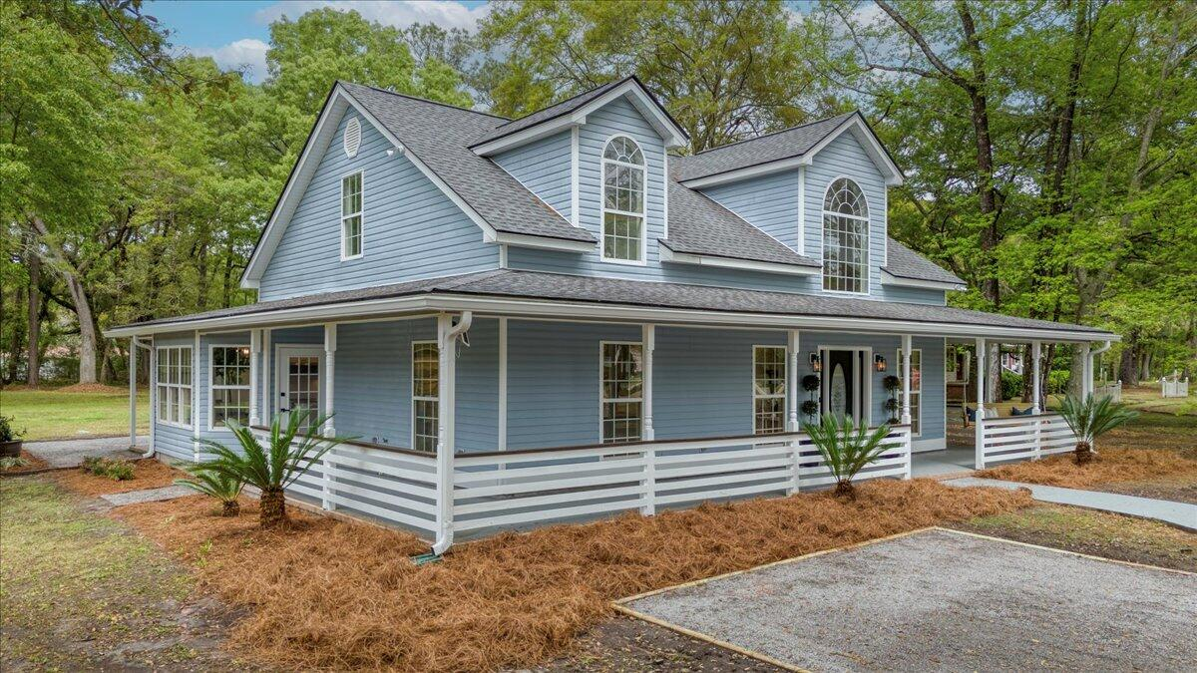
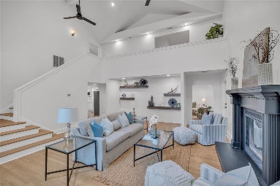
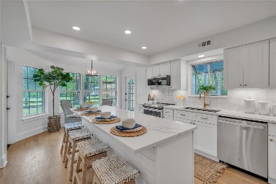
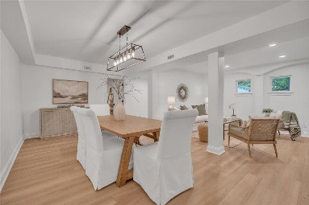
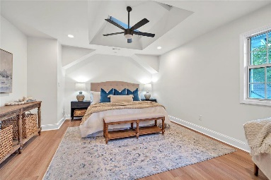
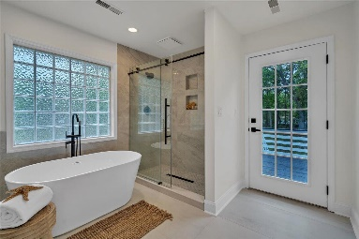
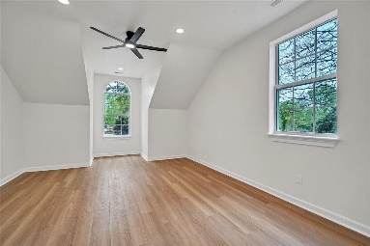
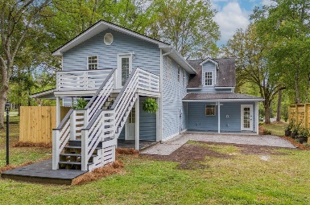


514 Scotch Range Road
Scotch Range · Summerville, SC 29483 · MLS# 24007782 · $799,900
PRICE REDUCTION $799,900
Welcome to your inviting completely renovated turnkey, 6 bedroom and 5 full bathroom home in the heart of Summerville. Drive into your new custom-made driveway on your private 1.2-acre lot dream home with no HOA and park your boat or jet skis with no hassle. Enjoy Summer evenings on your newly partial wrap around porch swing with a tottie. Zoned for District 2 Schools, 3.4 miles to Publix and shopping/restaurants, 6 miles to Historic Summerville, 4 miles to Pinewood Preparatory school and 8 miles to Rollings Middle School of the Arts.
Step into the front door of this freshly painted magnificent home, to find a large open floor living space with high vaulted cathedral style ceilings, new charming chandelier and lots of windows for natural light. Resurfaced stained hardwood flooring, 6 inch base boards, new light fixtures, new fans and new LVP flooring throughout the home. Make yourself cozy around the distinctively painted gas fireplace and place your pictures on your new shiplap centerpiece wall design in your living area.
A chef's dream kitchen awaits you, with brand new fabulous quartz counter tops, brand-new stainless steel GE appliances, new custom cabinetry, a farmhouse sink and breakfast nook area with bay window views of the property. Off the Kitchen and living space is a separate formal dining room with an attached family living space in the back of the first level of the home. Possibilities are endless for short/long term rentals, large families or a mother-in-law suite, as the first level of the home includes 3 bedrooms/office, and 2 Fully enhanced and beautifully renovated bathrooms to include beautiful tile work, all new toilets, light fixtures and new vanities.
Escape upstairs to your primary bedroom Oasis with a generously large walk-in closet. A gorgeously updated Primary Bathroom with all new dual vanity sinks, exquisite tile work to your new walk in glass door shower and a large soaking tub that awaits you at the end of your long day. There are 2 additional spacious bedrooms upstairs with 2 additional fully updated gorgeous bathrooms, with all new vanities, toilets, brand new tile work galore and new light fixtures.
There is a separate entry off of the Primary Bathroom onto your rebuilt back deck that overlooks the lush landscaping of the property and newly repainted patio below. You will also note all new gutters around the home and smell the ambience of confederate Jasmine on your newly built privacy fenced wall. With lots of space for a future separate garage and pool area, a staycation would always be considered right here at home.
The entry to the upstairs primary bedroom hallway has a separate open space area perfect for the kids study area/game room or just a reading nook. Down the hall upstairs from the open space area, is a separate entry door into a very spacious laundry room that includes a sink and separate area for a folding region or storage space. In the laundry room is an all new electric sub panel.
The HVAC and plumbing have been serviced and thoroughly inspected. Newly tapped city water access. There is a septic tank out back that was serviced, inspected and pumped out March 2024, providing peace of mind for years to come!
Don't miss out on this stunning home today! Go and Show!
Danyelle Kayhani
843-530-8776
danyelle.kayhani@agentownedrealty.com

