Slide 1
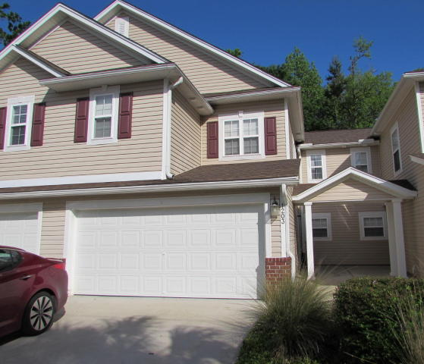
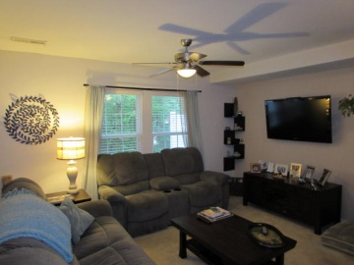
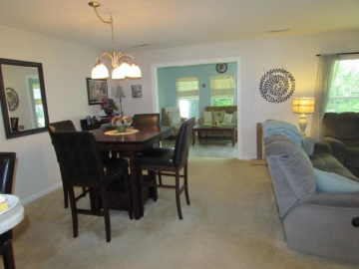
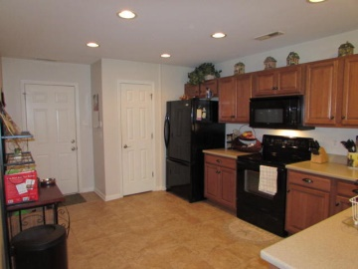
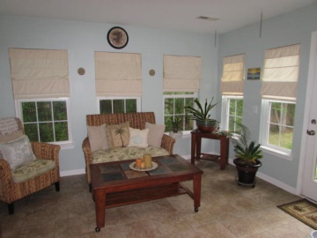
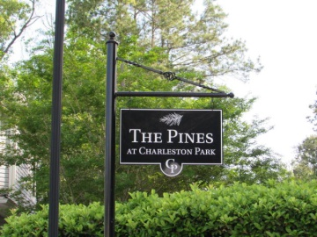
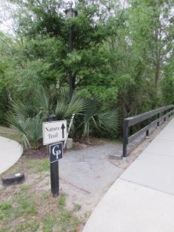
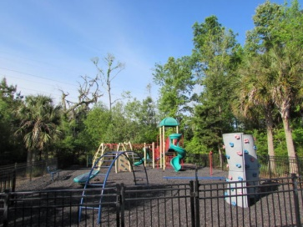
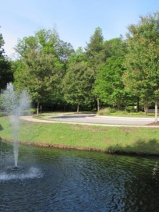
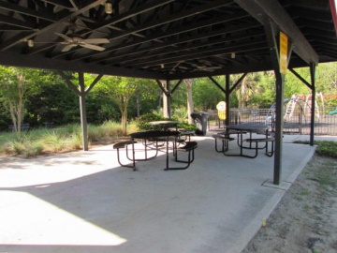


5150 Trump Street 1203
· Charleston Park · North Charleston · MLS# 15009474 · $169,900 ·
55 and Better!
New Price in I'on
Welcome home to this move in ready townhome in beautiful Charleston Park. This home has a spacious open floor plan. The owners have customized the foyer with wainscoting making the entrance so inviting. The kitchen has a deep double sink, Energy Star appliances and Corian countertops. There is a sunroom off the dining area perfect for relaxing. Upstairs are the bedrooms and the laundry room. The master has a walk-in closet, two closets in the master suite and his and hers sinks. The regime covers lawn maintenance, termite bond, pressure washing and gutter cleanouts so all you have to do is relax. There is a nature trail and a play park in the neighborhood as well. Close to Boeing, shopping, dining and Wescott Park.
Heather Broadwell-Derexson
(843) 303-2065 – C
heather.derexson@carolinaoneplus.com
www.Lowcountryhomesbyheather.com
Carolina One Real Estate
900 N Main St.
Summerville, SC 29483

