Slide 1
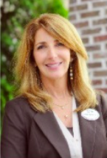
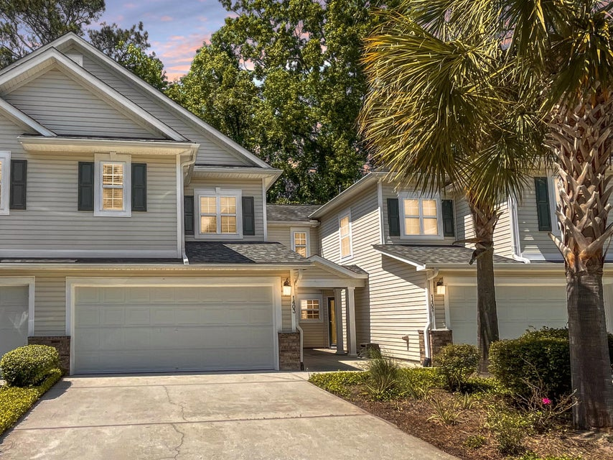
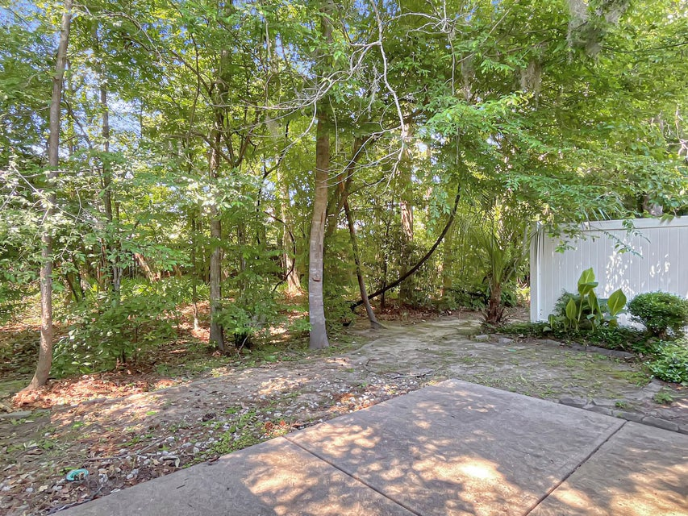
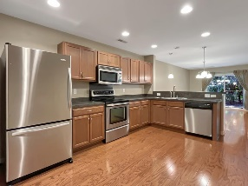
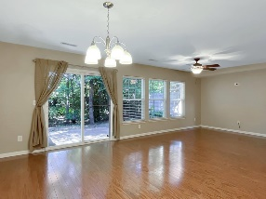
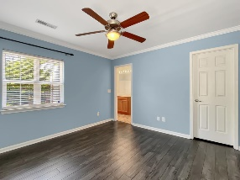
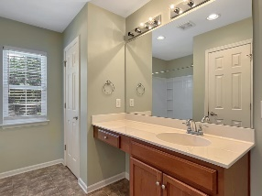
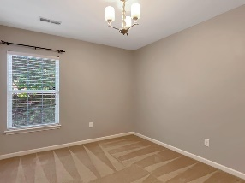
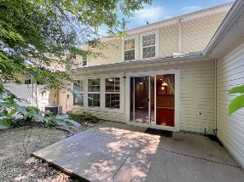


Price Improvement
PLUS 3% BA!
Michael Moseley
843-442-0959
michaelsmoseley@gmail.com
charlestonrealestateandgolf.com
5150 Trump Street 1403 | Charleston Park | MLS# 24010433 | $299,900
Brand New Flooring!
Gorgeous townhome located in The Pines of Charleston Park close to the airport, Boeing, and Bosch + new shopping center across the street. Enjoy cul-de-sac living and private lot that backs up to woods and wetlands.
Upon entering, you will immediately be drawn to the gleaming hardwood floors throughout the main level. The kitchen is open to the dining and living rooms and is equipped with stainless fridge, smooth top range, breakfast bar, pantry and an abundance of cabinets. Enjoy your morning coffee or that afternoon cocktail on your private back patio. Upstairs you will find three large bedrooms including primary bedroom walk in closet and shower/tub combo. Other bonus features are attached 2 car garage and security system.
The only thing missing is YOU!!
Carolina Elite Real Estate | 1081 East Montague Ave | N Charleston, SC 29405

