Slide 1
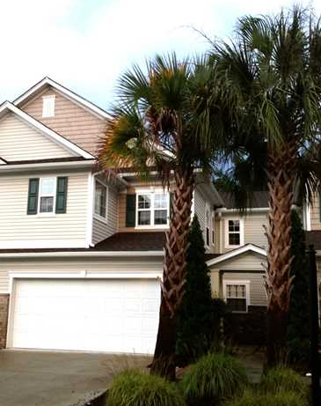
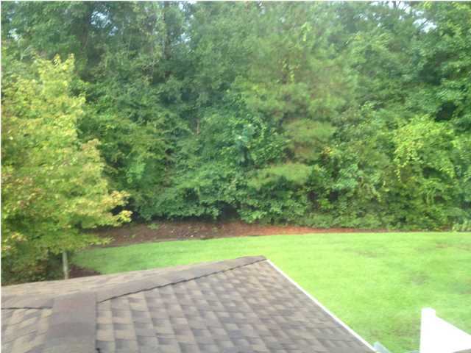
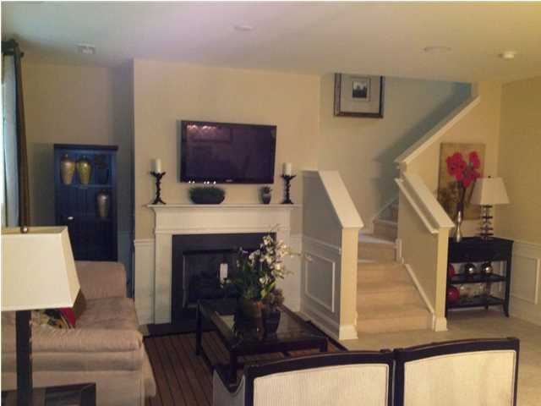
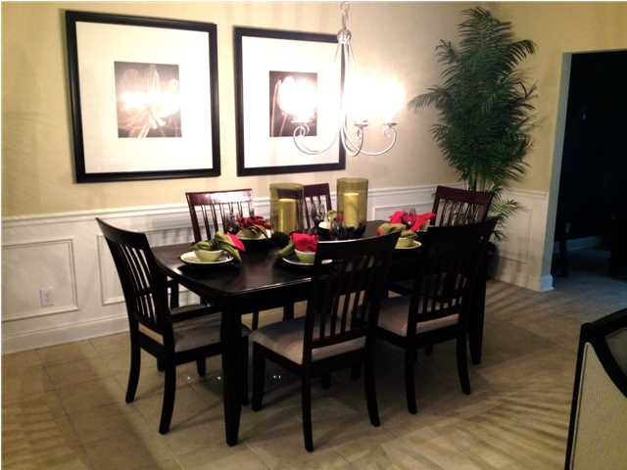
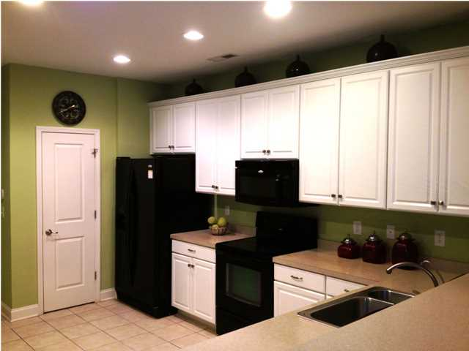
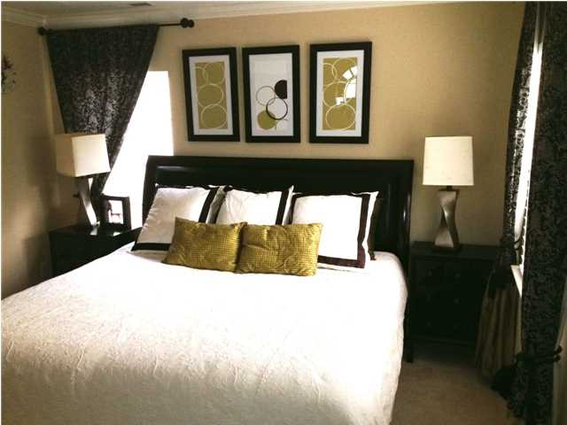
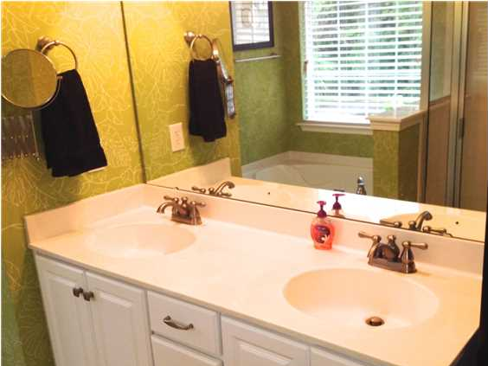
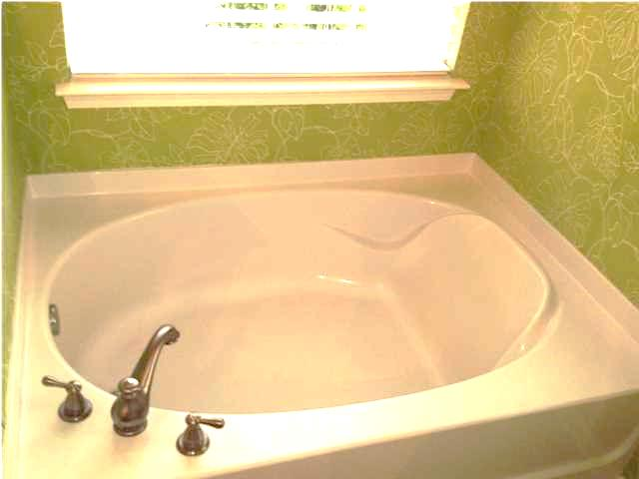


Model Home Spectacular! ~ Charleston Park ~
5150-1904 Trump St
North Charleston
MLS# 1422116
$170,000
3 Bedrooms / 2½ Baths / 1,713 sf
Central location near Dorchester Rd & Ashley Phosphate.
Surround sound, fire place, sun room, private back yard. Luxury feeling through out the impressive entrance, living, dining and sun rooms. Open floor plan! You can entertain in this house and enjoy a private patio an wooded back yard. Upstairs laundry room. Large 2 Car Garage. Community amenities include a picnic shelter, tot lot and 2.5 miles of walking trails. Ideal location and within minutes from Boeing, AFB, Bosch, beaches and downtown Charleston. HOA cares for the entire exterior including roof and insurance, termite, landscaping and annual pressure cleaning. HURRY! check out this great home today!! If sq footage is important measure. Is schools are important research independently
Di Johnson
ABR, EPRO
(843)-270-6448
dijohnsonsc@gmail.com
Keller Williams Realty Charleston
496 Bramson Ct, Ste 200
Mt. Pleasant, SC 29464

