Slide 1
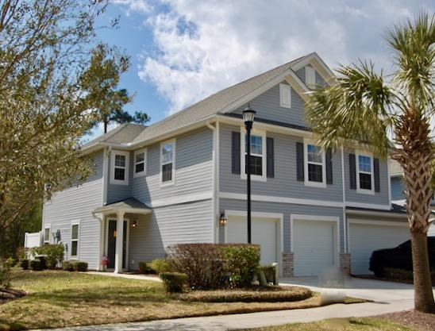
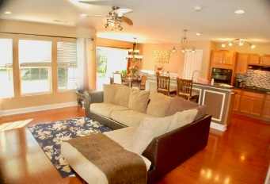
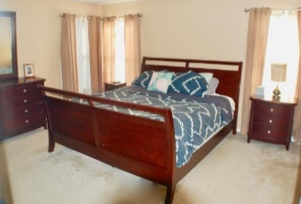
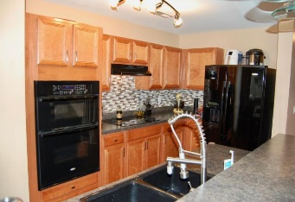
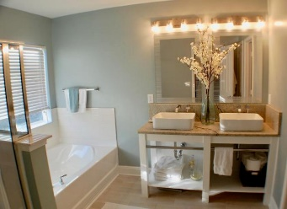
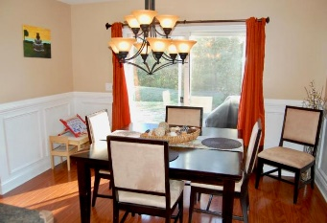
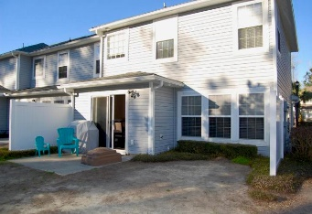
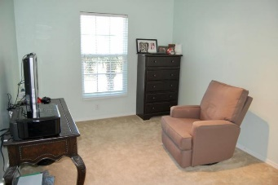
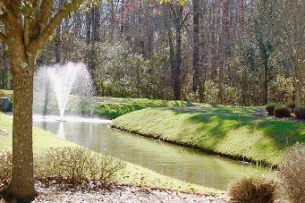


5150 Trump Street
#2005
Charleston Park
N Charleston, SC 29420
MLS# 18005955
$200,000
3 Beds | 2½ Baths
1,724 Square Feet
Open House Sun 12-2
Have it ALL, location, price, stunning finishes, No Maintenance & No Flood Ins!
Least expensive, newest construction in the area! End unit/ lots of windows. Open floor plan for great entertaining. Beautiful, upgraded kitchen w 42 in cabinets, wall oven & microwave, smooth top range, cast iron sink. Master that is Amazing! MUST SEE Custom master bath w designer dual sinks, faucets, separate shower, garden tub, tile floor. Lge Walk in closet. 2 car garage. Upstairs laundry & loft. UPGRADES; laminate floor on entire first floor, wood tread stair case, wainscoting, lighting, molding...
Back Patio has view of wild life area & 2 Fountains. RELAX! Yard work, ext washing, pest treatment, roof, exterior insurance, all inc in HOA. Aquatic complex being built by town. 8 Mins to airport.
Di Johnson
843-270-6448
dijohnsonsc@gmail.com
www.agentownedrealty.com
AgentOwned Premiere Group
824 Johnnie Dodds Blvd
Mt Pleasant 29464

