Slide 1
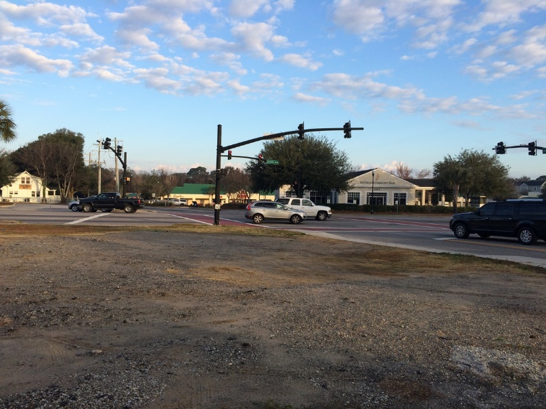
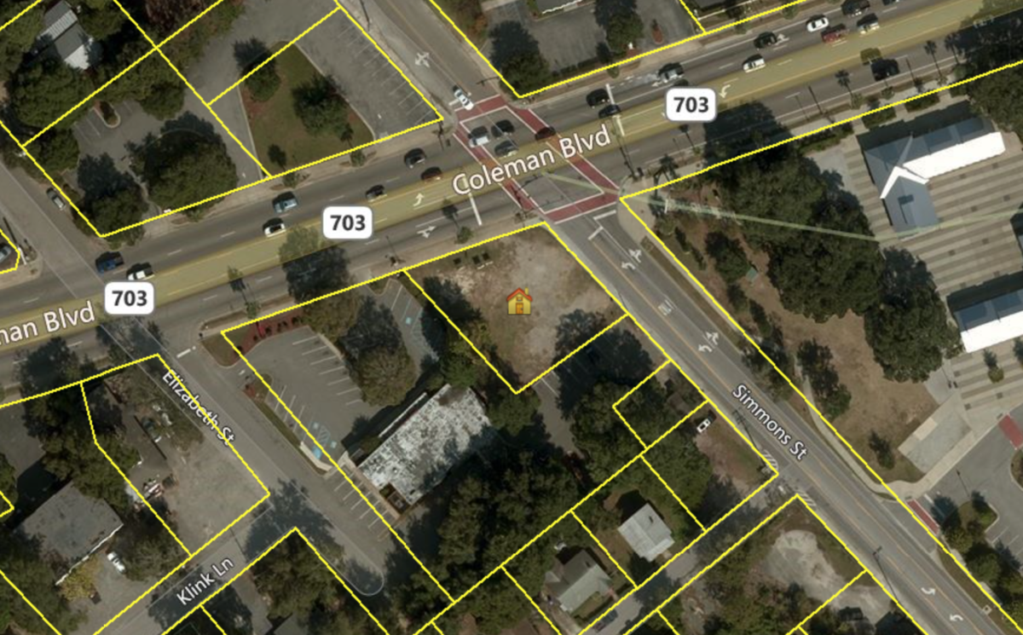

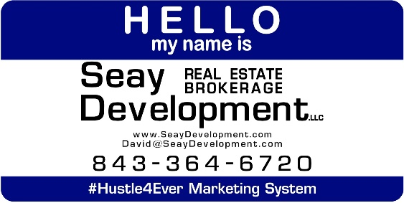
Coleman Boulevard Corner Parcel
515 Coleman Boulevard
Mount Pleasant, SC 29464
VACANT LAND FOR SALE
100 feet of exposure on the most flexible zoning you can pretty much get in the Town of Mt. Pleasant and on a lighted corner offering a maximum height of 45 feet. Perfect for retail, restaurant, entertainment or commercial use on the ground floor and either commercial or residential/multi-family on the above floors. Ideal opportunity for a local business owner that wants a prominent location or a developer wanting to use the opportunity to yield from 6,000 square feet and up to a maximum building size offering a developer flexibility to cast their vision.
Catylist ID: | #29932658
Gross Land Area: | 0.23 Acres
Sale Price: | $695,000
Unit Price: | $3,021,739 Per Acre
Highway Access: | Directly on Coleman Blvd.
Zoning: | GB - General Business
Property Visibility: | Excellent
County: | Charleston
Tax ID/APN: | 532-01-00-151
David H Seay
CCIM, BIC, CCIM, REALTOR
(843) 364-6720
david@seaydevelopment.com
Seay Development, LLC
3404-202A Salterbeck Street
Mt. Pleasant, SC 29466
www.seaydevelopment.com

