Slide 1
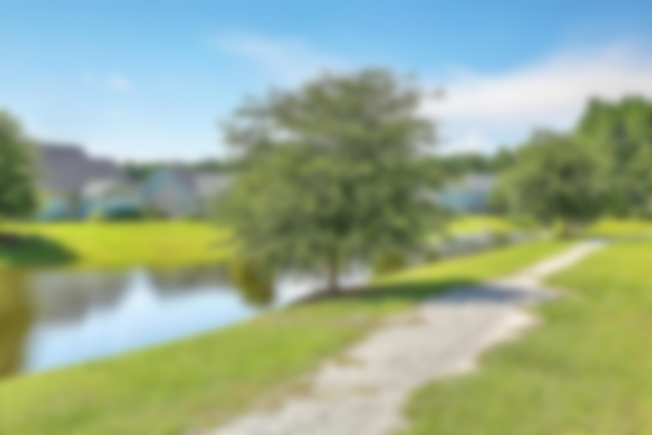
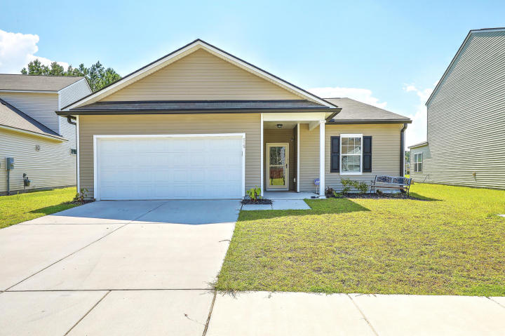
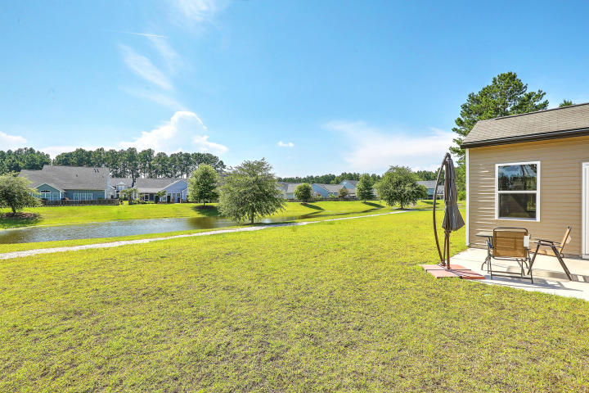
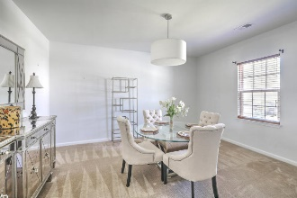
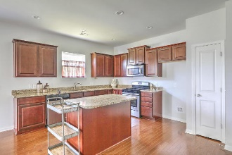
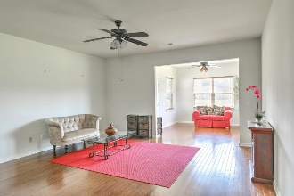
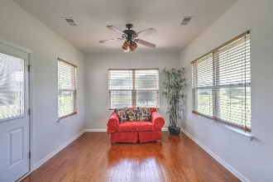
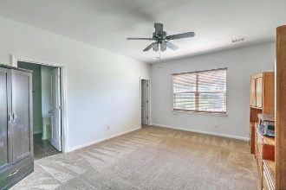
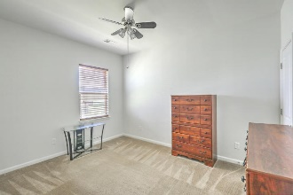
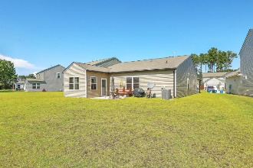
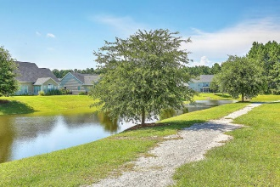
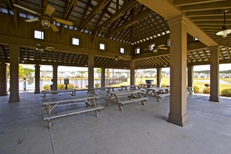
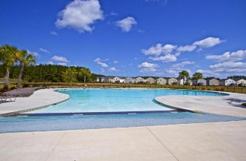

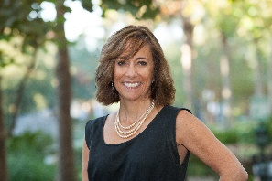
Join Us Sunday from 11a-3p
Just Listed – Move-in Ready in Cane Bay
515 Stafford Springs Court
Cane Bay Plantation | Summerville, SC 29486 | MLS# 18019011 | $239,775
No need to wait for new construction with this wonderful move-in ready one-story home with open floor plan that is wonderful for entertaining friends and family! Features include: Formal dining room**Kitchen with upgraded cabinets, granite counters, s/s appliances, island, pantry and ample counter and cabinet space**Hardwood floors throughout main living area**Sunroom with lovely pond views and leads out to large patio**Privately nestled master en suite with dual vanities, shower and separate soaking tub**Two additional bedrooms with guest bath situated separately from Master. Cane Bay is a wonderful Master Planned Community with wonderful amenities, three schools, shopping and dining within a golf cart ride distance. Enjoy miles of walking trails, community pavilion, resort-style pool as well as playground. Schedule your showing today!
Desiree Maurer
Office - (843) 416-2000
Mobile - (843) 327-9010
desiree.maurer1@gmail.com
www.yourcharlestonhousesearch.com
Keller Williams Realty
496 Bramson Ct Ste 200
Mt. Pleasant, SC 29464

