Slide 1
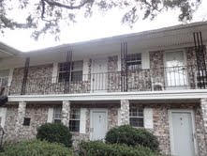
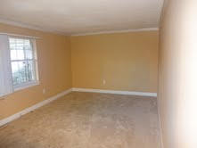
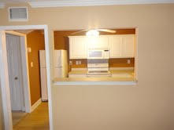
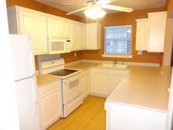
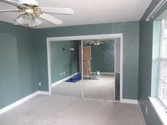
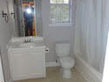


516 Arlington Drive A7
The Savannah
Charleston
MLS# 15000957
$59,750
OWN YOUR OWN WEST ASHLEY HOME
…FOR UNDER 60K!
LOCATION! LOCATION! LOCATION!
This condo is located in The Savannah in West Ashley. So convenient to everything! Hwy 526, The Citadel Mall, restaurants, shopping, and more are just minutes away, and just a ten minute drive to downtown Charleston! Why rent when you can buy a super affordable home like this? This is a one bedroom that has a living room / dining room area, kitchen with white cabinets and plenty of cabinet space, and a large bedroom with ample closet space. Another bonus is it is located on the second floor which means no noise from above like you might have on a first floor unit. It has a nice floorplan with the kitchen open to the lr/dr area. This is really a great price for West Ashley!
Contact KJ Property Management, Kathleen Green, 843-763-0943 for HOA info.
Bill Smith
843-442-5906 M
bsmith@carolinaone.com
www. carolinaone.com

