Slide 1
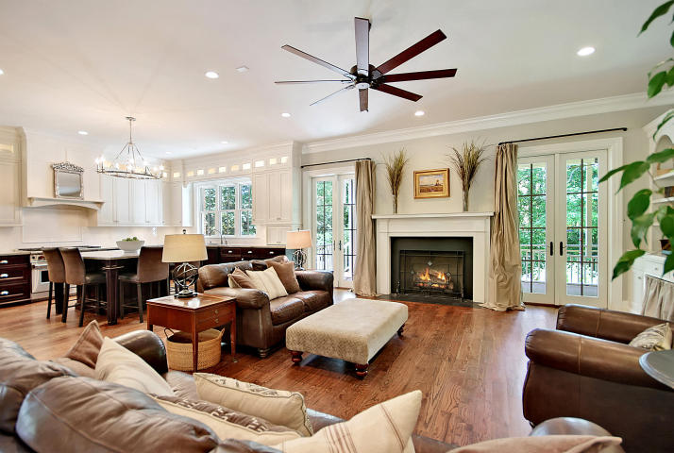
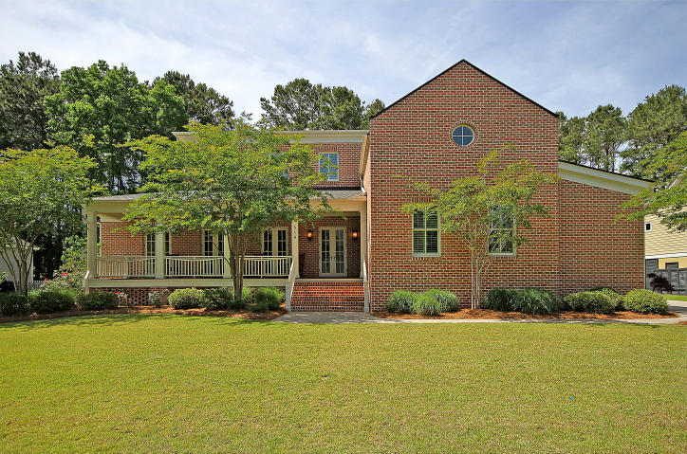
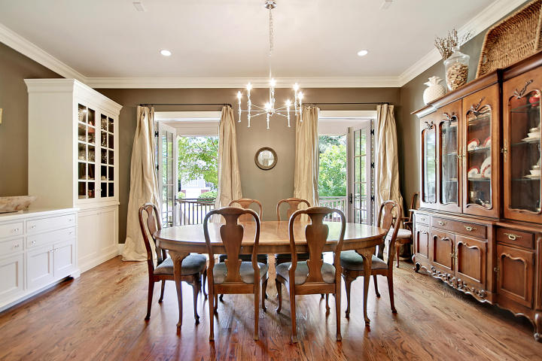
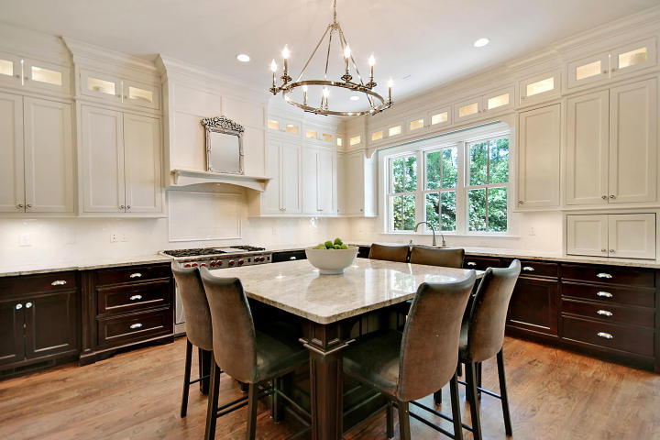
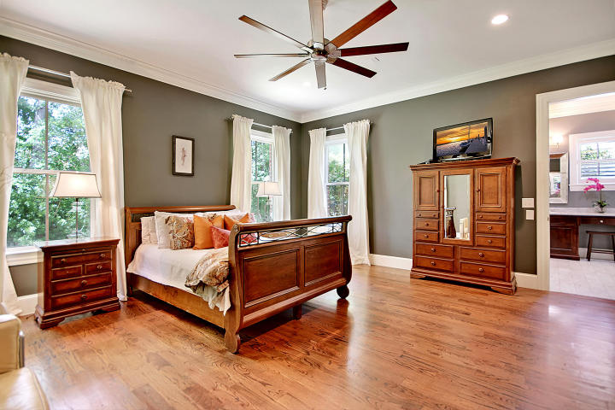
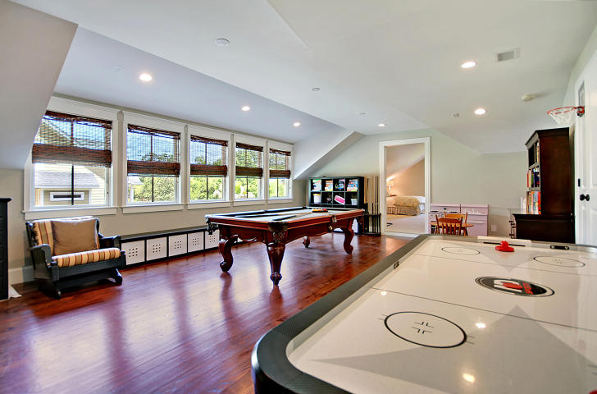
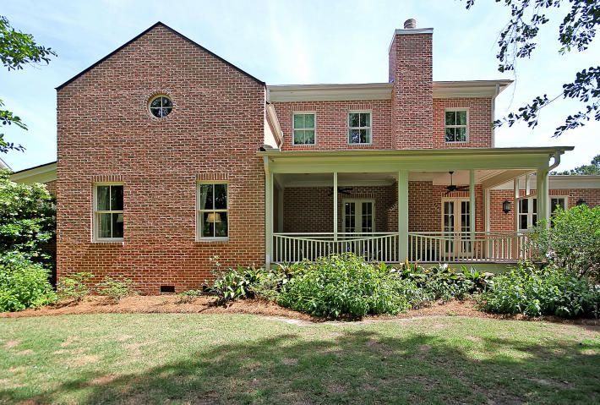
Great Downtown Investment Opportunity
Price Reduced in Hobcaw Creek Plantation!
516 Chimney Bluff Drive Mount Pleasant, SC 29464 ~ MLS# 18013362 ~ $1,050,000
This is the PERFECT home for entertaining -- you must see it to believe all of the great features! This 2-story, 6 bedroom, custom brick home is located in Hobcaw Creek Plantation, one of Mt. Pleasant's most sought after neighborhoods. This home features "his and hers" home offices and the owner's retreat on the main level. With the french doors open in the living room and dining room, outdoor living flows smoothly into the open concept floor plan making it easy for friends & family to mingle. The large kitchen features custom cabinets, high end appliances and a walk-in pantry. The kitchen island seats six and houses wine storage, a wine fridge and ice maker. The fully integrated Subzero fridge/freezer combo is the jewel of the kitchen, built to look like a mirrored armoire.
Upstairs are 3 large bedrooms - 2 beds share a "Jack & Jill" bath and one bed has an ensuite bath. The game room/FROG has it's own wet bar and plenty of room for games, toys & endless hours of fun! Attached FROG also has a full bath, walk in closet, and a separate room that could be used as a bedroom. Entire house, including back and front porches, is wired for speakers. Loads of storage! This home was built with extreme attention to detail and only the finest qualities. All windows and doors have impact resistant glass. Fully landscaped yard with irrigation system and fence in the back yard.
Book your viewing today!
Paige Rhodes 843-830-3281 paige@mattoneillteam.com
Ben Laaper 843-642-3546
ben@mattoneillteam.com

