Slide 1
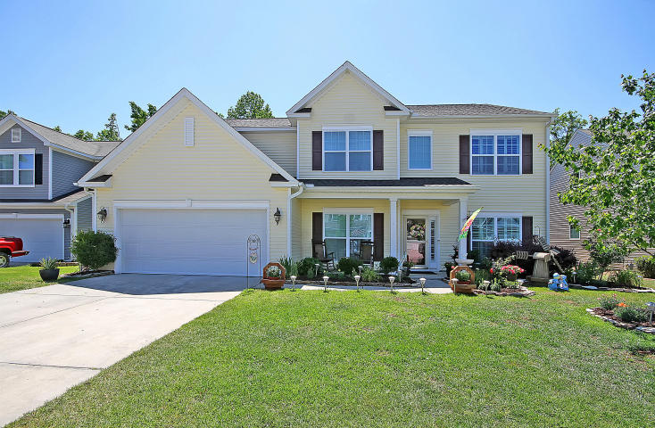
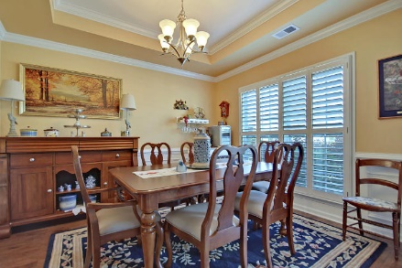
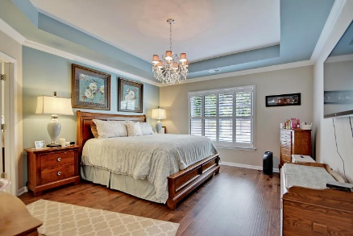
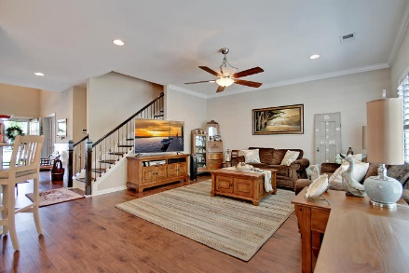
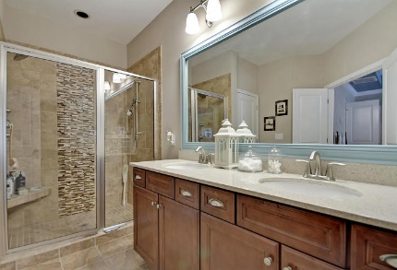
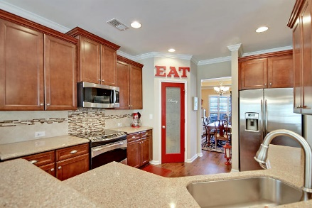
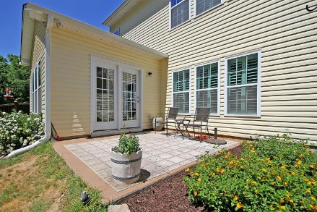
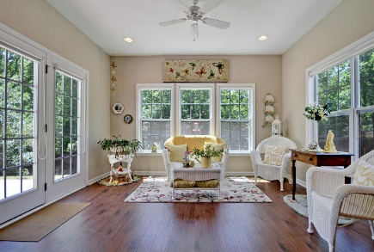
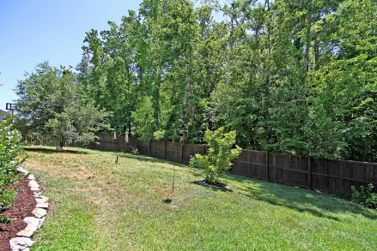
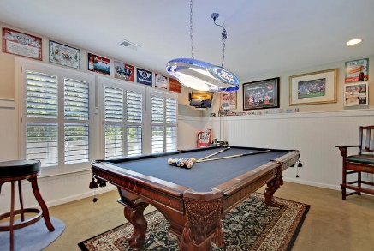
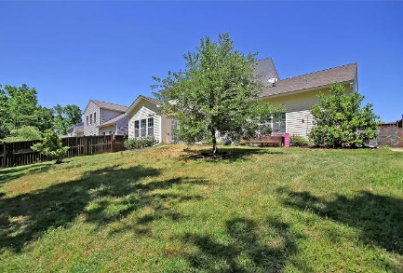
Price Reduced!
LUXURY HOME! BARGAIN PRICE!
516 Mountain Laurel Circle
Brickhope Plantation ~ Goose Creek, SC 29445 ~ MLS# 18013441 ~ $329,900
Beautiful Brickhope Plantation in Goose Creek proudly presents this amazing floor plan that backs to wetlands.
This open floor plan boasts a two story foyer, a breakfast bar in the kitchen, tile backsplash, wainscoting and a tray ceiling in the dining room, French doors in the office and a sun-drenched sun room off of the kitchen which is a custom finish not found in other models.
The first floor master features a walk-in closet, a dual vanity and tile, walk-in shower in the en-suite bath.
Let the party begin in the FROG with its wet bar and get ready to rack the balls for endless pool games in the 2nd bonus room.
The patio overlooks the private, fenced-in backyard and the covered front porch is perfect for your rocking chairs.
Come by today!
Chip Walsh chip@mattoneillteam.com 843-822-4663

