Slide 1
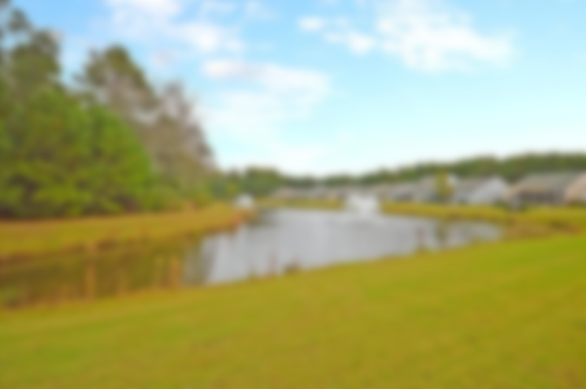
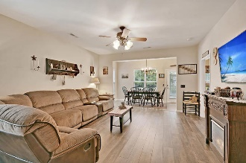
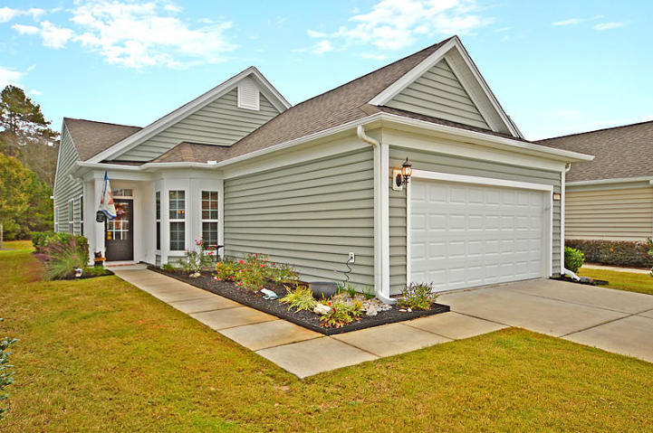
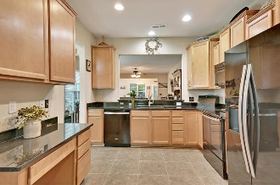
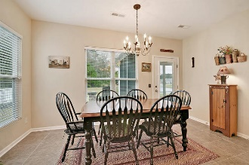
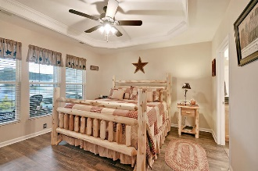
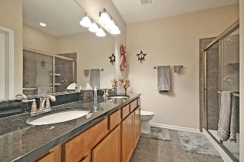
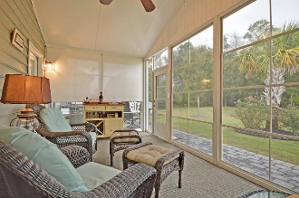
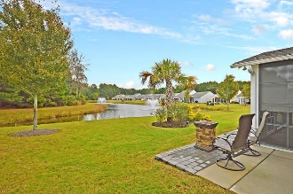


Just Listed in Del Webb
JUST REDUCED!
516 Sea Foam Street
Cane Bay Plantation · Summerville
MLS# 18029844 · $265,000
Enjoy living in Charleston's premier Active Adult community, Del Webb at Cane Bay. Inside the Gray Myst floorpan you will find an open-concept living design with 2 bedrooms, 2 baths, office, eat-in kitchen, dining and great room combo, sunroom and attic storage! As you enter the home, you will notice an upgraded glass front door bringing in natural light and new vinyl lifeproof flooring. Just around the corner is your kitchen, featuring tile flooring, granite counter tops, upgraded black appliances (gas hook-up for range installed), upgraded Birch cabinets with Lazy Susan, built-in desk with upper cabinets, and eat in kitchen with bay window. The entry from the garage is just off the kitchen area for easy access.
A four season sunroom with additional patio and gas grill hook-up overlooks a lagoon and protected wooded area. The master bedroom is situated at the back of the home and offers additional views of the lagoon and woods. The master bathroom features a double sink vanity, granite countertops, tile flooring, walk-in tiled shower with glass shower door and large walk-in closet. Your secondary bedroom, bath and office are located towards the front of the house down a separate hallway from the master bedroom. Also down the hallway, you will find an oversized storage and linen closet. Additional upgrades include tray ceiling in the master bedroom, ceiling fans, refrigerator, and hardwired for a security system.
A $1400 Lender Credit is available and will be applied towards the buyer's closing costs and pre-paids if the buyer chooses to use the seller's preferred lender. This credit is in addition to any negotiated seller concessions.
Bryan Smith
(843) 530-0688 · bryan.smith@carolinaone.com
www.charlestonhomeagent.com
Carolina One Real Estate | 628 Long Point Rd. | Mt Pleasant, SC 29464-3032

