Slide 1
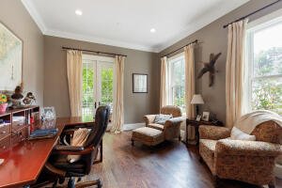
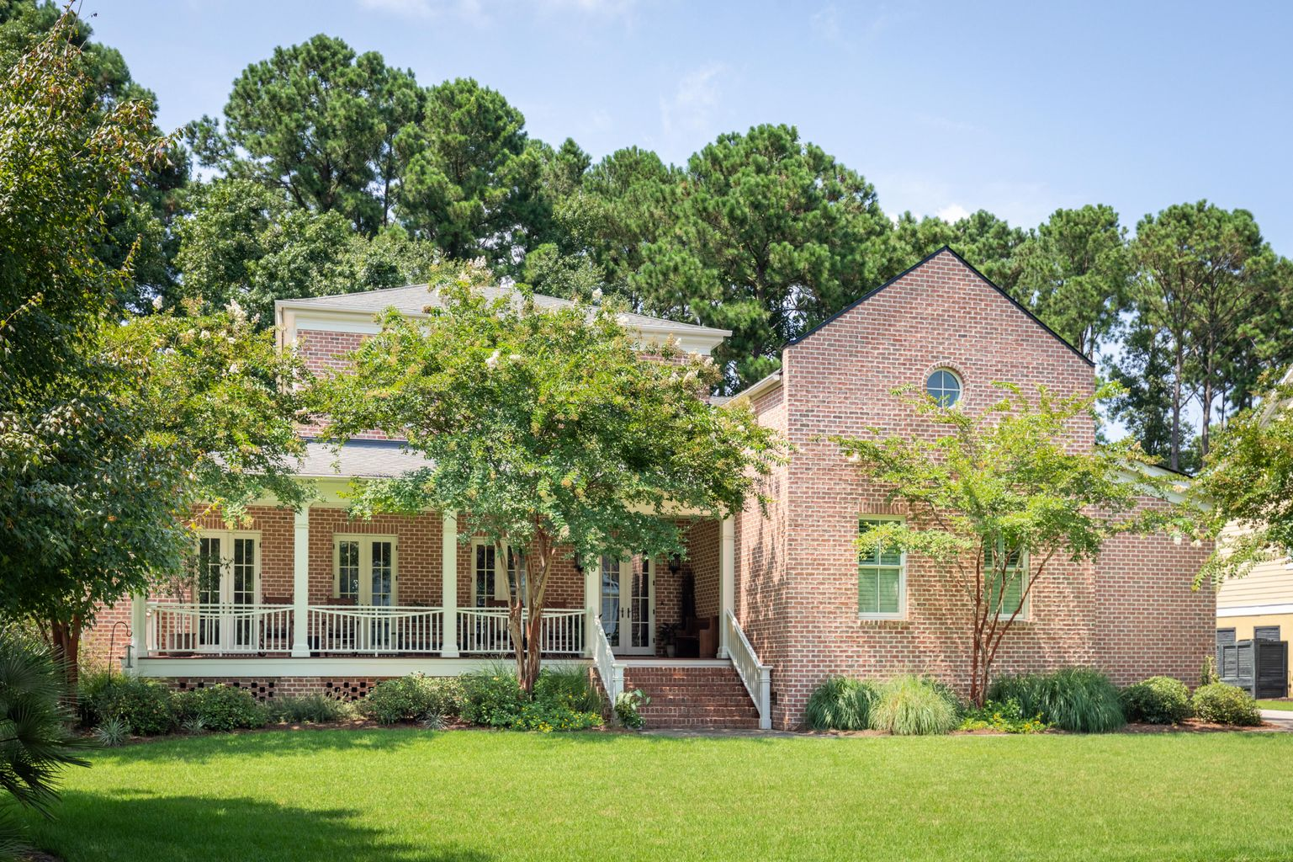
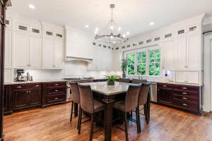
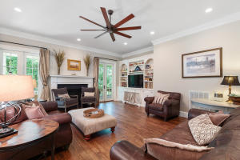
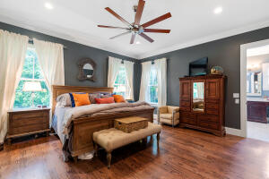
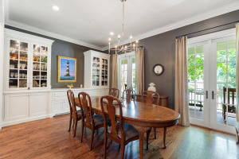
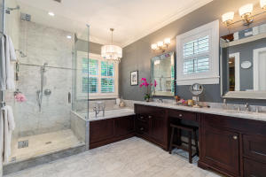


OPEN HOUSE SATURDAY 8/14 FROM 3-5PM
516 Chimney Bluff Drive
Hobcaw Creek Plantation ~ Mount Pleasant, SC 29464
Custom, custom, custom! Overbuilt is an understatement! This gorgeous all brick home was built by the current owners to withstand all that the Lowcountry climate can throw at it. Located in the very desirable Hobcaw Creek Plantation neighborhood with its beautiful pool amenity center and private neighborhood boat ramp and dock. A quick boat ride out of Hobcaw Creek to the beautiful Wando River and Charleston Harbor. Lowcountry living at its finest! Centrally located in Mt. Pleasant it's a quick drive to anywhere you want to be. Minutes to area beaches, downtown, shopping and the airport. Rarely is a home of this caliber available in such a desirable neighborhood.
Open House Saturday 8/14 from 3-5PM. Offer Deadline is 2PM EST on Sunday 8/15. Offers should be accompanied by Pre-Approval or Proof of Funds. Total Commission is an even split between companies. Co-Broke of 2% is an even split offered by The Brokerage, LLC. Please investigate anything that is important to you or your Buyers. Information offered and represented is deemed as reliable, but not guaranteed.
Take a virtual tour: https://my.matterport.com/show/?m=QFsb5zfccmJ
MLS ID: | 21022097
Sale Price: | $1,695,000
Area: | 42 - Mt Pleasant S of IOP Connector
Bedrooms: | 5
Bathrooms | 4½
Apx. SqFt: | 4,852
Year Built: | 2010
County: | Charleston
Tax Map #: | 5371000100
David H Seay
CCIM, BIC, CCIM, REALTOR®
843-364-6720
david@seaydevelopment.com
John Teffeau
REALTOR®/Co-Owner
843-813-1228
l.johnteffeau@gmail.com
The Brokerage, LLC | 3404-202A Salterbeck Street | Mt. Pleasant, SC 29466 | thebrokerageyouwinhere.com

