Slide 1
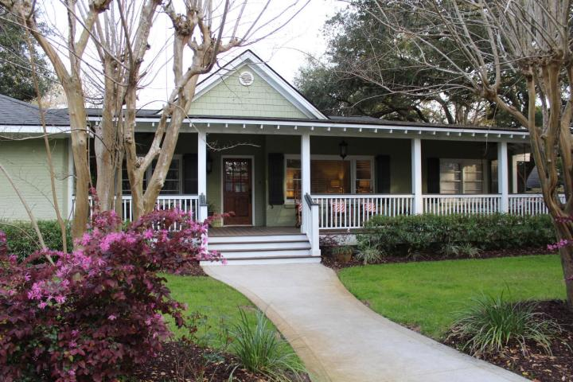
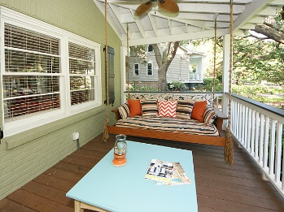
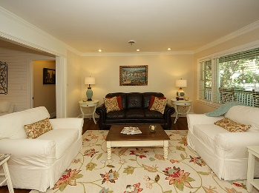
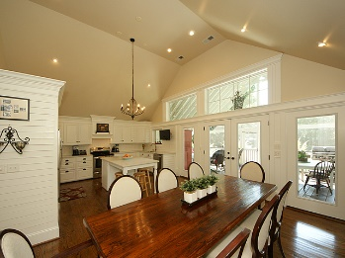
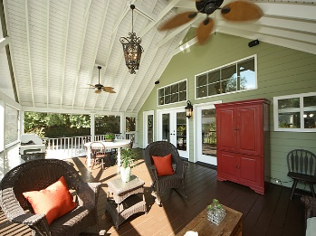
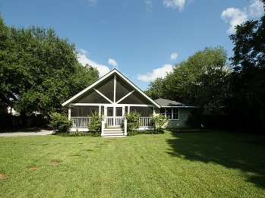



517 Deer Street Old Village Mount Pleasant, SC 29464 MLS# 16023079 $1,199,999 4 Bedrooms ▪ 3½ Baths ▪ 2,866 sq. ft.
Open House ~ Sunday ~ 1-4
Just Reduced!!!
This charming Old Village home has gone through a complete renovation and has been transformed into a modern-day design and an open floorplan. An extensive renovation with over 1,000 sq. ft. of additional living space, and a 1,000 sq. ft. of porches. A beautiful one story home with approximately 2,900 sq. ft. of living space, 4 bedrooms and 3.5 baths. This is almost a new home! Great room with custom built-ins and family room with shiplap. New kitchen with cathedral ceiling, custom cabinets, stainless appliances, large kitchen island, and quartz countertops. Kitchen opens to the huge screened porch just perfect for outdoor entertaining. A wonderful master suite with a separate entrance to the back screened porch. The master bath is beautifully appointed with separate tiled shower, Jacuzzi bathtub, dual vanities, granite counters and a fantastic master closet! The second bedroom is large and has its own private bath with tiled tub surround, granite counters, tiled flooring and built-ins. Two other bedrooms with another renovated bath which features tiled tub surround, granite counter, and tiled flooring. Hardwood flooring throughout, except for tiled baths, smooth ceilings, almost of the home has new electrical and plumbing & lighting. There is a laundry room with sink, cabinets, quartz counters and barn doors, a powder room and a home office. Lots of storage throughout the home. Home is on a beautiful wooded lot, with large backyard, (large enough for a pool), a two car detached garage and workshop. All located in the highly desirable Old Village neighborhood, on a quiet street within walking distance to Mt. Pleasant Academy, and Pitt St. Bridge. Bike to Moultrie Middle School, Pitt St. Pharmacy, Alhambra Hall, Play Park, tennis courts, Charleston Harbor and Shem Creek for dining and shopping. Minutes to beaches and downtown Charleston. Don't miss this one, it's a gem!
Jennifer Nipper, Realtor®
(843) 478-1800 | jen@AgentOwned.com
www.AgentOwned.com
The AgentOwned Realty Co | 824 Johnnie Dodds Blvd | Mt. Pleasant, SC 29464
Real Estate • Mortgage • Insurance

