Slide 1
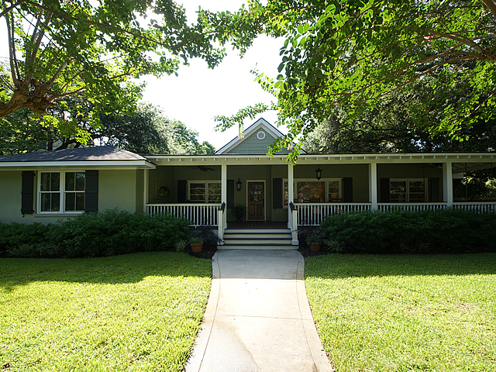
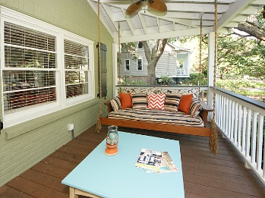
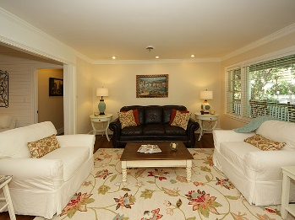
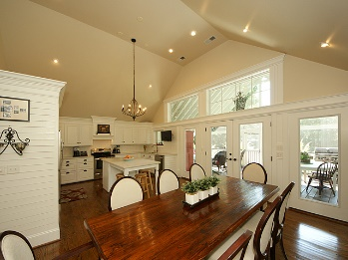
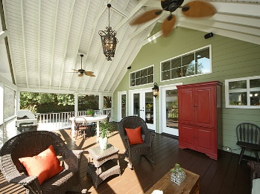
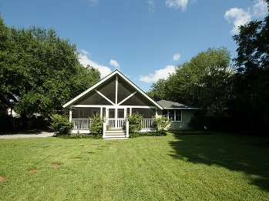



517 Deer Street
Old Village
Mount Pleasant, SC 29464
MLS# 16023079
$1,249,000
4 Bedrooms ▪ 3½ Baths ▪ 2,866 sq. ft.
Open House
Price Reduced!
This charming Old Village home has gone through a complete renovation and has been transformed into a modern-day design and an open floor plan. An extensive renovation with over 1,000 sq. ft. of additional living space, and a 1,000 sq. ft. of porches. This is almost a new home. New kitchen with vaulted ceilings, custom cabinets, an island, stainless appliances and quartz countertops. Full front porch and huge screened porch overlooking the large backyard. (Large enough to add a pool) All hardwood flooring and tile, laundry room, home office, 2-car garage and a workshop. All on quiet Deer St., 3 doors off of Royall Ave. Walk to Mt. Pleasant Academy, Alhambra Park, and Pitt St. Bridge. Short bike ride to Moultrie Middle School, Shem Creek, and Pitt St. Pharmacy.
Jennifer Nipper, Realtor®
(843) 478-1800 | jen@AgentOwned.com
www.AgentOwned.com
The AgentOwned Realty Co | 824 Johnnie Dodds Blvd | Mt. Pleasant, SC 29464
Real Estate • Mortgage • Insurance

