Slide 1
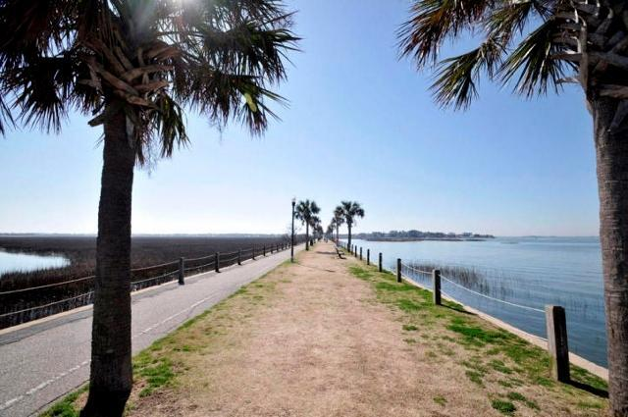
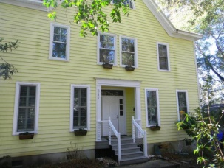
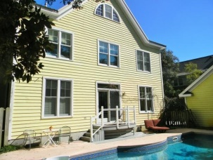
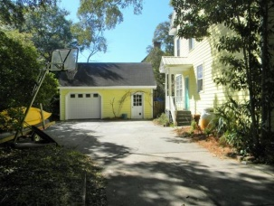
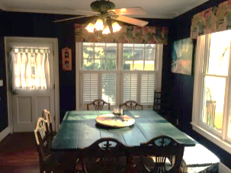
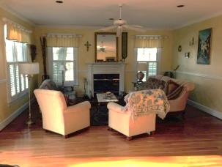
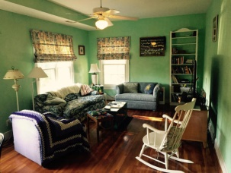
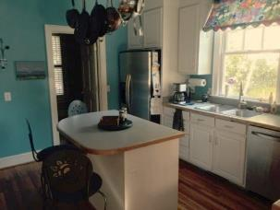
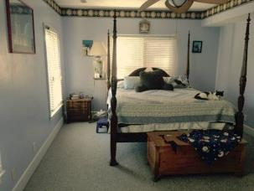


517 Royall Avenue
Old Village ~ Mount Pleasant
MLS# 15003446 ~ $949,000
Agent Open House ~ Thursday from 10am-12pm
4 BEDROOMS | 3½ BATHS | 3,600 SQ FT
Great home in the middle of Old Village of Mount Pleasant, within walking/biking distance to all of the Old Village amenities: Shem Creek, Alhambra Park, Old Mount Pleasant Bridge, Mount Pleasant Academy.
This wonderful, traditional floor plan, hidden by the majestic oak tree in the front is a custom built home by a well known local builder Pat Idlerton. Home has a southern light exposure, just perfect for the in-ground POOL and living area.
Some of the many updates include new metal roof, new windows, exterior stairs, foam insulation in the attic & HVAC. The 3rd floor, heated and cooled, is a ''work in'' progress with lots of potential for expansion adding about 1,000 sq. ft. FLOOD ZONE X = flood insurance not mandatory and optional.
One year home warranty! Lots in the area sell for $500K
Daniel Carabus
843-793-9265 M
dcarabus@carolinaone.com
www.danielcarabus.com
Carolina One Real Estate
195 W Coleman Blvd
Mt Pleasant, SC 29464

