Slide 1
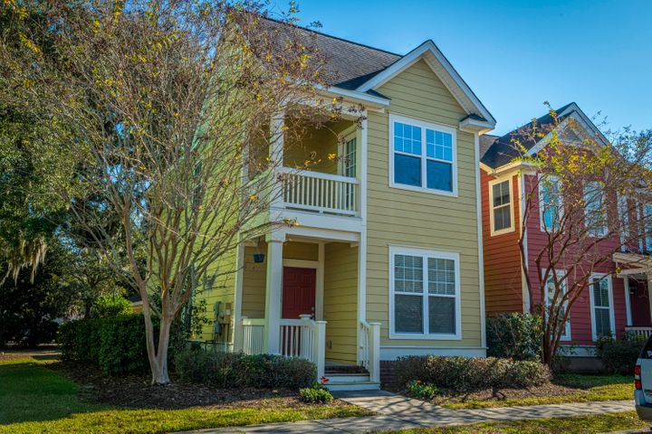
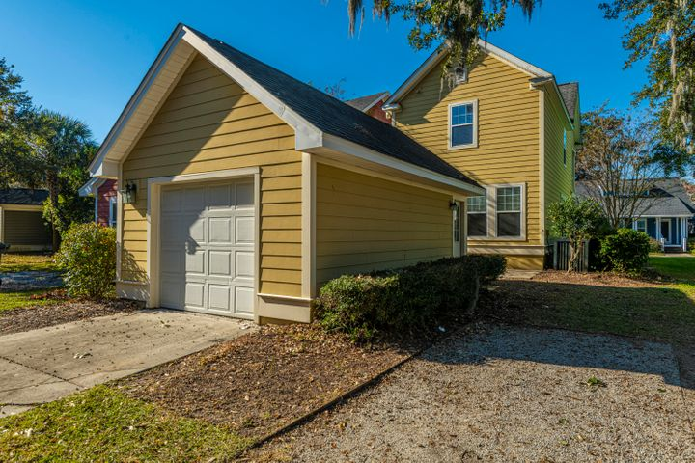
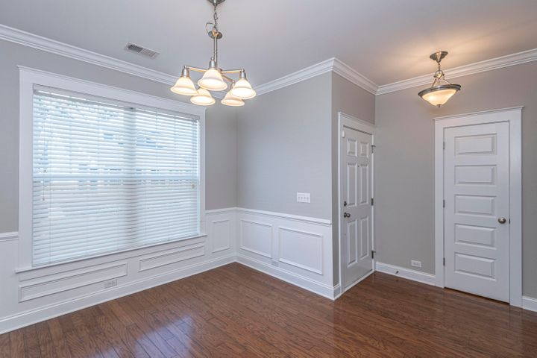
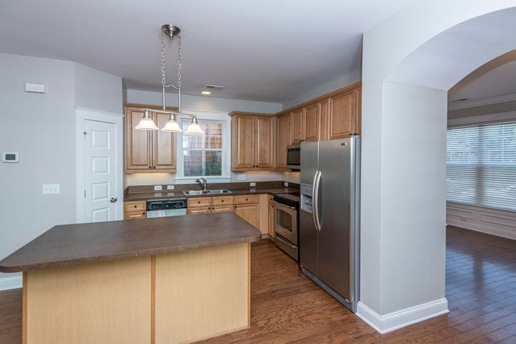
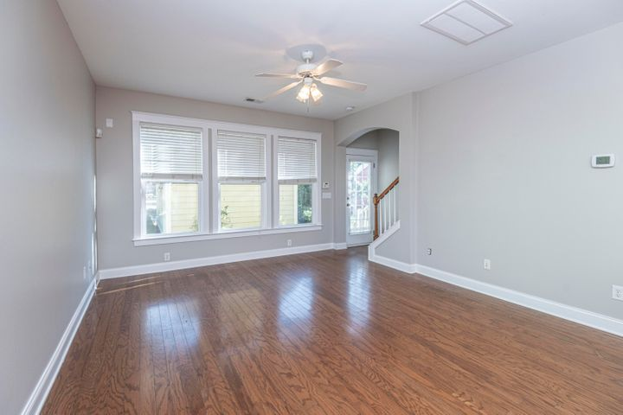
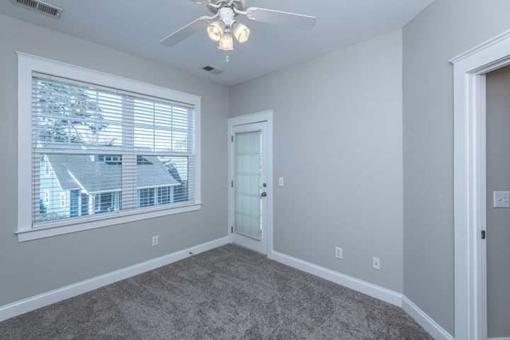
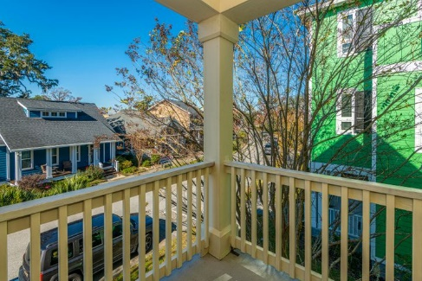
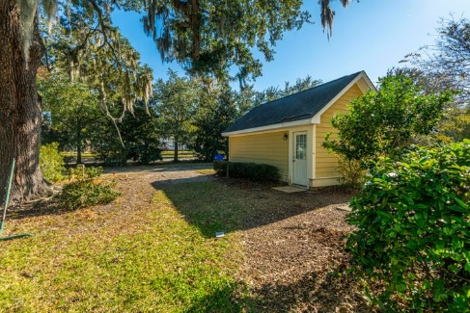



Why wait for new construction?
This Park Circle area home is LESS THAN 2 YEARS!
New Listing in Oak Terrace Preserve!
5183 E Liberty Park Circle
Oak Terrace Preserve ~ North Charleston, SC 29405 ~ MLS# 20032924 ~ $325,000
Welcome to 5183 E Liberty Park Circle in lovely Oak Terrace Preserve! This newly listed home has been a great rental and was just freshly updated for your viewing. There is new carpet and new paint to greet you with a lovely lighted floorplan. The first floor is inviting with hardwood floors, arched doorways, an open floor plan and a formal dining room with the perfect wainscoting. The kitchen boasts maple cabinetry, stainless steel appliances and a kitchen island. There is also craftsman style trim and a master bedroom porch for enjoying the perfect Charleston air. Come see this vacant home today and see the amazing potential it possesses to make it your own!
Virtual Tour: https://my.matterport.com/show/?m=3VMiE8VNw17
Del Shaffer
843.408.6821
dshaffer@carolinaoneplus.com
2713 Highway 17 North
Mt. Pleasant, SC 29466

