Slide 1
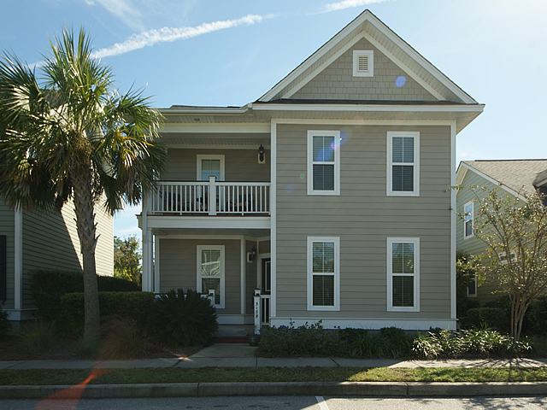
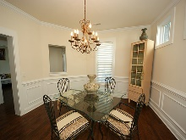
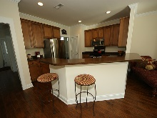
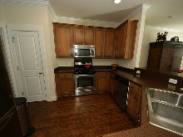
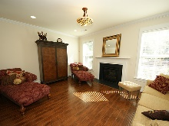
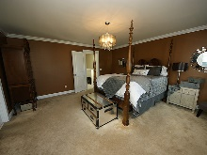
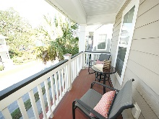
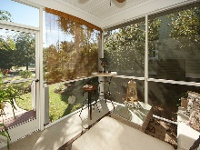
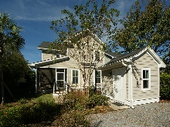
Don't Wait to Build in Park Circle
5189 E Liberty Park Circle Oak Terrace Preserve
North Charleston
MLS# 16028093 ~ $340,000
Turnkey 4 Bedroom, 3 full bath home located in the most desired Park Circle area. Gorgeous floor plan with 9ft ceilings, 5”inch dark hand scraped wood flooring throughout all first floor. A formal dining room with beautiful wainscoting. One bedroom downstairs with a full bath great for guest. Open kitchen with 42” inch cabinets, island, stainless steel appliances, gas stove. Great floor plan for entertaining. You can’t help to notice the upgraded crown molding, 8” inch baseboards, wood frame around all windows, two nice size closets downstairs for storage. Gas fireplace in family room, recessed lighting throughout. Upstairs you will find a spacious master bedroom with an entry to outside porch, master bathroom has whirlpool tub, separate shower, and dual vanities. Also upstairs you will see laundry room and two other spacious bedrooms with another full bathroom. You can enjoy three porches, two large front porches where you can sit and enjoy Charleston weather and scenery and one screened patio in back. Private back flagstone alley for entry into back of the home. A beautiful area for courtyard in the back with a gas line for grilling outside. Home also comes with a detached storage shed for extra storage. High energy efficient home with gas heat, tankless water heater. Lovely community in a central location convenient to airport, shopping, beaches, and downtown.
Rita Adkins
yourcharlestonrealestate@gmail.com | (843) 270-8814 | www.yourcharlestonrealestate.com
Brand Name Real Estate | 4 Carriage Lane, Suite 106 | Charleston, SC 29407

