Slide 1
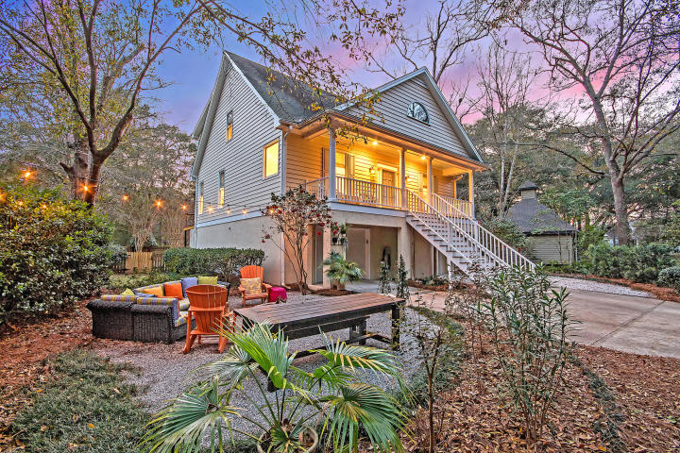



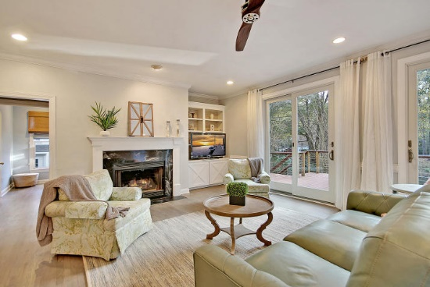
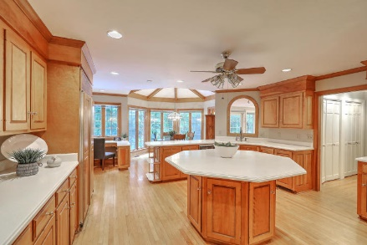
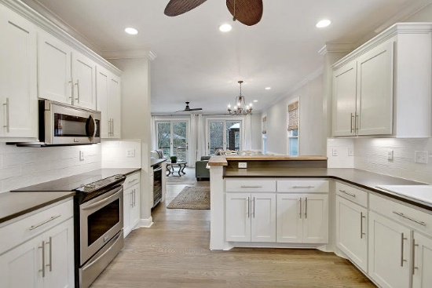



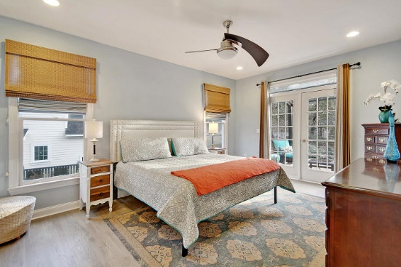

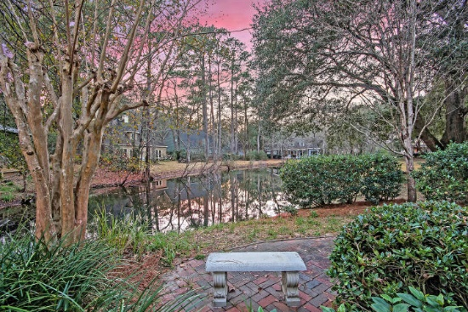
Parkshore Marshfront
Amazing Spaces Indoors & Out
5189 Stablegate Lane
Stono Ferry ~ Hollywood, SC 29449 ~ MLS# 19004267 ~ $389,995
Whether you love indoor or outdoor living, this home is for you! Inside the home you will find beautiful upgrades such as newly redone and custom stained hardwood flooring (2019), fireplace with built ins, updated kitchen, & lovely neutral paint colors. The cheery kitchen flows right off of the living & dining area & is complete with quartz countertops, custom box cut bar top, bead board accent, white cabinetry, a custom tile backsplash, upgraded under cabinet lighting, stainless appliances & slide in range. The outdoor space is just as amazing as the inside! Wander onto the back deck with a gorgeous pond view...this is the perfect space for entertaining & dining alfresco! The yard below also has great entertaining space with tons of areas for relaxing including a built in fire pit!
Additional features include:
5 bedrooms/2.5 baths
Brand new kitchen and bathroom doors and hardware; all cabinetry painted inside and out
House completely painted in 2019
Beautiful lot overlooking pond
Large deck with ipe handrail and stainless steel railing is great for entertaining
Beautifully landscaped back yard
Large Southern front porch
Updated kitchen
Bus service provided for Academic Magnet High School and School of the Arts Middle School
Parental transportation to Low Country Leadership Charter School (K-12) and all CCSD charter schools including CE Williams Middle School, Math and Science Charter School, Ashley River Creative Arts Elementary, Buist (K-8), St Andrews Math and Science Elementary
Book your showing today!
Christopher Smith christopher@mattoneillteam.com 843-267-0735

