Slide 1
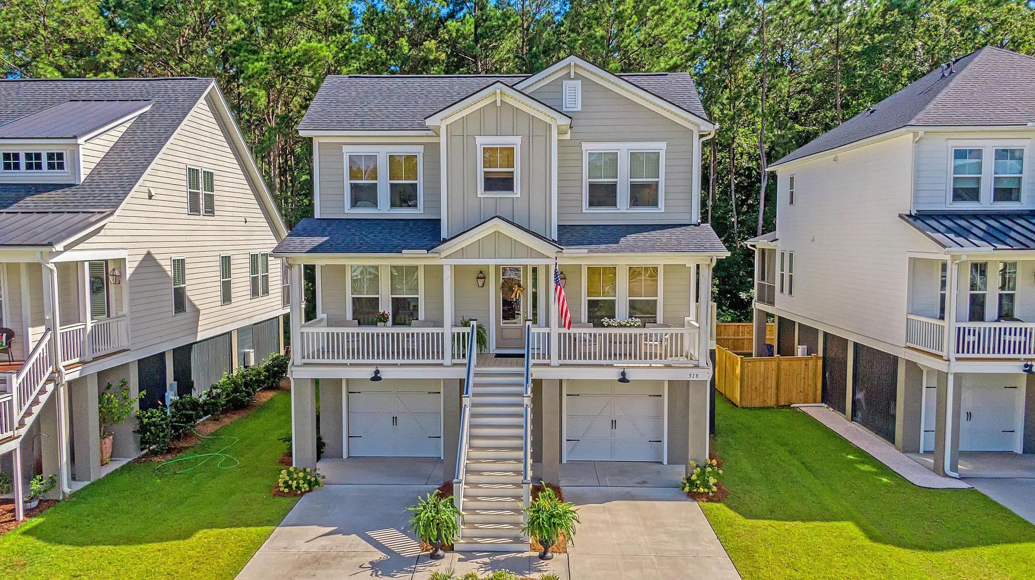




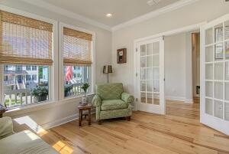

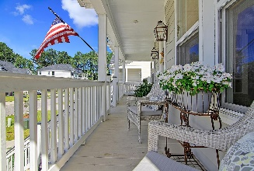
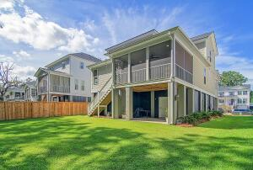
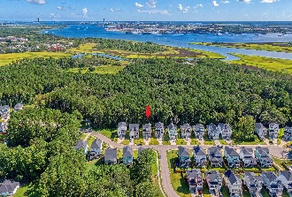
Immaculate Elevated Home With LOADS of Upgrades!
518 Amalie Farms Drive St Thomas Preserve | Wando, SC 29492 | MLS# 22021056 | $825,000
This immaculate elevated home is located in St. Thomas Preserve, a marsh-side community with a community pool and dock, within the Daniel Island School District. Enjoy all of the Daniel Island amenities just a bike ride or golf cart ride away. Built in 2019, this home has been meticulously maintained and has every upgrade imaginable! It features open concept living, an abundance of natural light, a gourmet kitchen with stainless steel appliances and cabinet pull outs, a master bedroom on the main floor, a home office on the main floor, and parking for 4 cars in the garage. In addition to two bedrooms and a shared bath, the second floor has a landing area and a large bonus room - perfect for a media room, kid's play area, or a second home office. This home also features 3 great outdoor spaces including a screened in porch overlooking a private wooded area, a large front porch, and a patio downstairs with natural gas - perfect for a grilling area or a fire pit. Additional features include engineered hardwood floors throughout all of the main living areas, a 4-zone irrigation system, gas lanterns and a tray ceiling in the master bedroom. There are simply too many upgrades and features to list in this "must see" home!!
Take a video tour: https://vimeo.com/736740319
Paige Rhodes 843-830-3281 paige.rhodes@carolinaoneplus.com

