Slide 1
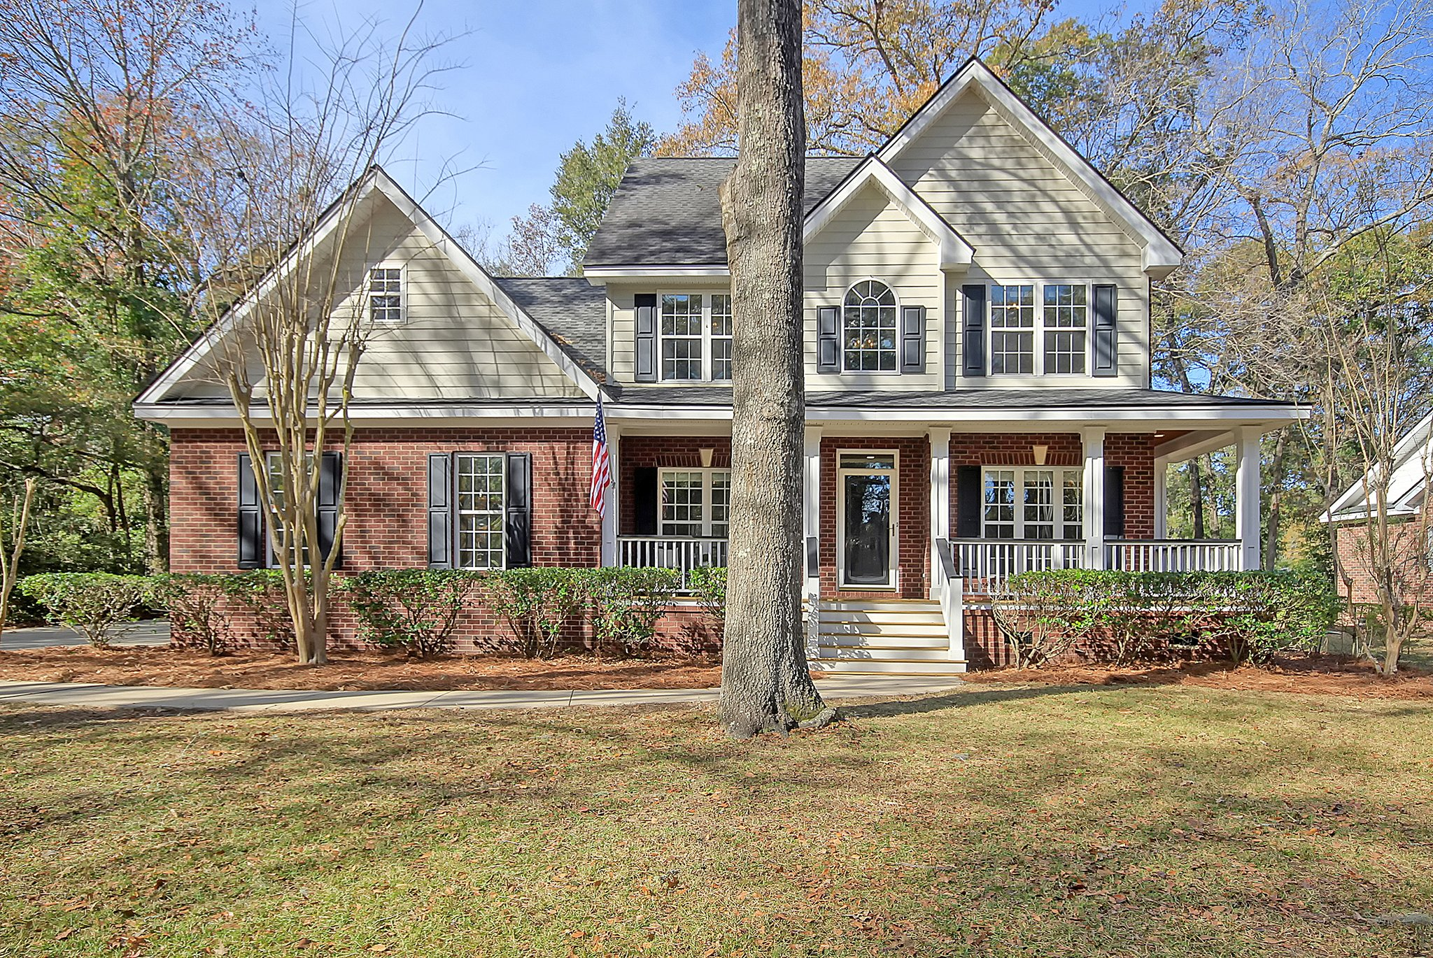
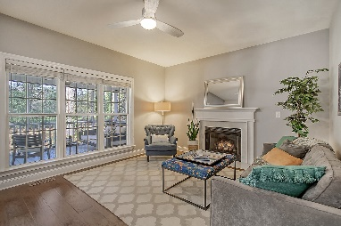
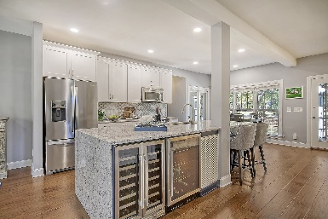


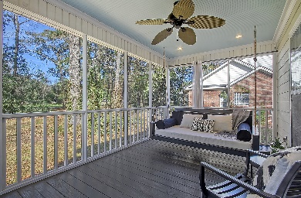


5195 Forest Oaks Drive
Stono Ferry | Hollywood, SC 29449 | $700,000
STONO FERRY - BROKER EVENT
Thursday, January 4th, 11am-1pm | Light Lunch Provided
5 Bedroom | 3 Bath | 2,529sf | Golf Course Views
Steve Kaul
843-817-5547
skaul@carolinaone.com
http://www.charlestonhousehunt.com/
Carolina One Real Estate
195 W Coleman Blvd
Mt Pleasant, SC 29464-3495

