Slide 1
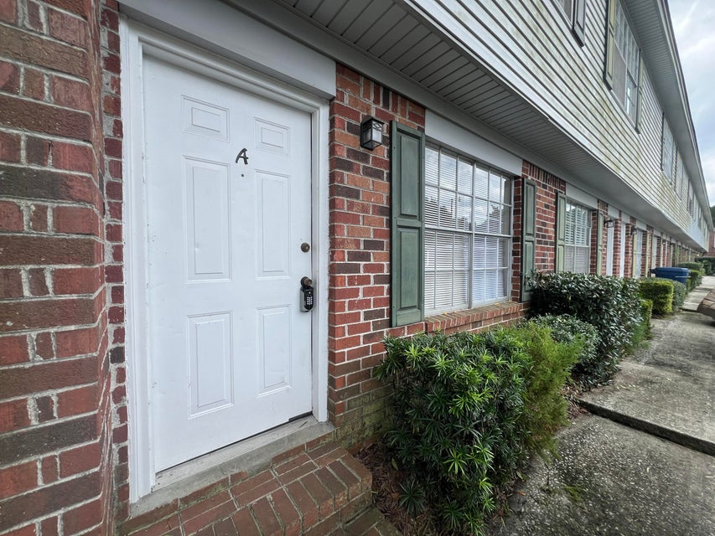
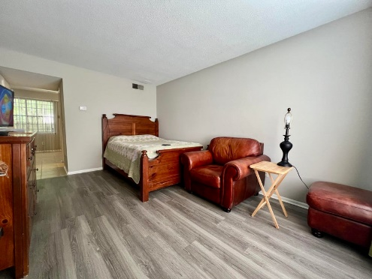
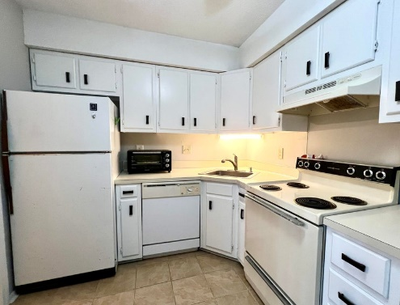
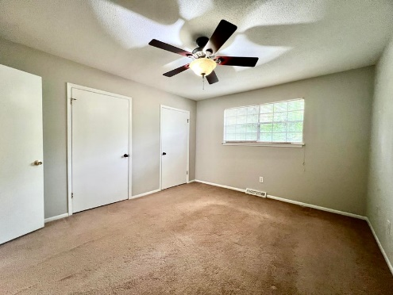
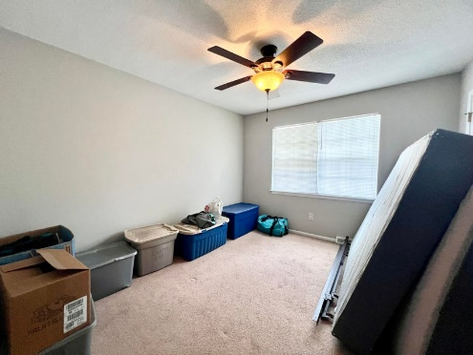
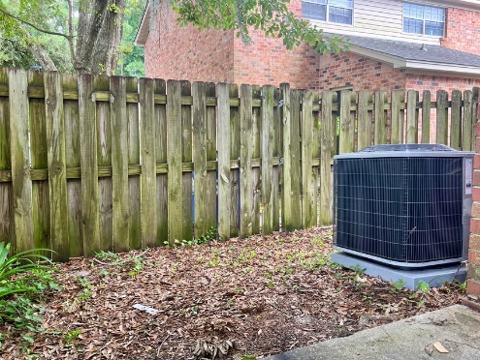


519 Parkdale Drive A
Parkdale | Charleston, SC 29414 | MLS# 24021039 | $200,00
West Ashley! Great Primary or Investment Property
This clean end unit condo will make a great starter home or investment property. Great location off Savannah Hwy. Minutes to 526, downtown Charleston, schools, hospitals, shopping and beaches! This unit received new flooring down stairs and was painted 6 months ago. There is a new HVAC unit that was installed in 2023 and a new water heater in 2024! Exterior Maintenance is covered by the regime which includes the roof.
Kelly Rozier
(843) 209-3129
kellywrozier@gmail.com
Brand Name Real Estate
4 Carriage Lane Suite 106
Charleston, SC 29407

