Slide 1


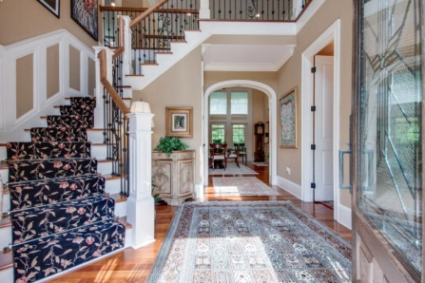
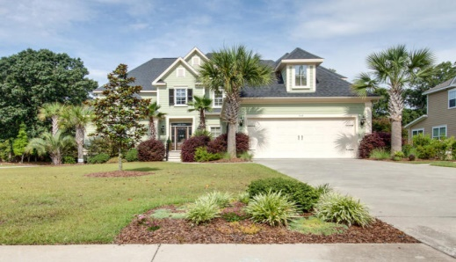
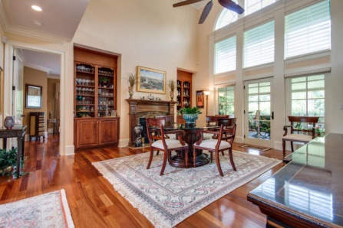
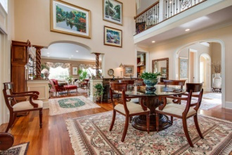
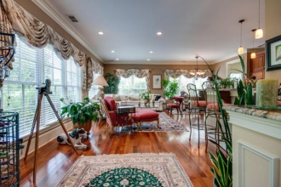
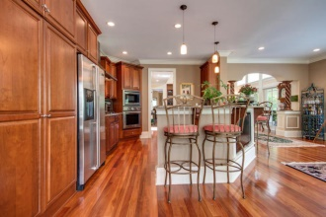
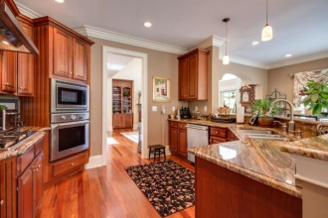
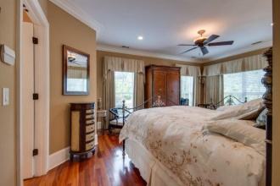
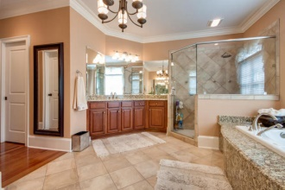
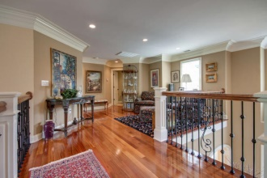
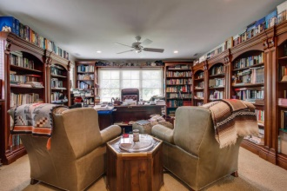
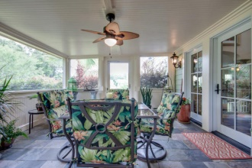
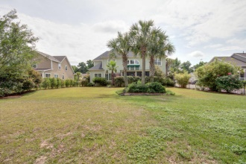


Custom Luxury Home Close to Downtown!
519 Rainsong Drive
Island Shores - Charleston, SC 29412
MLS# 15015517 - $705,000
The First Luxury Home Custom Built by the original developer of Island Shores. Close to downtown on James Island.
The home has it all and sits on two lots allowing for an expansive back yard, large enough for a Pool and more! See photos this home is truly exquisite and has many extras.
Largest Lot in Island Shores, an additional lot was purchased with this house it is now one lot. If you are looking for a Luxury showplace close to downtown Charleston, don't miss this one!
They have done many things since the purchase. The pantry in the kitchen was $5,000 to install. Each shelf holds 100 lbs.
Garage Door is brand new, $3k and the inside and outside were recently painted. All back yard landscape was added by this owner and the wrought iron fencing ran close to 8k.
Custom remote blinds in the family room to cover wall of windows.
Jan M. Miller, REALTOR
jan.miller@goldenbearrealty.com
www.GoldenBearRealty.com
Golden Bear Realty | 654 Coleman Blvd, Suite 100 | Mt Pleasant , SC 29464
Cell (843) 345-9719 | Office (855) 352-9088 | Fax (561) 721-3311

