Slide 1


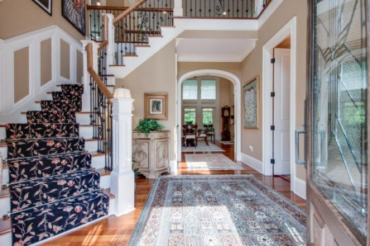
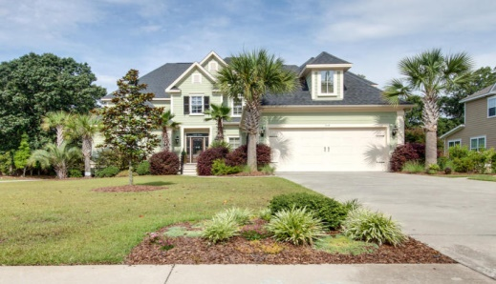
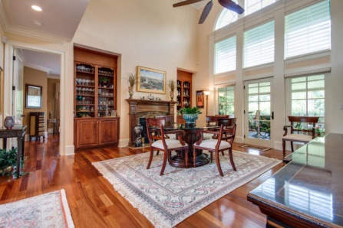
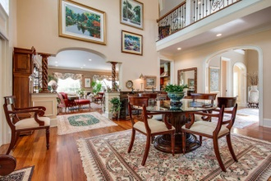
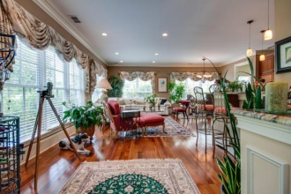
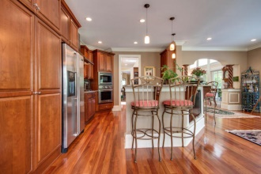
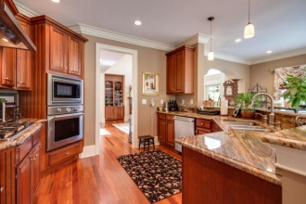
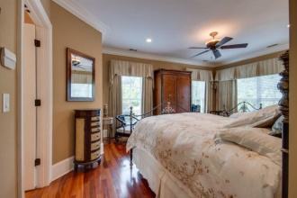
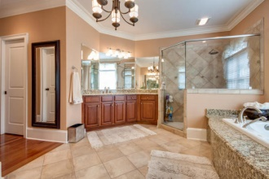
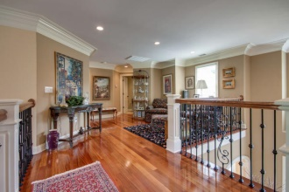
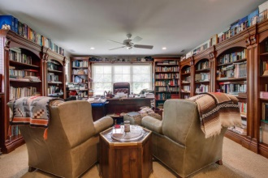
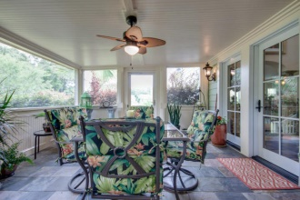
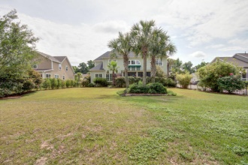
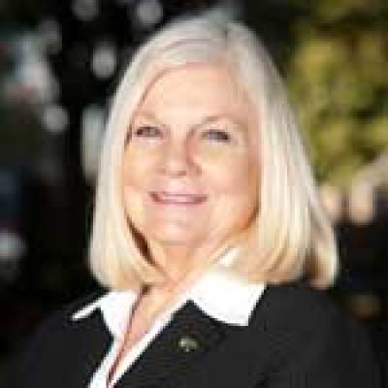
MUSC Buyers Must See!
519 Rainsong Drive
Island Shores - Charleston, SC 29412
MLS# 15015517 - $699,000
According to Google Maps, via James Island Connector, this Luxury Custom Home is 5.5 miles from MUSC (11 minutes travel time)
The First Luxury Custom Home in Island Shores. Built by the original developer. It is Truly exquisite and has many extras. A real showplace, CLOSE TO DOWNTOWN Charleston, don't miss this one! Could easily be 5 bedrooms, bonus room used as exercise area. Master Suite is DOWNSTAIRS, all other bedrooms are up. A room suitable for an office or music room, with a private entrance near the garage, is also a plus! No other luxury living this close to downtown!
Largest Lot in Island Shores, on double lot. Additional LOT is subject to HOA approval for subdividing, if buyer prefers or plant lots of trees and have a Sprawling Sanctuary just outside of the city! Easy to see, don't let your clients who want a short commute to downtown miss this one!
Jan M. Miller, Broker Associate
jan.miller@goldenbearrealty.com
www.GoldenBearRealty.com
Golden Bear Realty | 654 Coleman Blvd, Suite 100 | Mt Pleasant , SC 29464
Cell (843) 345-9719 | Office (855) 352-9088 | Fax (561) 721-3311

