Slide 1
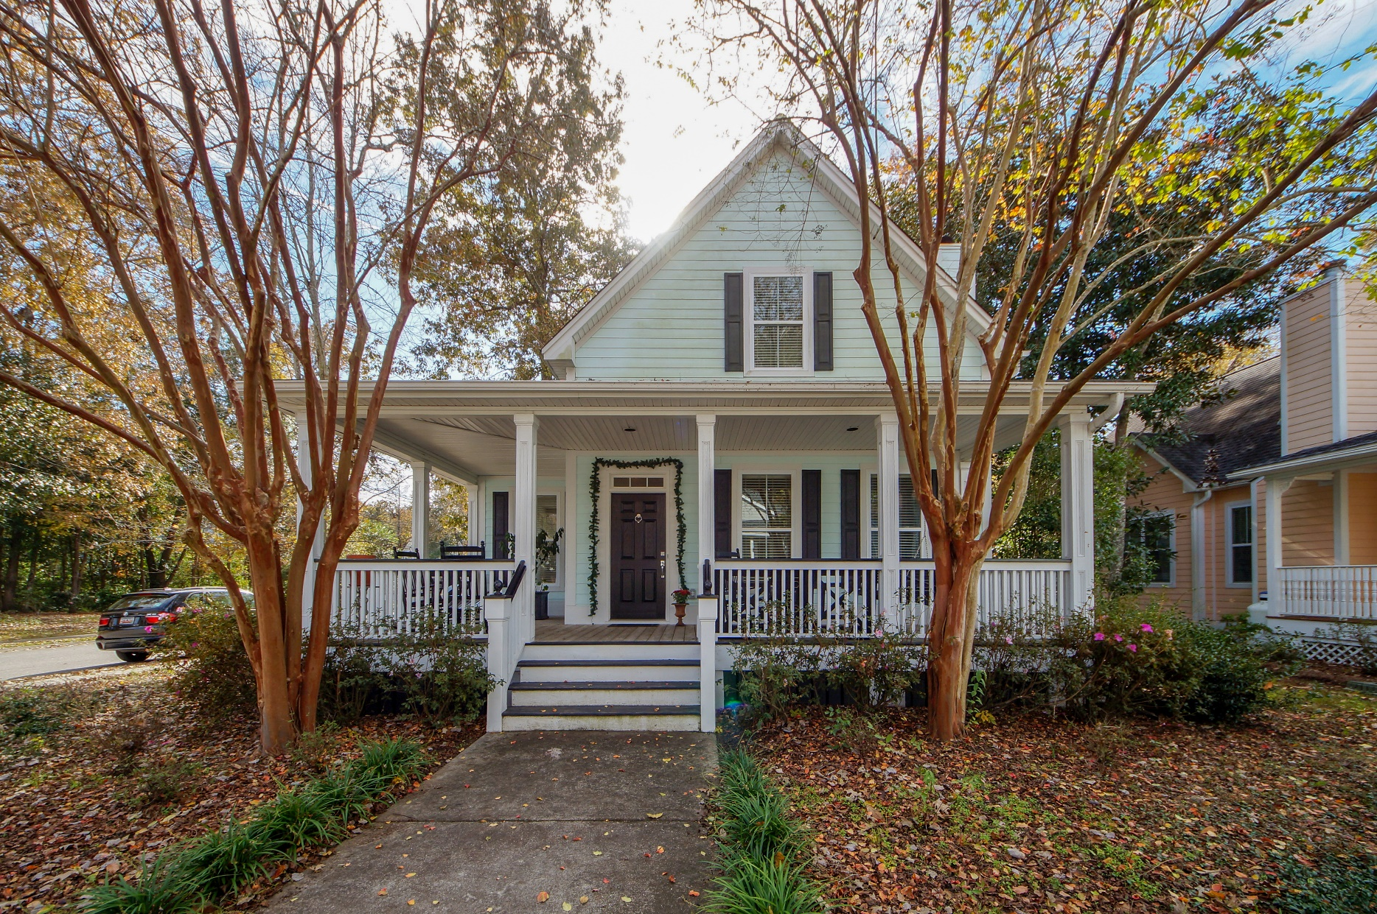
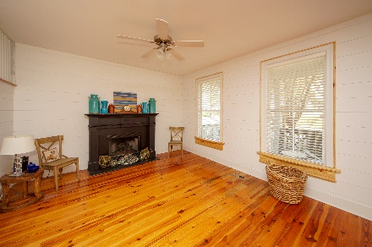
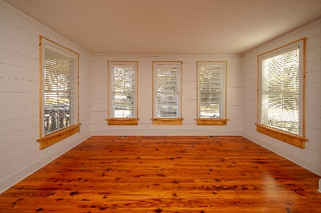
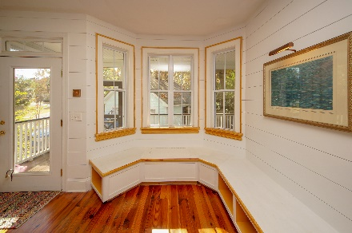
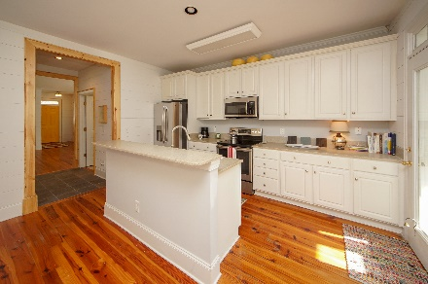
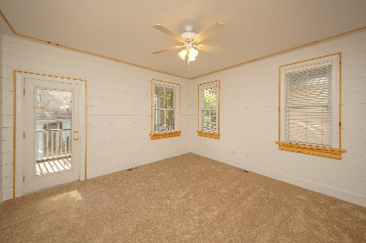
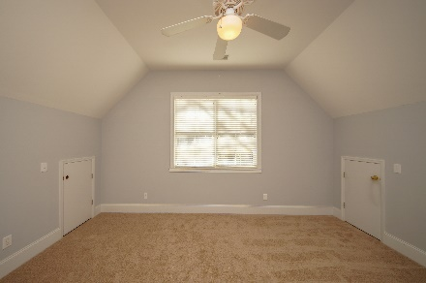
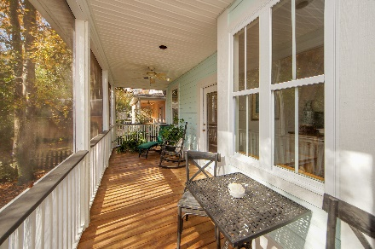
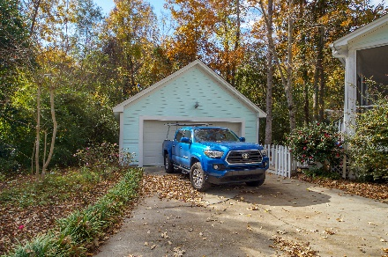


$5,000 Price Reduction!! $2,000 Buyer's Agent Bonus Limited Time!
519 Shem Butler Court Schieveling Plantation | Charleston | MLS# 18032447 | $343,000
LOVELY LowCountry home in a scenic neighborhood with an avenue of oaks that welcome you. Do you love SHIP LAP? This owner has installed ship lap in the Family Room, Dining Room, Butler's Pantry, Kitchen and Master Bedroom/closet!! It is amazing! NEW stainless appliances in the kitchen with a bay window seating for the eat-in kitchen area. Newly refinished Heart of Pine wood floors throughout most of the main areas and up the stairs. Master BR is DOWNSTAIRS! Large and inviting with beautiful jetted/soaking tub and separate shower in master bath. Double vanity and tile floor. Private toilet room. Master BR has a huge walk in closet with ship lap on the walls in it! Back to the Family Room with gas fireplace that is open to the Dining Room - open and spacious for entertaining.
Susan Weeks
(843) 813-0495
susanweeksdesign@gmail.com
www.agentownedrealty.com
AgentOwned Charleston Group
902 Savannah Hwy
Charleston, SC 29407-7802

