Slide 1
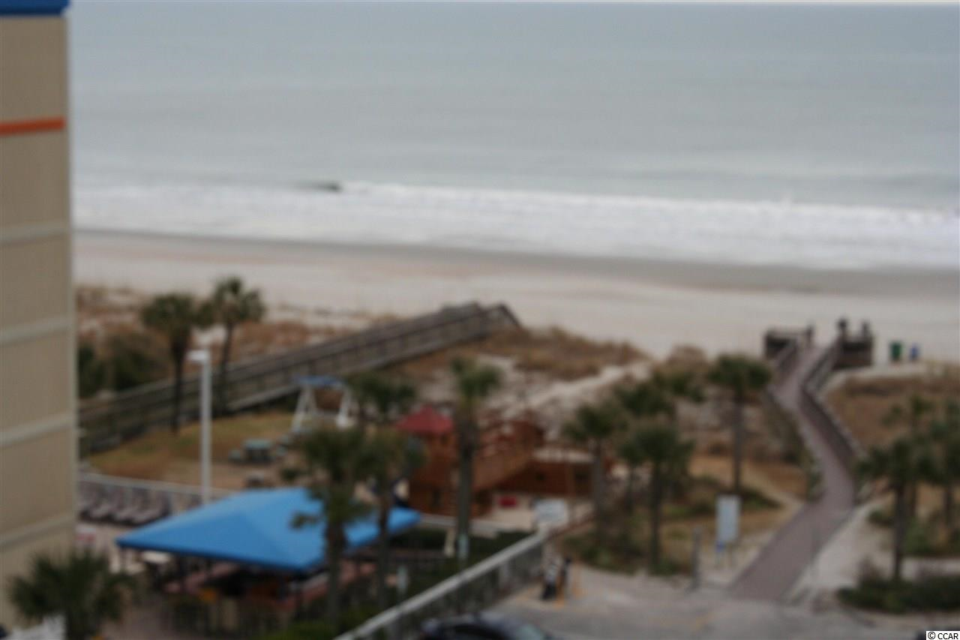
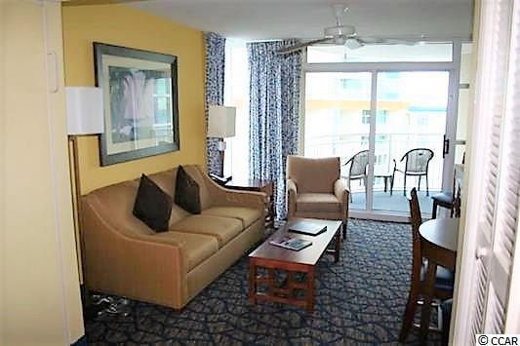
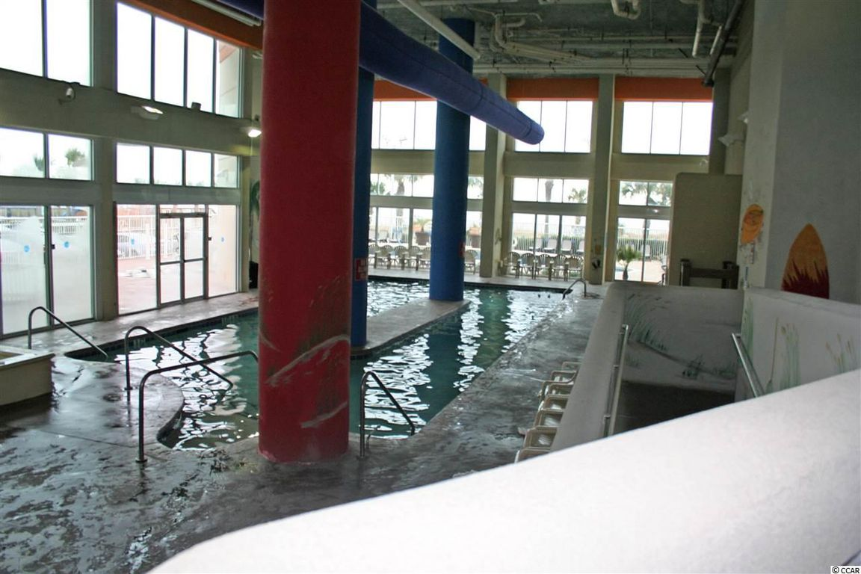
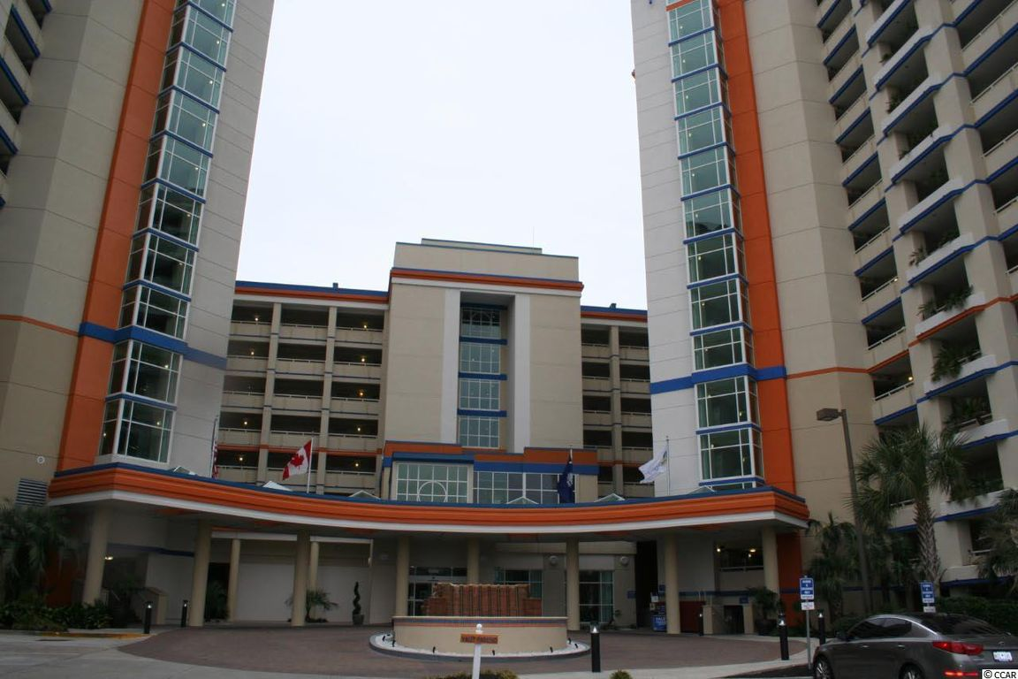
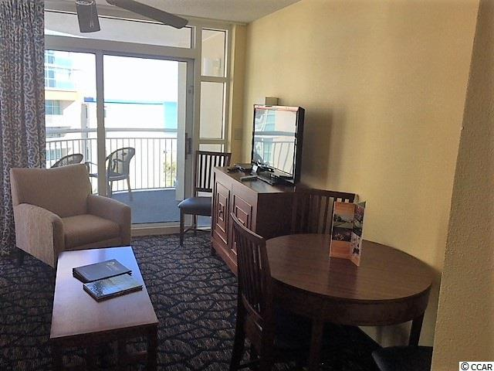
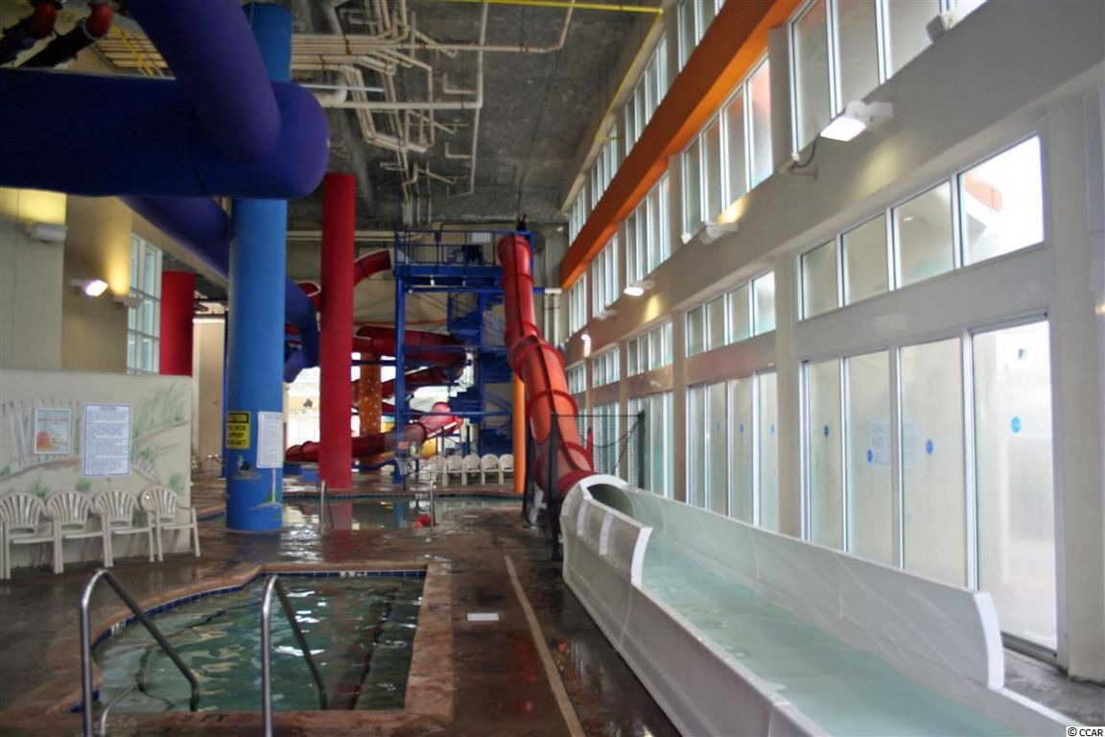
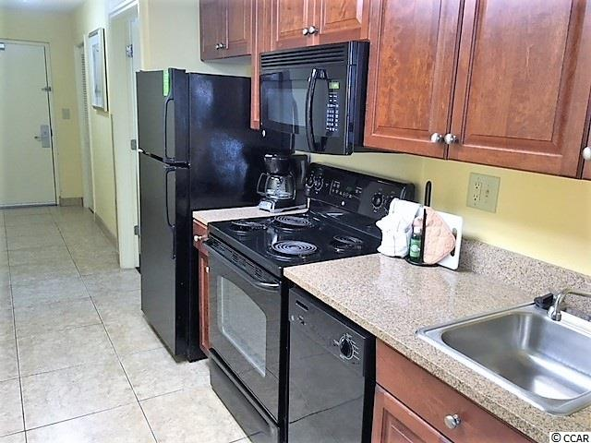
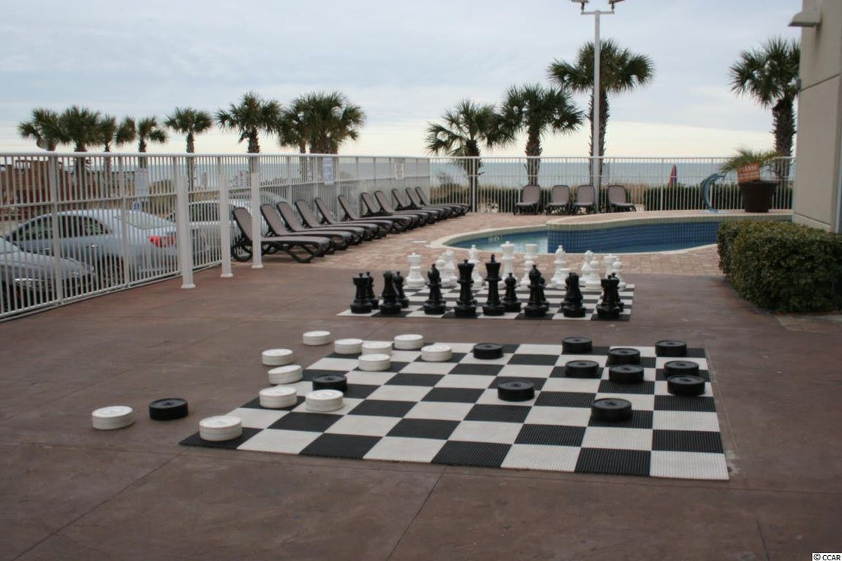
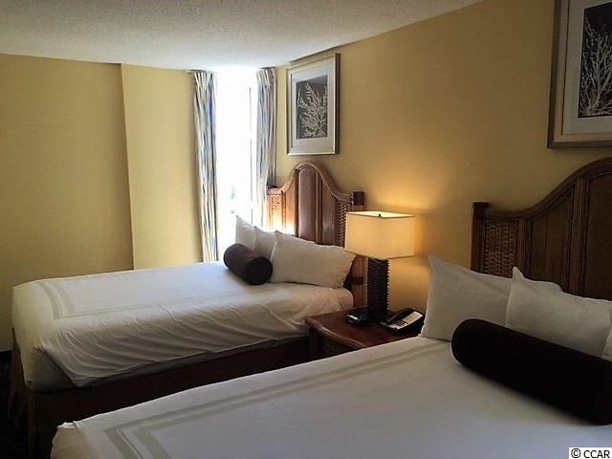
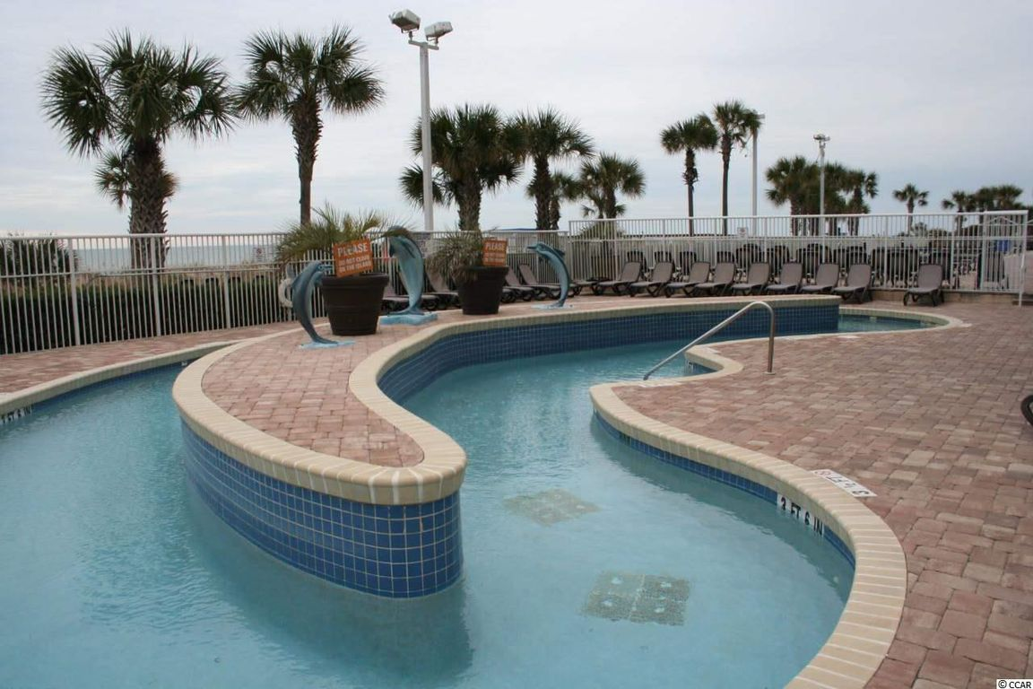
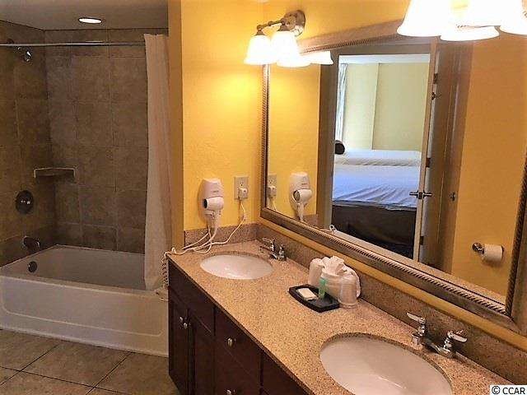
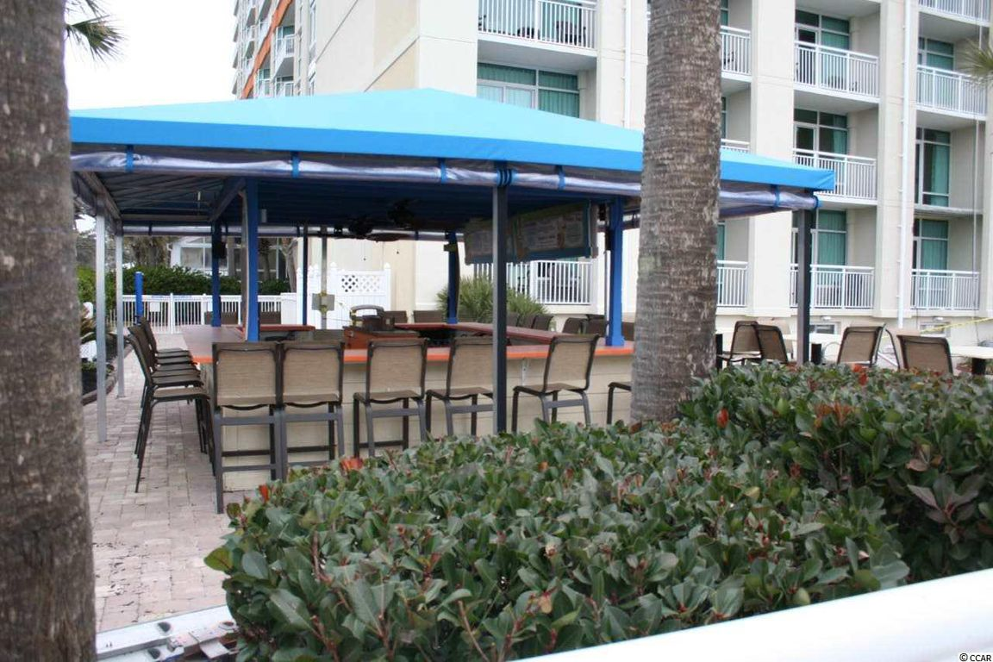
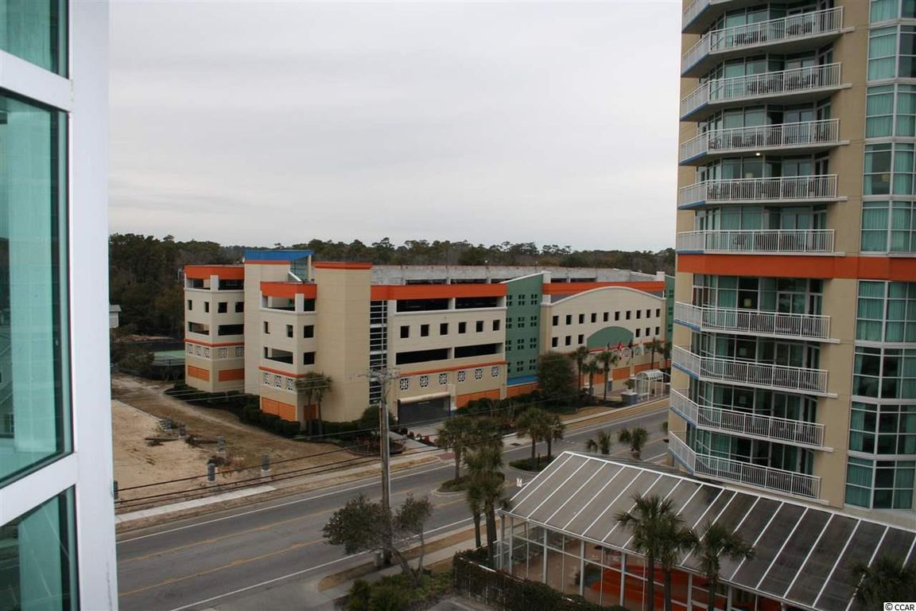
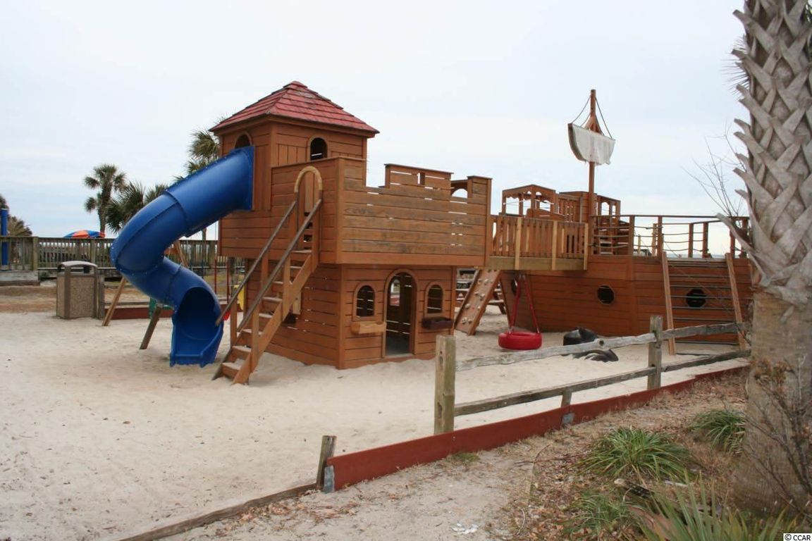


Oceanfront Condo
5200 N Ocean Blvd. N #631
Myrtle Beach, SC 29577
MLS# 1805466 - $197,900
1 Bed | 1 Bath | 701 sqft
Terrific views of the beach and ocean from this beautiful furnished and upgraded one bedroom angle view ocean condo located in a topnotch oceanfront building in the northern section of Myrtle Beach, SC. This spacious one bedroom corner end unit features extra windows, two queen size beds, a Murphy bed plus sleeper sofa, and can easily sleep eight. The upgraded interior is nicely furnished with several TV's, a washer and dryer, a spacious bath area with double sinks, and a full size kitchen comes granite counter tops, dishwasher, full size refrigerator, range with oven, and a microwave. The amenities in the Dunes Village Resort and Dunes Village PH II are second to none featuring two indoor water parks, several pools, lazy rivers, hot tubs, kids splash areas, plus four indoor waterslides and more. There are also two restaurants on site and a coffee shop. Terrific rental income is a plus for the investor or your family when not using the unit for family enjoyment.
Priced to sell. Hurry!
Jim Spring
REALTOR®
(843) 504-6308
jimspringrealestate@gmail.com
The Carolina Agent Group
1240 Winnowing Way Ste 102
Mount Pleasant, SC 29466
www.carolinaagentgroup.com

