Slide 1
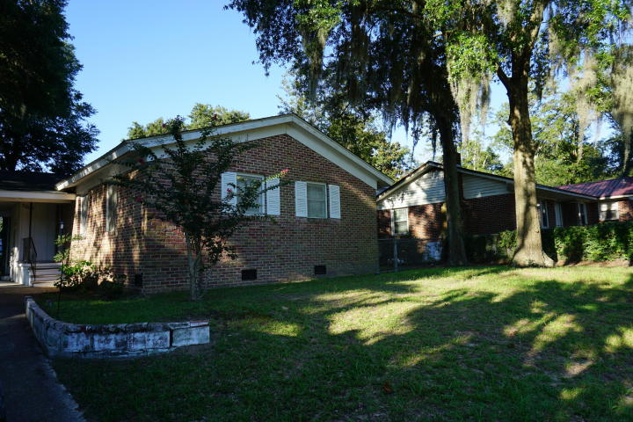
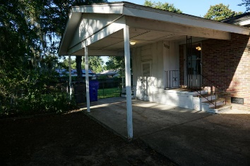
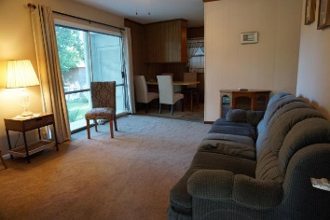
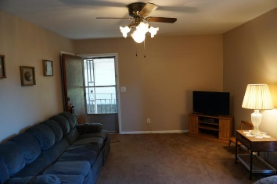
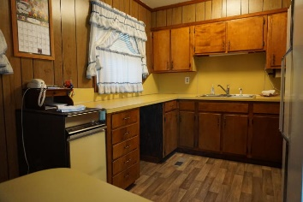
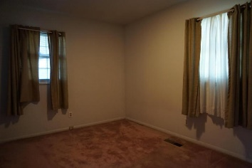
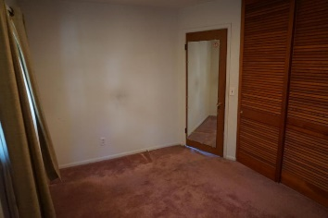
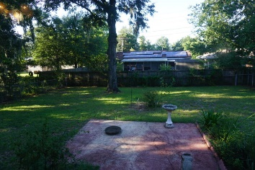
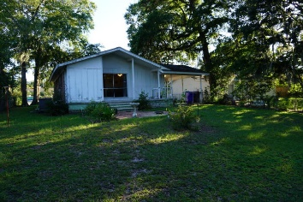


5202 Dorchester Road
Oakridge Estates ~ North Charleston, SC 29418
MLS# 18023974 ~ $154,900
Open House Lunch ~ Friday, Oct 3 from 11 - 1
Handyman Special… Bring your hard hats!
Motivated sellers!!
Charming 3 Bedroom, 1.5 bath single-story Brick Ranch home located in Oak Ridge Estates. Centrally located near I-26, Military Base, Boeing, Bosch, shopping and restaurants. Has fenced in back and side yard. Family room has sliding doors that leads out onto the deck and beautiful patio and back yard. In X Flood Zone. Single car garage Central heat Air and Gas heat. Ceilings are smooth. Home is eligible for the PATH Mortgage Program which offers 100% financing, 30 year fixed rate, NO PMI, credit score 620. DTI 43%
Bonnie Dickson
864-219-1674
bonnie.dickson@gmail.com
HomeGate Real Estate
4000 S Faber Place Dr Ste 300
Charleston, SC 29405

