Slide 1
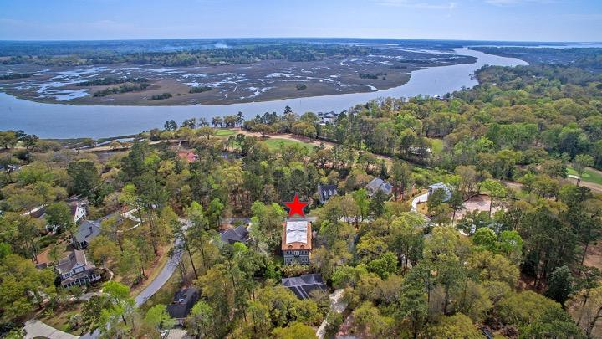
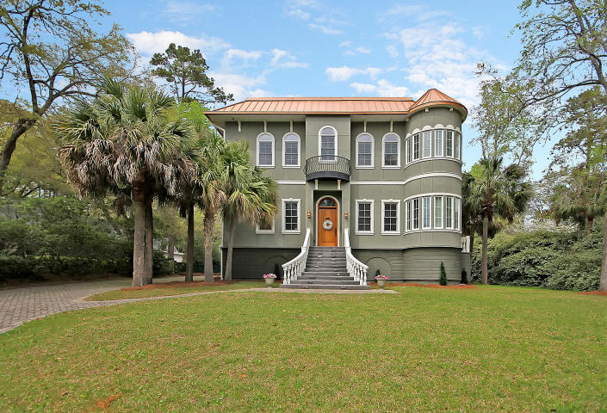
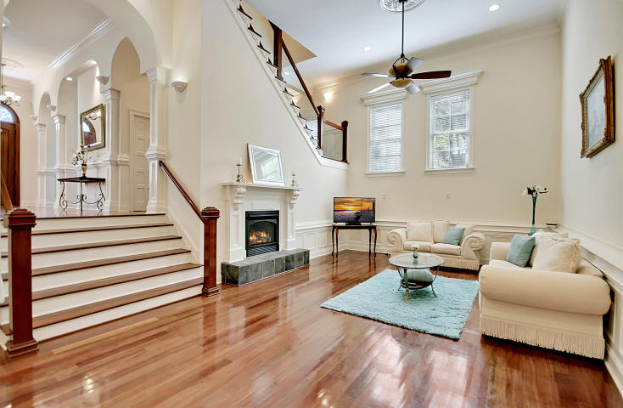
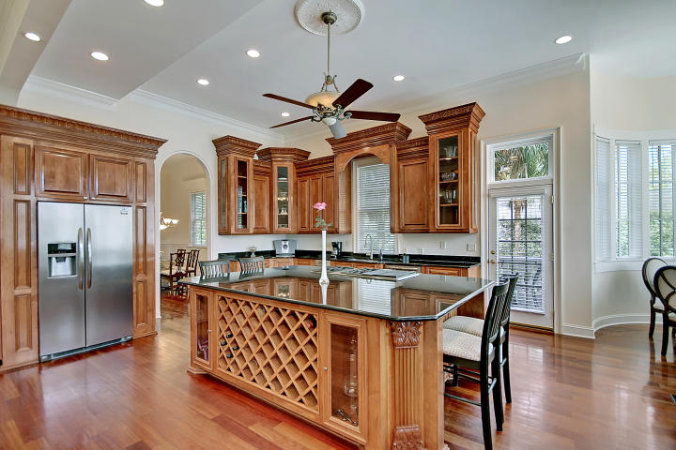
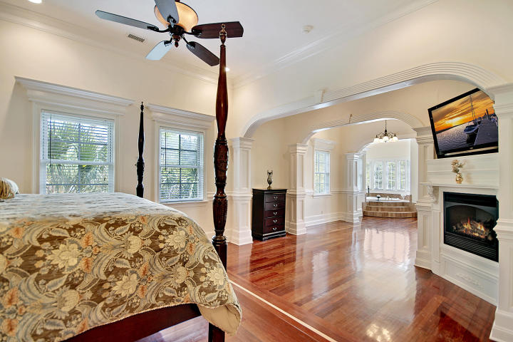
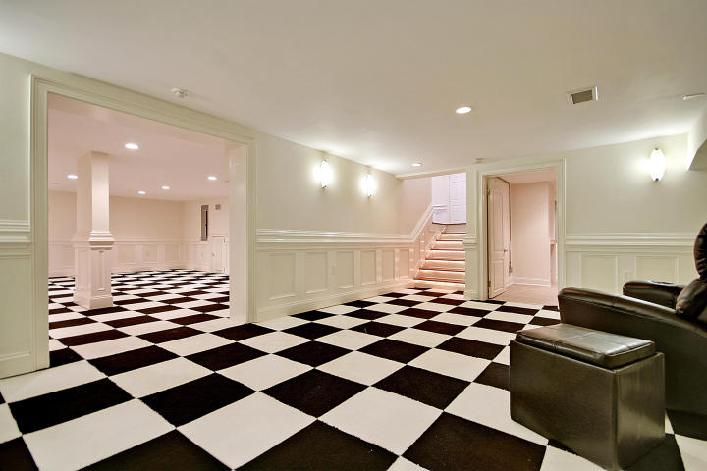
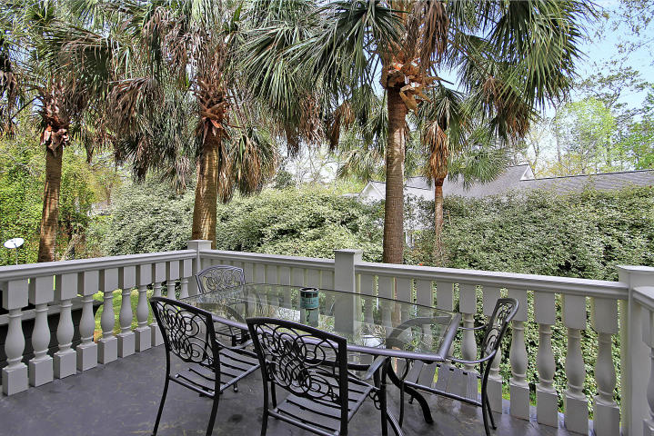
Great Downtown Investment Opportunity
Price Reduced!
5204 Oak Cove Lane Stono Ferry ~ Hollywood, SC 29449 ~ MLS# 18008714 ~ $799,999
Have you ever imagined what it'd be like to live in your own fairy tale castle? Have you dreamed of waking up in a home that's fit for a King and Queen? Your dreams can come true with this stunning, unique masterpiece in Stono Ferry! Known in the community as ''The Castle,'' this majestic 6-bedroom home is ideal for entertaining and mingling with family and friends. This home boasts large oversized bedrooms, an elevator, a 4+ car garage with loads of storage space, a game room, a media room and a mother-in-law/guest suite on the third floor. Two home offices are perfect for the working couple or the studying at home student. The chef in your family will enjoy cooking in the gourmet kitchen complete with a large center island and built-in wine storage. Enjoy your morning coffee or a glass of wine in the evening on the veranda while enjoying the privacy of your back yard. This home is quite simply a work of art that must be seen in person to be fully appreciated!
Stono Ferry is an equestrian and golf community with two polo fields, a junior Olympic swimming pool, a pavilion, three tennis courts and a clubhouse that serves breakfast and lunch daily. Stono Ferry is also home to the annual Steeplechase of Charleston event each year.
Book your viewing today!
Paige Rhodes 843-830-3281 paige@mattoneillteam.com
Ben Laaper 843-642-3546
ben@mattoneillteam.com

