Slide 1
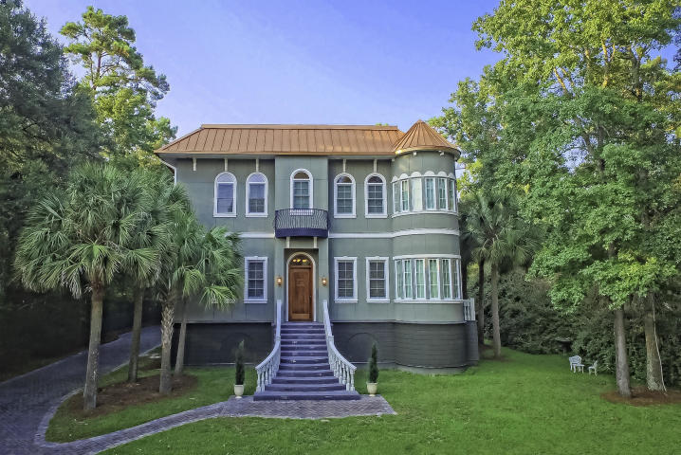
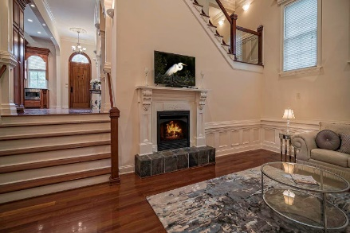
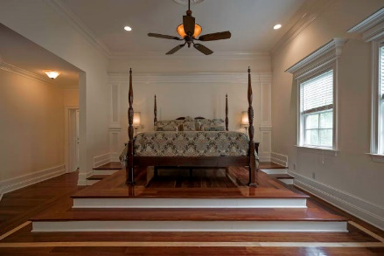
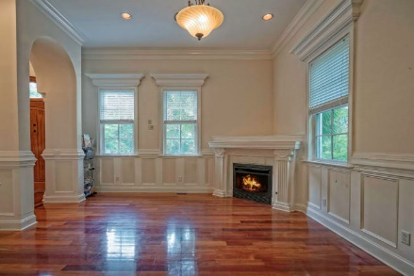
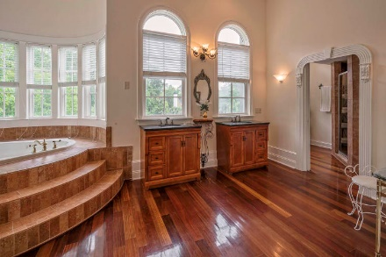
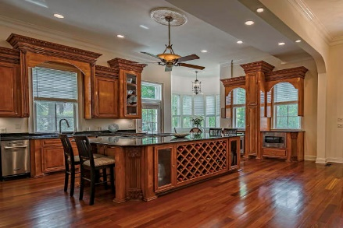
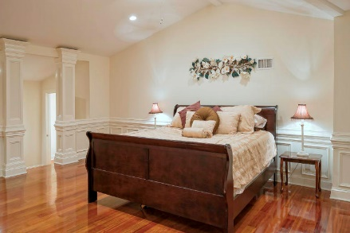
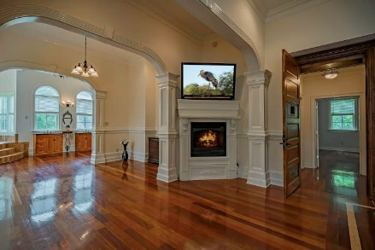
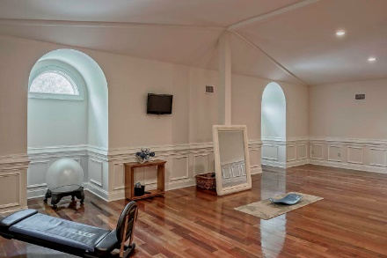
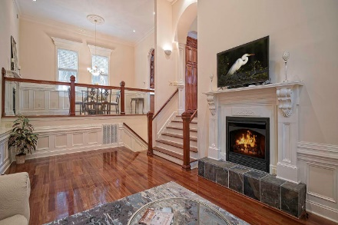
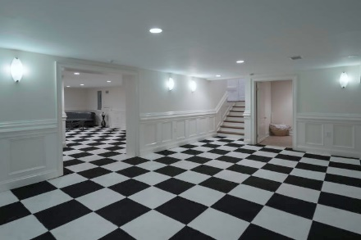

Luxury Living at Stono Ferry
Price Reduced
For Quick Sale
Open House Saturday 12-3
5204 Oak Cove Lane
Stono Ferry ~ Hollywood, SC 29449 ~ MLS# 19014247 ~ $749,999
This luxuriously appointed 6360 SF custom estate is ideally located within the gated community of The Plantation at Stono Ferry. This classically inspired dream home features artesian crafted and exquisitely designed interior spaces that invite grand scale living and entertaining. Featuring five plus bedrooms, and additional options for playrooms, nurseries, media rooms, and offices, this custom home is within minutes of local beaches, the airport and downtown Charleston. Whether you enter from the four car garage or up the beautiful stone stairway and through the massive hardwood castle door, the feeling is the same...WOW! Once inside, the main level includes a soaring 16 ft ceiling, crown molding, wainscoting, a formal dining room, gourmet kitchen, den, and great room. The kitchen boasts beautifully handcrafted cabinetry that towers eleven feet high over the massive granite center island with ample built-in wine storage. The kitchen also features a lovely eat-in area with lots of natural light, and a door off the kitchen opens up to the veranda. Stroll down into the great room and feel the warmth of your fireplaces as the flames glisten off the premium rosewood flooring which adorns three stories of this finely crafted home. The grand staircase with glass railing connects to three levels of the home, and a 4 stop elevator can whisk you from the garage straight to the master suite. The master suite features colossal archways, detailed molding work, a fireplace, and the walk-in master closet/room can accommodate the most diverse wardrobe imaginable. A huge private workout room neighbors this extraordinary dressing room. At the far end of your master suite, you'll find the master bathroom with a beautiful sunken jetted tub, a dual vanity, and a large step-in shower. The third floor houses the estate's second master with room for a fifth bedroom, office, media room, playroom, or flex area. All the spacious bedrooms in this magnificent home include walk-in closets.
The build quality and workmanship are out of the ordinary for a home in this price range. Whether it's the 2x6's and foam insulation throughout, the roof with three full layers of Hydrostop, or the four car garage with 20' ceilings that could accommodate innovative two-tier car parking, this home is unique.
Katie Wishneff kwishneff@mattoneillteam.com 843-870-8784

