Slide 1
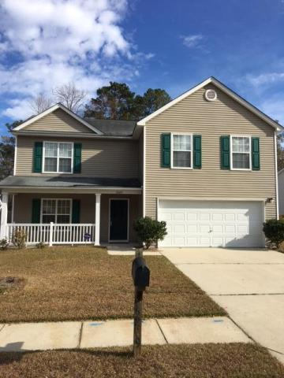
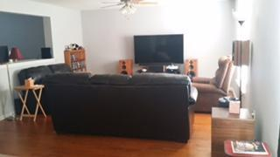
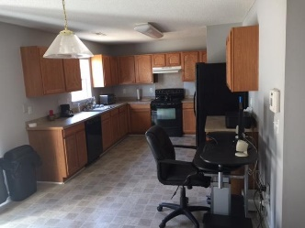
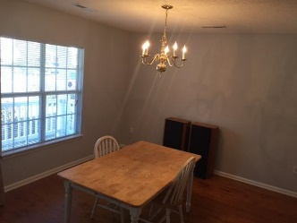
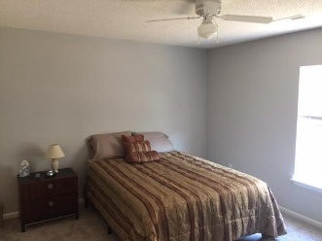
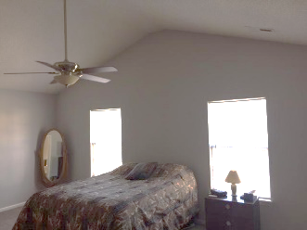
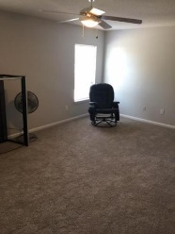
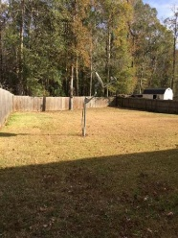
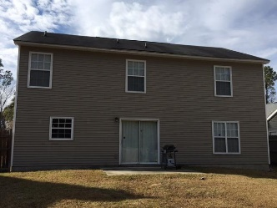

5209 Carlisle Court Wescott Plantation Summerville, SC 29485 MLS# 16030972 $219,999 3 Bedrooms | 2½ Baths | 2,160 sf
Owner Transferred...
His Loss is Your Gain!
Did you ever hear the phrase, "Your loss, my gain?" Well, this home is your gain! Owner has been transferred and has to sell this beautiful home. Wescott Plantation is the address of this 3-bedroom home with 2.5 baths, a large bonus room and a lot of work done in the few months since he's owned this dream home. New hardwood floors, carpet, door knobs, ceiling fans, freshly painted and a few other updates. The large fenced-in yard and private cul-de-sac give you so much privacy. A great family room with a separate dining room makes this home a wonderful place for entertaining your family & friends. Upstairs are three large bedrooms and a fantastic loft for the kids to watch tv, do homework or just have their own space! Wescott Plantation and this neighborhood is a desirable area and home of the award winning Fort Dorchester High School. Come see!
Susan & Greg Day
843-900-0477 | 732-757-2904 charlestonbyday@gmail.com
www.charlestonbyday.com
AgentOwned Realty Co. Premier Group, Inc. | 824 Johnnie Dodds Blvd | Mt Pleasant, SC 29464

