Slide 1
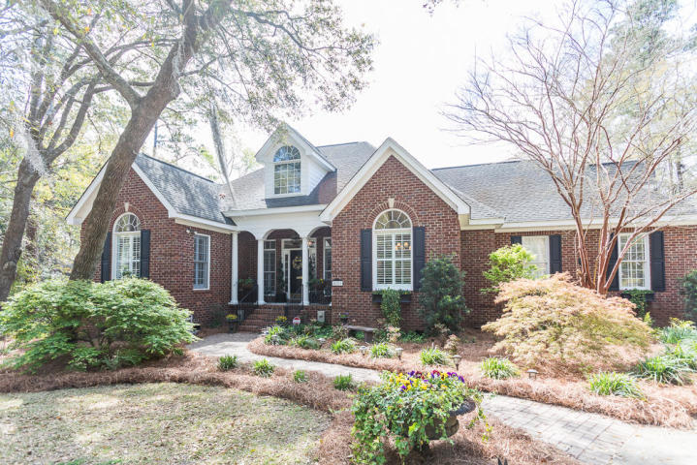
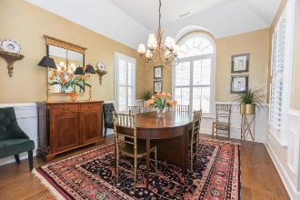
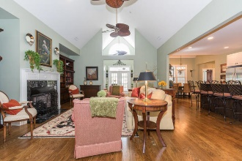
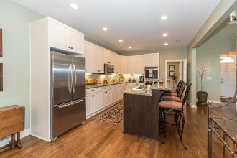
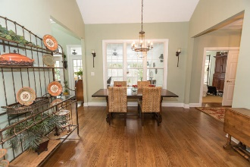
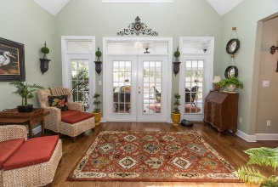
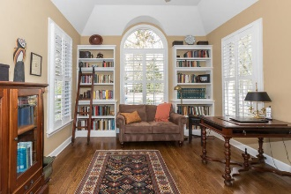
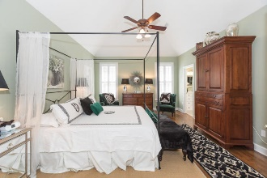
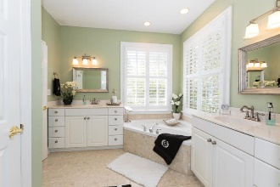
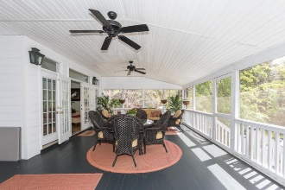


5209 Myrtle Cove Lane
Stono Ferry
Hollywood, SC 29449
MLS# 19008864
$549,900
Welcome to an impeccably well maintained all brick 2 car side entry garage home in Stono Ferry. As soon as you enter this beautiful home you will notice the large foyer and cathedral ceilings and open floor plan. Family room with electric remote control fire place overlooks the sunroom and huge screen porch. Renovated kitchen with new cabinets, island, granite counter tops, sink, faucet and all new appliances. The owner's suite is tucked away in the back with access to the screen porch. Master bath has marble tile floors and a corner jetted tub. The 3 other bedrooms are on the opposite side of the house as are a full bath with marble floors and double sink and a half bath with a pedestal sink. There is a large game room and large storage closet above the garage. Plantation shutters throughout the house. This home shows better than new and model homes in the area. A copy of the lists of all the improvements of the house is on the kitchen counter with the listings information. The Stono Ferry community is located just 17 miles south of downtown Charleston and has two lighted tennis courts, pickle ball court, a junior Olympic size pool, pavilion, and play park. Stono Ferry is home to the steeplechase of Charleston horse races once a year. The links at Stono Ferry is an award winning 18 hole semi private golf course on the Stono River and intra-costal waterway. Membership is optional. The Links club and the community both offer several social events each year. Come and show this lovely home with a special touch.
Come And See This
Well Maintained Brick Home
Cathy Rosenblum
843-817-7869
crosenblum@comcast.net

