Slide 1
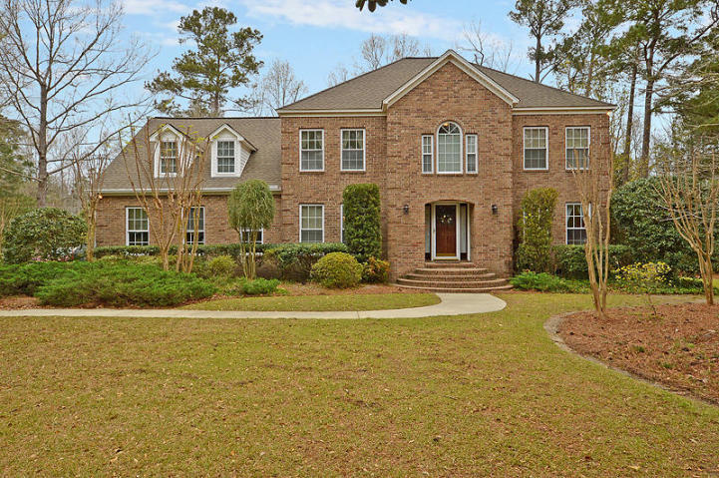
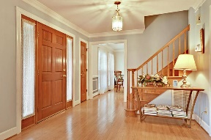
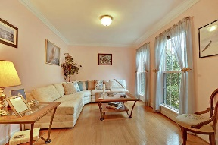
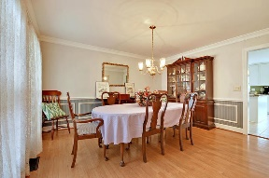
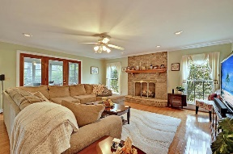
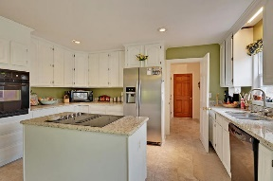
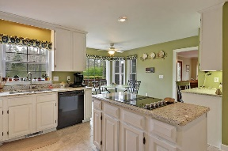
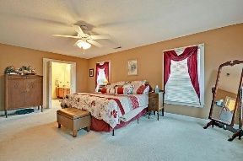
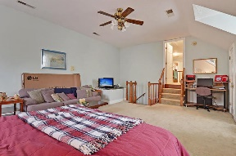
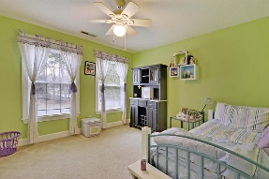
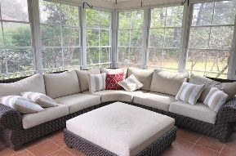
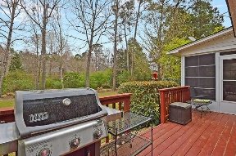
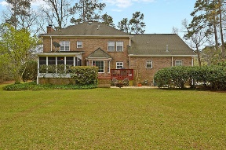


Summerville Walnut Farms Beauty!!
520 Barfield Drive
Walnut Farms
Summerville, SC 29485
MLS# 18007374
$399,000
4 Bedrooms | 2½ Baths | 3,070 sf
Lovely custom brick home awaits you in one of Summerville's most sought after neighborhoods, Walnut Farms! Situated on an almost one acre lot that is private and landscaped nicely, this home is ready for you to move in! Upon entering, your eyes will be drawn to the gorgeous wood floors. To your right, you have a large formal living room that could be used as an office as well. To your left, is the dining room which has ample space for entertaining. The family room is a great size complete with a fireplace and wet bar. Off the family room is a gorgeous sunroom that has tile flooring and lovely views of the backyard. Off of the sunroom is a deck perfect for grilling! The kitchen has been refreshed with new granite countertops, freshly painted cabinetry and new cooktop. There's a pantry, island, desk space and large eat in area. Off the kitchen you'll find the laundry room, half bath, garage access and secondary staircase. Head upstairs and you'll find the very large master suite. Off the master is a flex room that could be used as an office or nursery as well as a walk in closet. The master bath offers dual vanities, separate tub and shower. Back out in the hall, you'll find two more bedrooms as well as a full bath. At the end of the hall is the bonus room that could be a 4th bedroom. This room has tons of storage off of it and could be a media room or toy room. This home has it all, from the entire crawlspace encapsulation to the updated kitchen. Plus, being centrally located right off of Dorchester Rd, just a short drive to Bosch, Boeing, Palmetto Commerce Parkway, and serviced by the highly sought after Dorchester District 2 schools!
Come see this home today, you are bound to be impressed!
Larry & Kathy Mazalatis
Larry Cell 843-693-0529
Kathy Cell 843-693-0159
Office 843-871-9133
AGENTOWNED PREMIERE GROUP | 1800 TROLLEY RD | SUMMERVILLE, SC 29485

