Slide 1
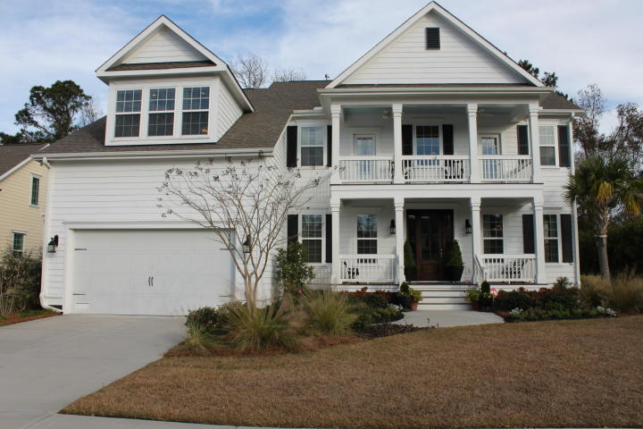
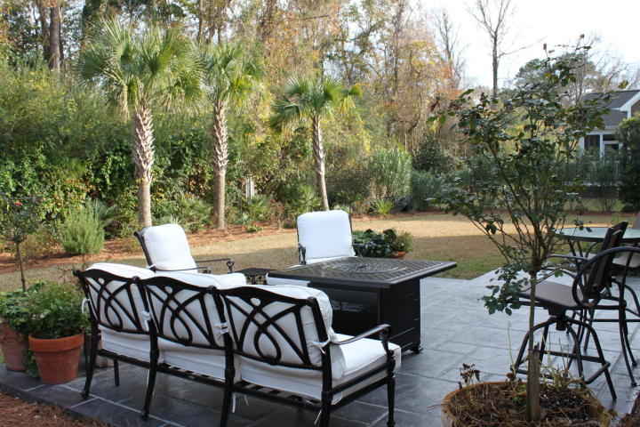
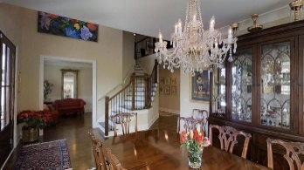
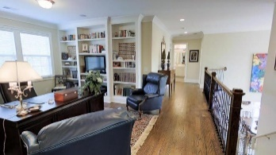
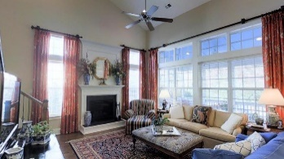
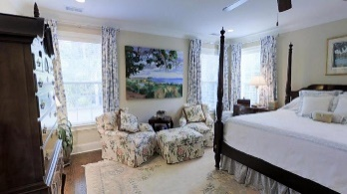
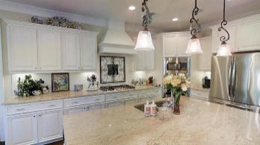
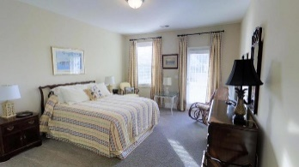
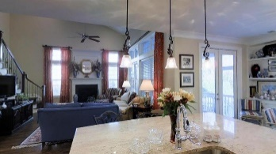
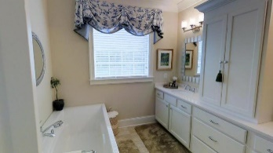
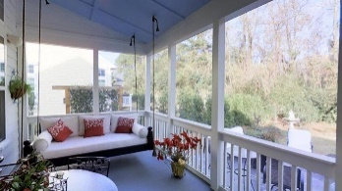
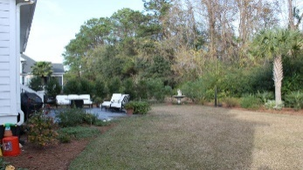



Beautiful classic two porch home on James Island close to everything
520 Rainsong Drive
Island Shores | Charleston
MLS# 16001269 | $649,000
5 Bed | 3½ Baths | 3,695 Sq Ft
CLASSIC FINE UPSCALE HOME with double front porch has it ALL!!! A two story foyer welcomes you into a gracious style of living with oh, so many upgrades!!! Pictures and words do not do this home justice so please take the 3-D virtual tour. Your new home is just minutes from shopping, James Island County Park, Folly Beach, downtown Charleston and the Riverland Terrace Boat Landing. This is the one you'd want to build, with the best upgrades & ''after move in'' improvements already done for you. The open layout flows uninterrupted which allows socializing between the kitchen, great room and screened in porch. Perfect for entertaining. Downstairs you'll find a separate living room/music room, formal dining room, and an incredible Gourmet Kitchen with all the fabulous features: 5 burner gas cook top, built-in microwave oven, convection oven, wall oven, matching refrigerator, wonderful easy-close upgraded cabinetry with granite countertops accented by tiled back splash. Pendant lights over the large island. Gas fireplace warms the great room on those chilly nights. Large master bedroom and bath, full size laundry room and powder room complete the down stairs. Upstairs you'll find 3 bedrooms, an open loft used as an office, bonus/ media/bedroom, and 2 full bathrooms. Hardwood floors throughout the first floor, upstairs hall and loft. Wood blinds throughout the house convey. The house has a Sonos Sound system in kitchen, living room, dining room, master bedroom, loft and screened porch. Each room has the ability to be controlled independently from the other. The media/bonus/ bedroom is pre-wired for surround sound. The yard has been professionally landscaped and has zoned irrigation system to include landscape lighting. It even has a gas line for the grill. Many GREEN features to include two tankless water heaters and Smart home technology. You can control many lights, alarm and heating and air by the touch of button on your phone. The crawl space is encapsulated and climate controlled. The garage has the Monkey Bars Garage storage system.
Charles Lent
REALTOR, AIC
843-864-6426
charles.lent@agentownedrealty.com
www.charleslentrealty.com
AgentOwned Charleston Group | 902 Savannah Hwy | Charleston, SC 29407-7802

