Slide 1
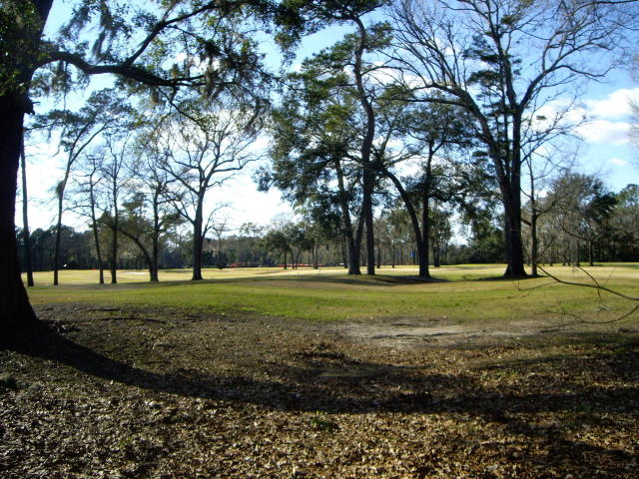
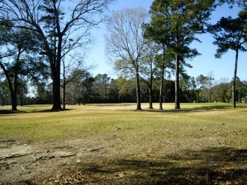
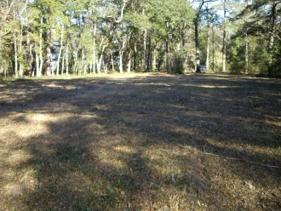
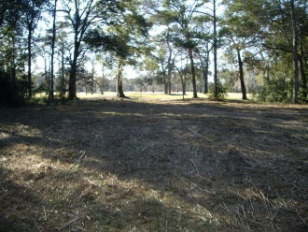
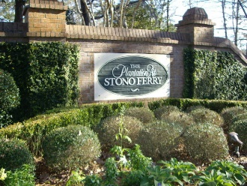
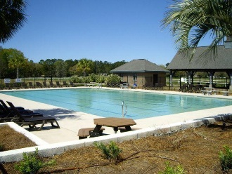
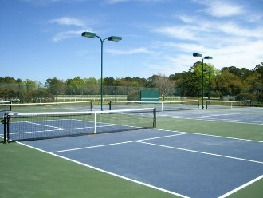


5213 Holly Forest Stono Ferry Hollywood, SC 29449 MLS# 19002973 $105,000
Come and build your dream home on this great golf course lot on a quiet cul-de-sac on Stono Ferry Plantation. This lot is already cleared and ready to build. This level lot backs up to the 10th fairway. Stono Ferry is a gated community with an 18 hole championship golf course, lighted tennis court, Jr. Olympic sized swimming pool, equestrian center, activities coordinator for events-meet and great, seasonal celebrations, children's events, and is surrounded by the Intra-Coastal Waterway. Historical Downtown Charleston is about 1/2 hour away and the local beaches are close by.
FULL ARCHITECTURAL PLANS FOR THE LOT ARE AVAILABLE WITH PREVIOUS APPROVAL BY THE HOA BOARD.
Thank you for showing.
Just Listed To $425,000
Build your Dream Home Along The Stono Ferry Golf Course
Cathy Rosenblum
843-817-7869
crosenblum@comcast.net

