Slide 1
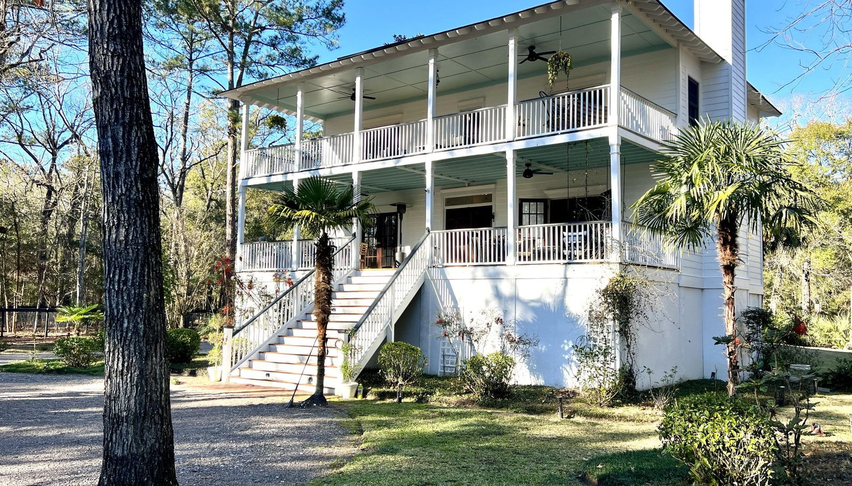
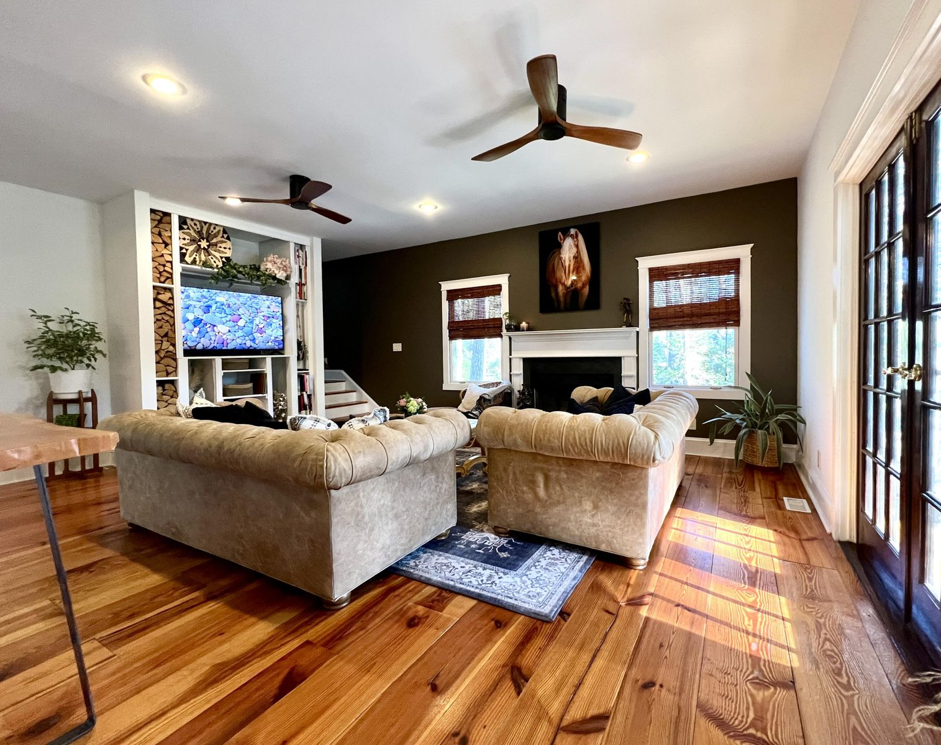
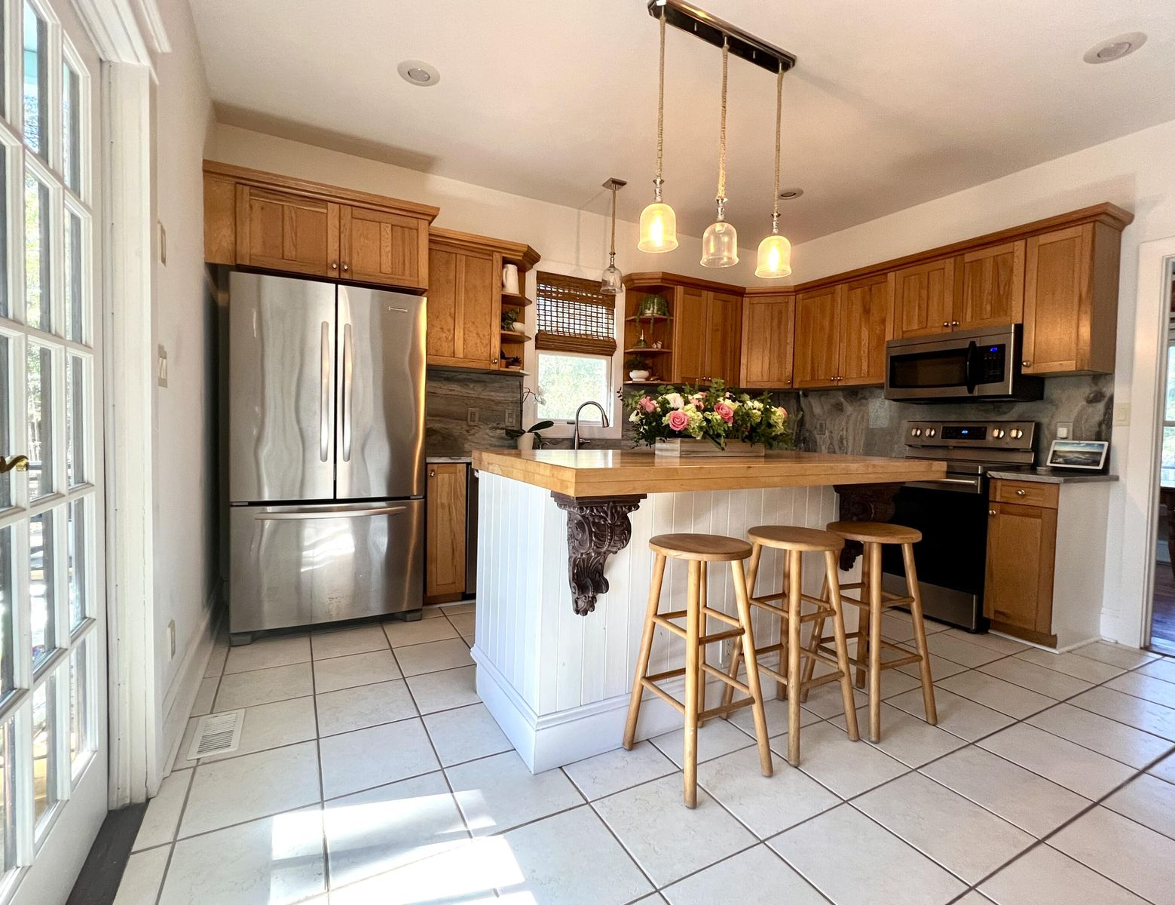
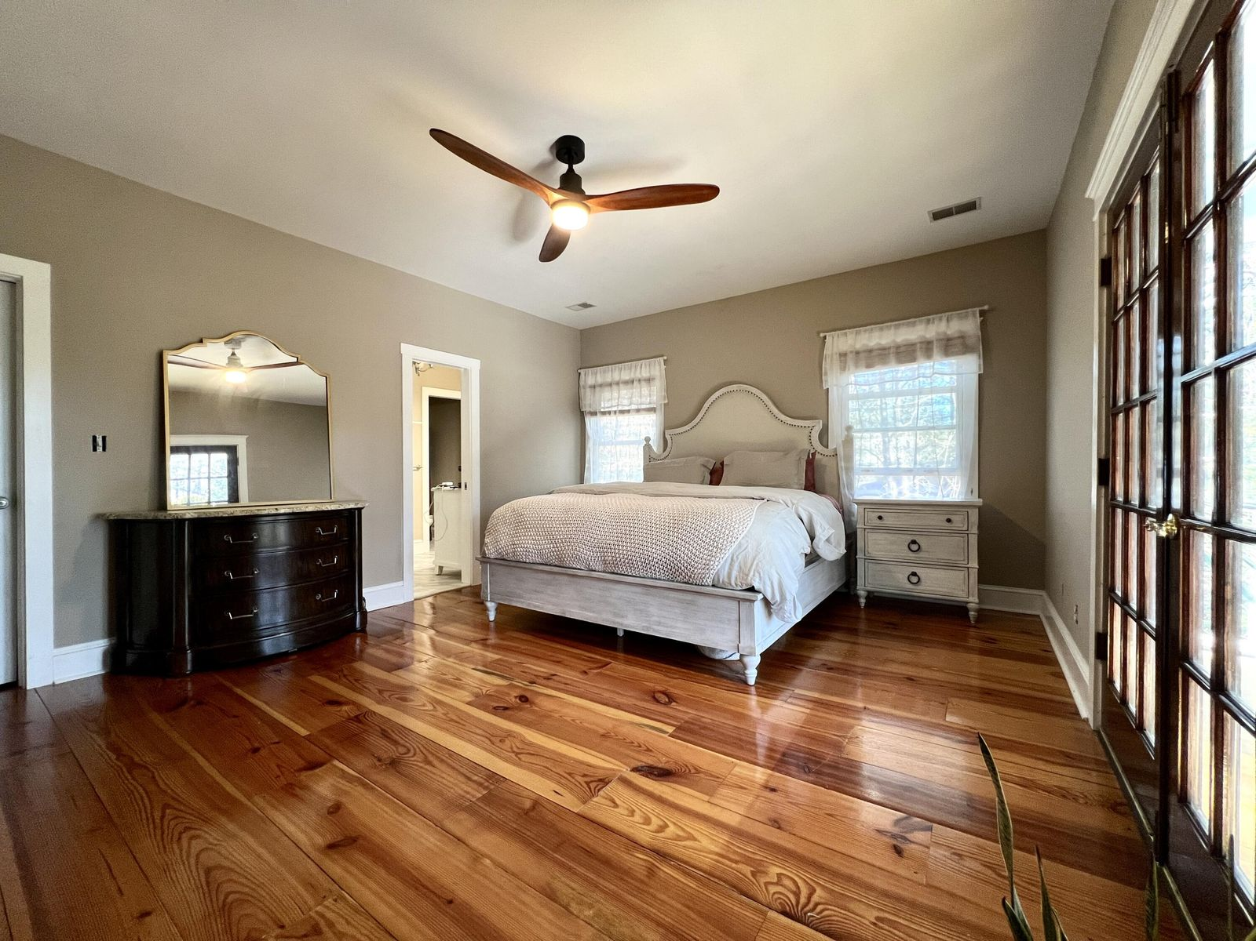
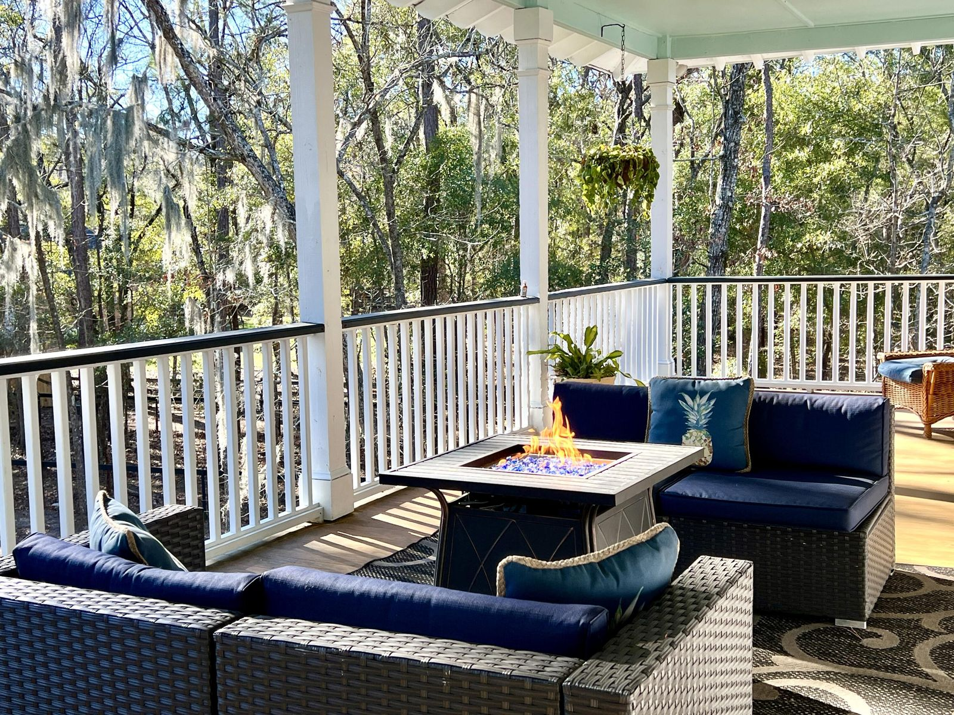
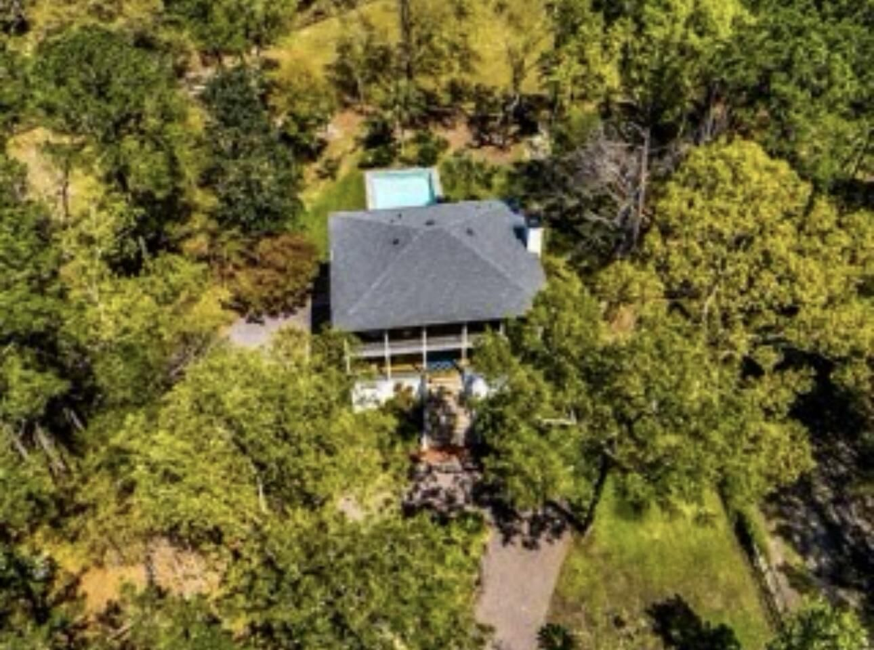
Open House Saturday from 11-2
5213 Whippoorwill Lane
Johns Island, SC 29455 | MLS# 24000314 | $1,399,000
This beautiful piece of property is a MUST-SEE! You can have it all in your own private equestrian sanctuary. Enter your private gate onto almost two and half acres of land, part of which is beautifully fenced for horses with a bridle path along the outer perimeter. Allow your horses to luxuriate in a bespoke 26x32 stucco barn with a central aisle and Dutch doors opening to three paddocks offering amble shade and Bahia grass for grazing. This beautifully kept smart home has plenty of charm including gorgeous wide plank heart of pine floors. Step out onto expansive front porches through French doors with your morning coffee and evening cocktails to enjoy the serenity of nature. And further enjoy your outdoor space in a saltwater pool, a sauna and ice bath (upon negotiation), a small yoga studio or art room, a full gym (upon negotiation, and a fenced garden. The home can also be sold furnished upon negotiation. Horse lovers please note that the property is only a fifteen minute drive to Mullet Hall Equestrian Center.
Shanel Pierce
843-779-5523 | shanel.homesales@gmail.com
Salmonsen Realty | 864 Lowcountry Blvd Ste B | Mt Pleasant, SC 29464

