Slide 1
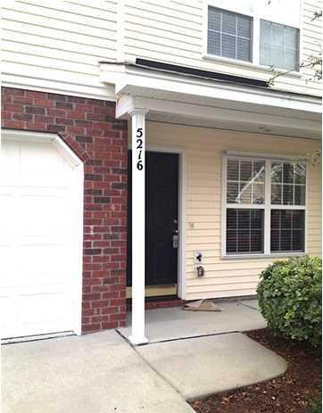
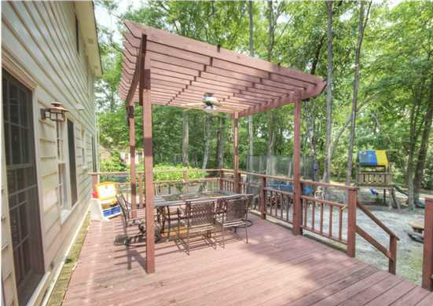
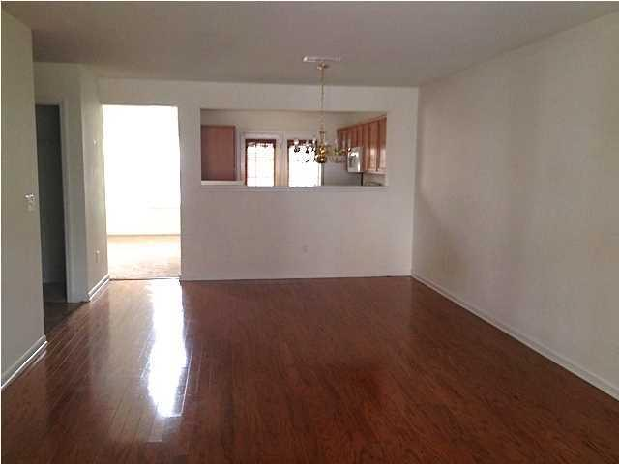
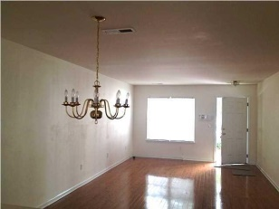
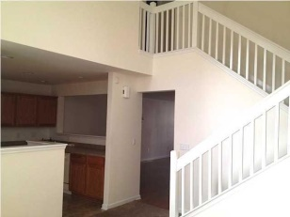
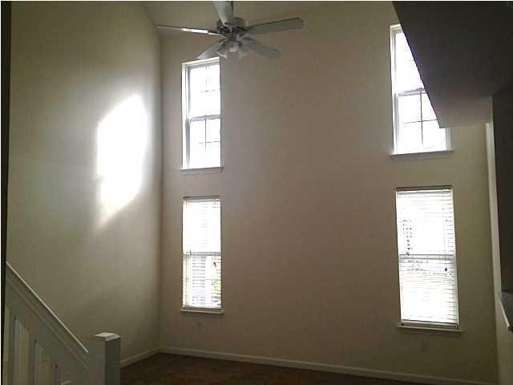
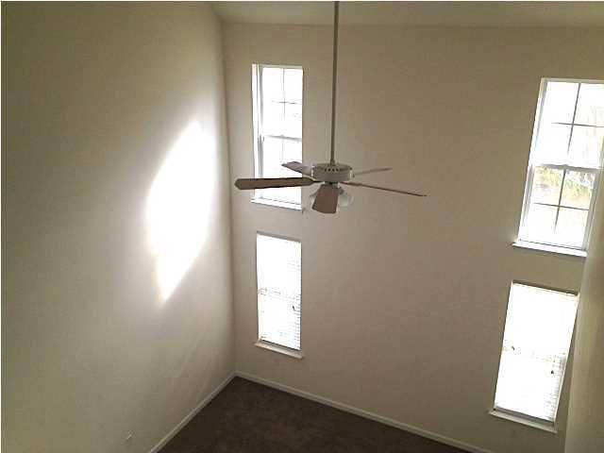
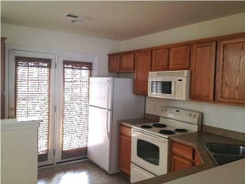
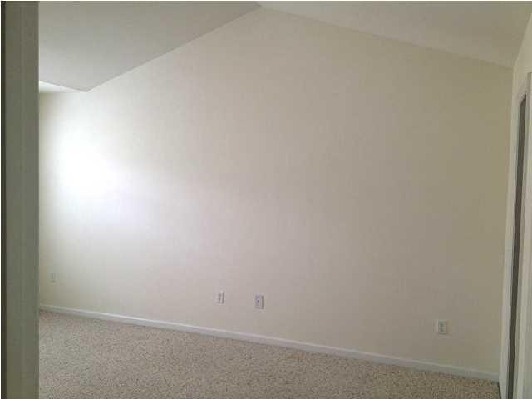
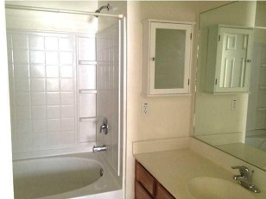
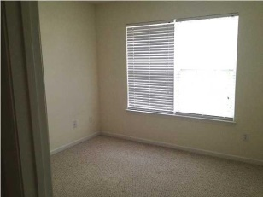


Townhome Close to Everything!
This beautiful 1,600 sq. ft., 3 bedroom, 2.5 bathroom unit is in excellent condition, overlooks a community pond and has upgraded hardwood floors downstairs. A perfect investment unit! The unit has a large living room / dining room combo with hardwood floors and a separate family room with vaulted ceilings. Community amenities including the pool as well as all exterior maintenance (lawn care / power washing / landscaping) are covered by the HOA fees. Home owners insurance for the building is also covered by the HOA fees! Back covered patio overlooks a pond. One car garage. This is easy living close to shopping, the Air Force Base and Bosch and all in Dorchester II schools!!
5216 Chicory Lane
Coosaw Commons
North Charleston, SC 29420
MLS# 1421200
$143,000
Larry & Kathy Mazalatis
Larry Cell 843-693-0529
Kathy Cell 843-693-0159
Office 843-871-9133
AGENTOWNED PREMIERE GROUP | 1800 TROLLEY RD | SUMMERVILLE, SC 29485

