Slide 1

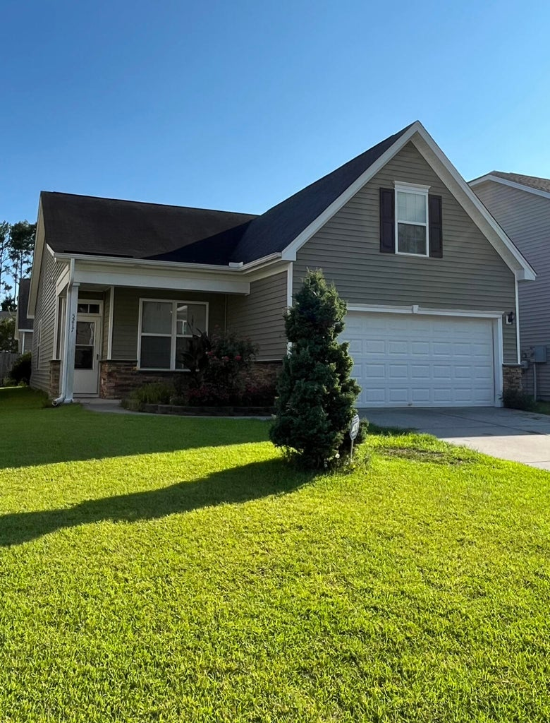


Showing 1 Day Only: Saturday 07/15
5217 Fallow Fawns Road
Deer Field Hall | Hollywood, SC 29449
MLS# 23015688 | $287,500
Price Reduced
1,600 square feet, 3/2, large yard, and quiet community
Only 8 minutes from West Ashley and a short drive to Edisto Beach
Primary Bedroom Downstairs
Open concept plan, lots of light, and a full kitchen with ample storage
Finished room over the garage is perfect for a flex room, office, or 4th bedroom
Across from Stono Golf
Showing One Day Only: Saturday the 15th, 10am-6pm. Deadline for all offers: Sunday the 16th, 2pm. Sold in AS-IS condition.
Leslie Tester
(843) 901-1971
leslietester.realestate@gmail.com
Charleston First Real Estate, Inc | 1922 Capri Dr | Charleston, SC 29407

